Slide 1
Social cognition: Evolving ideas in myotonic dystrophy
John B Williamson, PhD
University of Florida

Slide 2
Overview
Neuropsychology
Quality of life and social cognition
Understanding the effects of myotonic dystrophy on the brain
Brain and behavior
Linkage between the heart and the brain
Deficits in social cognition
How to understand and address

Slide 4
Myotonic dystrophy affects the brain
DM is a multi system disorder
Heterogeneous
GI dysfunction
Cognitive and affective disorders
Cardiac disease
Endocrine abnormalities (e.g., diabetes)
These conditions can influence one another
Effects can accumulate with age

Slide 5
Cognitive and emotional dysfunction and quality of life
Brain effects can be amongst the most debilitating
Impacts how we understand and relate to one another
Independence
Major National Institute of Health focus
Cognition, depression, psychiatric problems, dealing with disease all negatively affect quality of life
Accumulates with age in MD1, outcomes SF-36, neuropsych, and mood inventories (n = 40)
Antonini et al. 2006
Positive for quality of life?
Family interaction
Exercise
Self-efficacy
Attention control

Slide 6
Cognitive impacts reported in DM
Lower abstract reasoning ability
Executive dysfunction
Visuospatial impairments
Social cognition
Verbal and non verbal memory
Basically all domains

Slide 7
Why the breadth?
Factors
Location of white matter disease
Asymmetries in brain atrophy and structural involvement
Duration of disease
Changes in emotional experience affect many patients
Changes in personality
And emotional regulation
Or Social cognition

Slide 8
Brain imaging in myotonic dystrophy type 1
Okkersen et al., 2017 – Neurology
Reviewed 81 studies
Changes widely dispersed
Generalized atrophy
Widespread gray matter volume reductions in all lobes, basal ganglia and cerebellum
White matter hyperintensity prevalence = 70%
DTI decreased FA in all major association, projection, and commissural white matter tracts.
Functional studies demonstrate reduced glucose uptake, cerebral perfusion in frontal, parietal and temporal lobes
Reduced functional connectivity
Longitudinal studies very rare

Slide 9
Most common deficits associated with white matter injury
Location matters, but commonalities
Fronto-subcortical dysfunction
Processing speed
Executive dysfunction
Problems with word retrieval
Apathy and abulia
Shown in Parkinson’s (Canu et al., 2017)

Slide 10
Parent report
Parent-reported multi-national study of the impact of congenital and childhood onset myotonic dystrophy
N = 150
81.7% = communication issues and fatigue, emotion issues also significantly elevated
Decreased performance in social situations had the highest average life impact scores.
Issues significantly associated with CTG repeat length
Paternal inheritance had greater representation of:
Emotional issues
Changes in body image
Social issues
Impaired sleep
Johnson et al., 2017

Slide 11
What is social cognition?
is a sub-topic of social psychology that focuses on how people process, store, and apply information about other people and social situations. It focuses on the role that cognitive processes play in our social interactions

Slide 12
Social neuroscience, polyvagal theory
The autonomic nervous system “reacts” in a predictable hierarchical manner (dissolution).
The Polyvagal Theory uses evolution as an organizing principle to identify three neural ANS circuits, forming a phylogenetically-ordered response hierarchy, that regulate adaptation to safe, dangerous, and life threatening environments.
“Neuroception” of danger or safety or life threat trigger these adaptive neural circuits

Slide 13
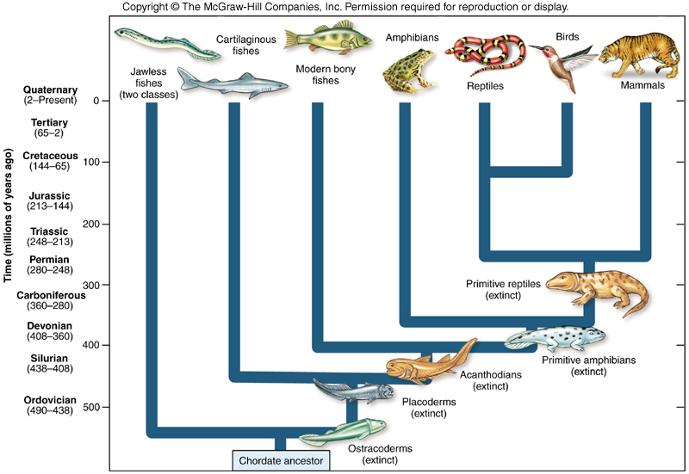
Evolution and the ANS
“new” vagus
“old” vagus
SNS

Slide 14
Dissolution
The higher nervous arrangements inhibit (or control) the lower, and thus, when the higher are suddenly rendered functionless, the lower rise in activity
Cortex
John Hughlings Jackson
Subcortical
Organs, e.g., heart

Slide 15
Neuroception
The detection of features in others or the environment – without awareness – that dampens defensive systems and facilitates social behavior OR promotes defensive strategies of mobilization (fight/flight) or immobilization (shutdown, dissociation).

Slide 16
Feature Detectors: Safety, Danger, and Life Threat
The importance of face⬄face interactions, vocalizations, body posture, and gestures
Cues of safety or danger
Efficient strategy to co-regulate physiological state
Cues of safety promote co-regulation (intersubjective regulation)

Slide 17
Faulty Neuroception
Challenges may:
Shift physiological and behavioral state
Distort social awareness
Displace ‘appropriate’ spontaneous social behaviors with asocial behavior or defensive reactions
Or, maintain social behaviors in an environment in which defensive strategies would be more adaptive

Slide 18
Neuroception
Environment
Behaviors
Safe
Social Engagement
Danger
Fight/Flight
Life threat
Shutdown
Physiological State

Slide 19
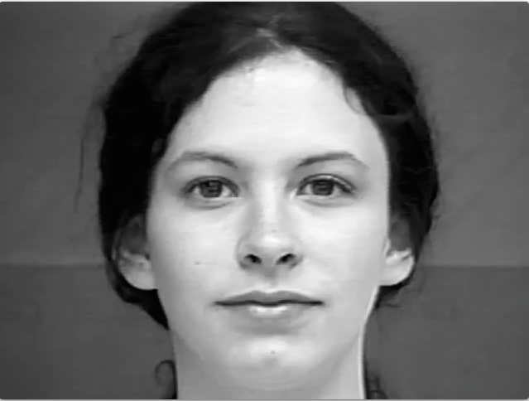
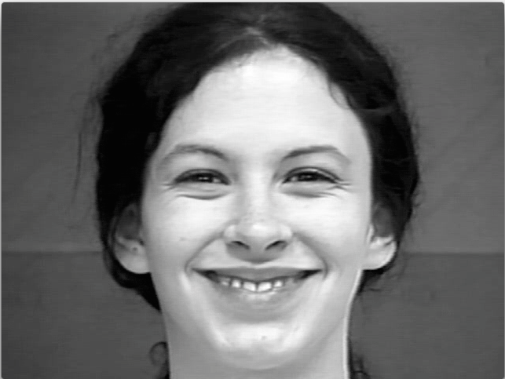
Common disorders of social cognition
Autism
Spectrum disorder
GI problems
Chronic stress
Autonomic dysfunction
Patients with DM1 often have
Reduced sensitivity to facial expressions
Particularly anger, fear and disgust
Associated with white matter injury
Kobayakawa et al., 2010
Also, higher rates of autism
Deficits in theory of mind

Slide 20
Heart rate variability declines with age and CTG repeat length
In DM1 patients a decline in HRV is observed as the patient ages and CTG repeat length increases.
Hardin et al., 2003
Though heavily researched in other conditions, linkages between autonomic attributes and emotion have not been published in myotonic dystrophy
Could be relevant biomarker for some aspects of social function in MD1
Can be a sensitive intervention point

Slide 21
Autonomic features predict health outcomes
Resting HRV
High, low, very low, all associated with mortality
Low frequency HRV associated with coronary artery disease
Lower nighttime RSA associated with increased stroke risk
Binici et al., 20

Slide 22
Theory of mind

Slide 23
Theory of mind and the brain
Many patients with DM1 present with no cognitive impairment but still have severe difficulties in activities of daily living
Serra et al., 2016
20 patients with DM1 versus 18 healthy controls
Theory of mind tests
Reading the minds in the eyes
Relationship between CTG triplet expansion and severity of impairment
TOM story tests
Resting state fMRI
Patients showed impairment in both tests
Associated with abnormal functional connectivity between temporal and fronto-cerebellar nodes
Shown to be important to theory of mind in other disorders
Schizophrenia, autism similar results

Slide 26
Potential non-pharmacological interventions
Psychotherapy
cognitive training targeting mentalizing abilities
Theory of mind training
Modulation of brain connectivity based on neurophysiological tools
Transcranial magnetic stimulation
Vagal nerve stimulation

Slide 27
Thank you!
Funding support:
Department of Veterans Affairs
McKnight Brain Foundation
National Institute of Aging
Center for Cognitive Aging and Memory
Brain Rehabilitation Research Center

