Slide 1
The Role of Rehab for Myotonic Dystrophy
Lisa Warren, MHS, OTR/L
UF Health Rehab

Slide 2
Client-Centered Approach

Slide 3
Multidisciplinary approach
Healthcare professionals working together for the common goal of improving the patient’s health, function and quality of life
Benefits include improved health outcomes, enhanced satisfaction for clients, and more efficient use of resources

Slide 4
What does a rehab team address?
Personal care
Mobility
Energy conservation
Community life
Work
Recreation

Slide 5
Personal factors
Perception, vision and cognition
Psychosocial factors
Environmental factors

Slide 6
Physical Therapy (PT)
Overall conditioning – physical activity is important for all
Exercise to slow progression of muscle wasting
Should be individualized and monitored – cardio/pulmonary considerations, low intensity
Stretching/flexibility
**individuals with myotonic dystrophy may have limited exercise tolerance and will need to be monitored carefully

Slide 8
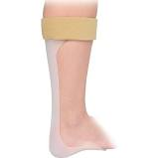
PT
Mobility - in home and community
Getting in/out of chair and bed
Assistive devices
Walkers
Wheelchairs
Motorized Scooters
Chair lifts, stair lifts, ceiling lifts, patient lifts
Orthotic devices
Orthotics can support weak muscles and slow contractures

Slide 9
Occupational Therapy (OT)
The purpose of OT treatment is to help clients learn or relearn occupational performance needed to live as independently as possible.
For the compensation approach, three options can be explored:
1)Alter the task
2) Prescribe assistive devices or
3) Adapt the environment

Slide 10
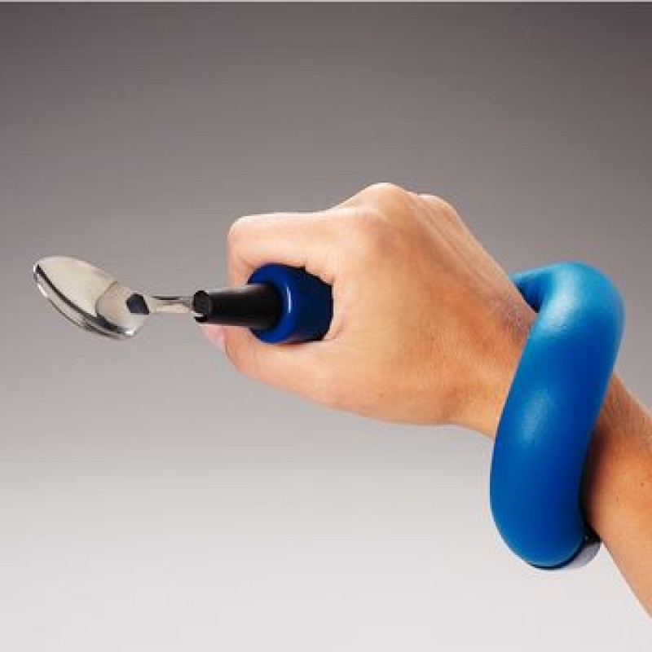
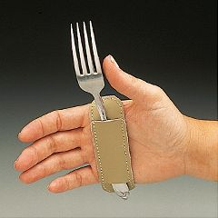
OT
Eating
Adaptive utensils
Positioning
Splints/universal cuffs

Slide 11
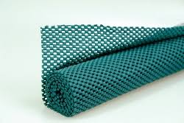
Multi-purpose adaptations

Slide 12
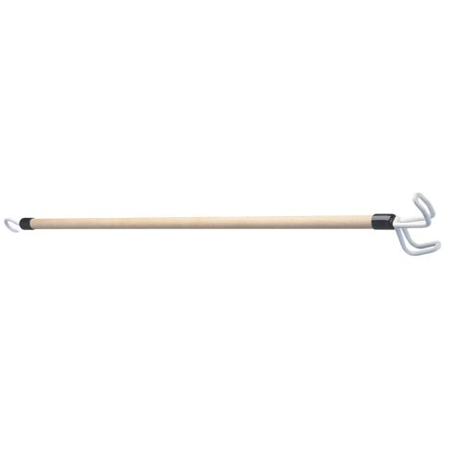
OT
Dressing
Avoiding buttons and tight clothing
Positioning for dressing
Adaptive equipment
Reacher
Dressing stick

Slide 13
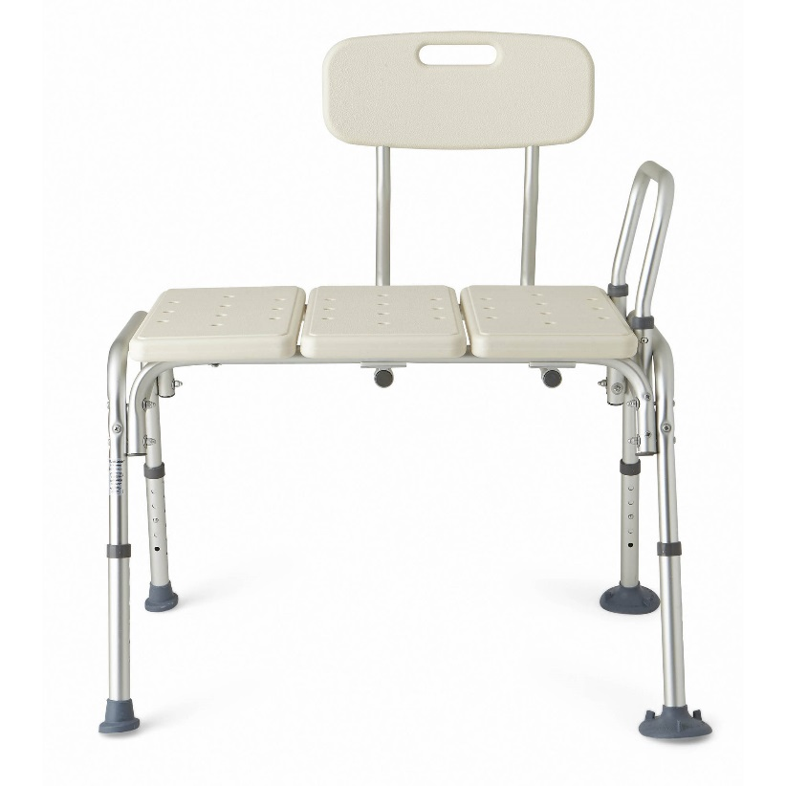
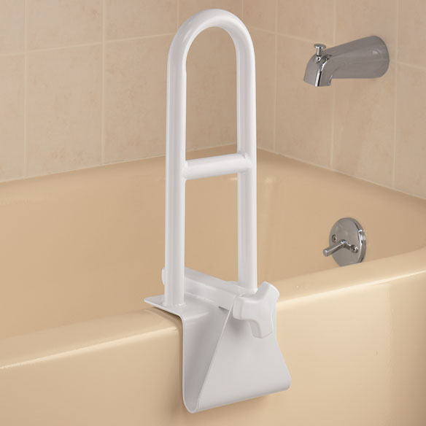
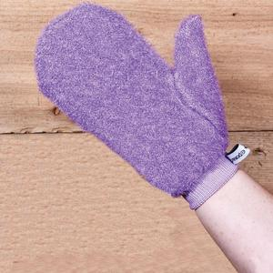
OT
Bathing
Seat in shower
Grab bars
Wash mitt

Slide 14
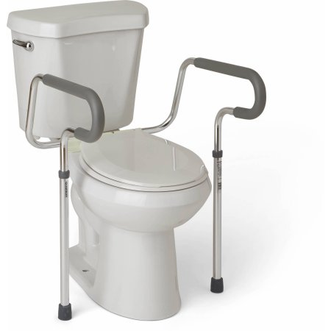
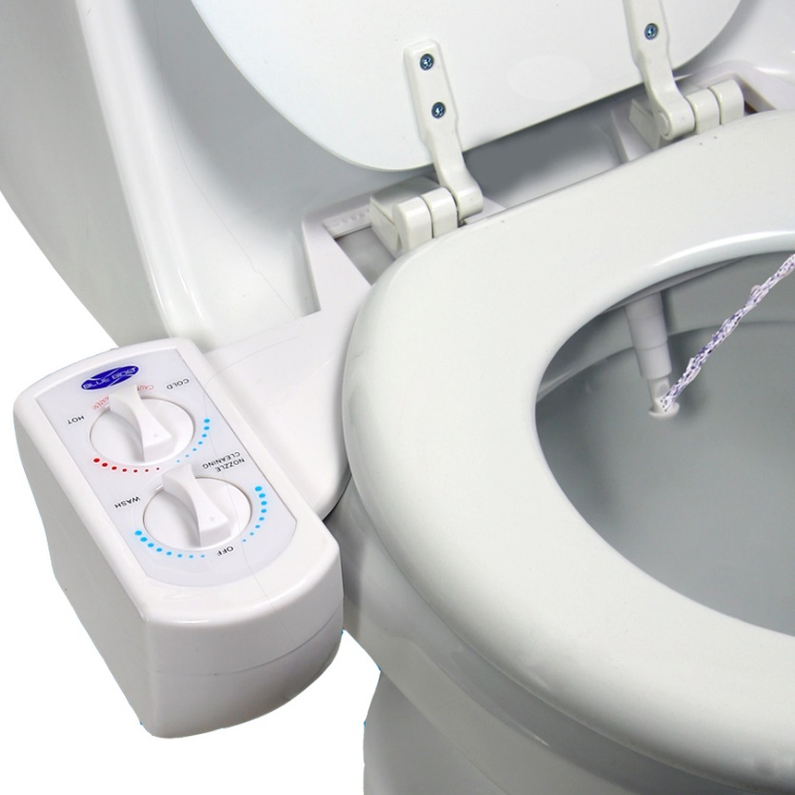
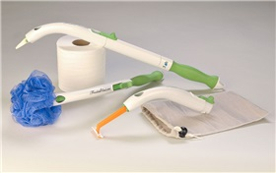
OT
Toileting
Elevated toilet
Grab bars
Attachable bidet
Hygiene assist

Slide 15
OT
Vision
Contrast and lighting education
Use of line trackers and other techniques to minimize eye fatigue
Cognition
Adaptive strategies

Slide 16
Speech Therapy (ST)
Assessment and education of swallowing difficulties
weakness of muscles in the upper third of the esophagus results in food “sticking”
Often unnoticed by client
Associated with nutritional insufficiencies, aspiration pneumonia
Recommendations for dietary changes
Positioning

Slide 17
ST
Techniques to address
Difficulty chewing
Drooling – due to weak lip closure

Slide 18
ST
Speech treatment strategies to compensate for
Slow speech rate
Decreased volume
Shortened speech stretches

