Slide 1
Assessment and Management of Individuals with Myotonic Muscular Dystrophy
The Role of Occupational Therapy, Physical Therapy, and Orthotics

Slide 2
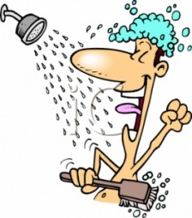
Occupational Therapy

Slide 3
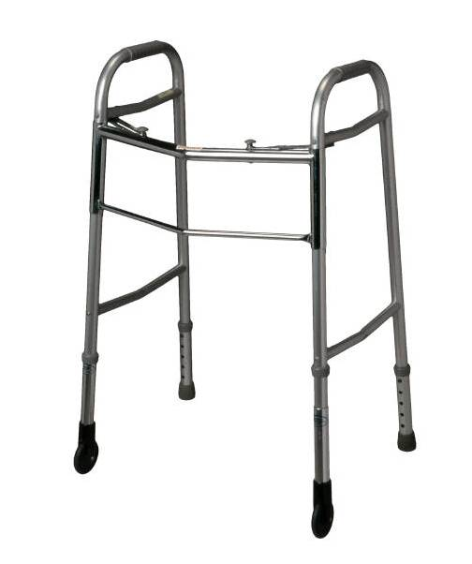
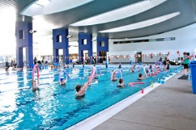
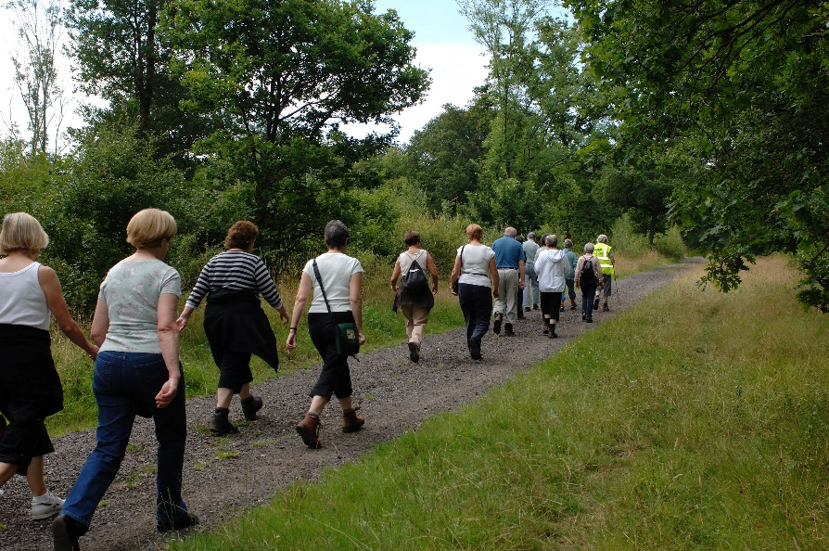
Physical Therapy

Slide 4
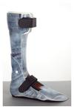
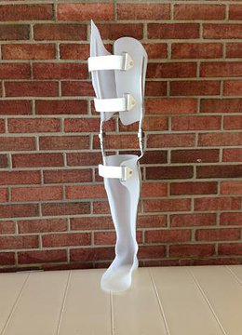
Orthotics

