Slide 1

2019 Myotonic Annual Conference
September 13-14, 2019
Philadelphia, PA

Slide 2
Symptom Management in Myotonic Dystrophy Type 2 (DM2)
Johanna Hamel, MD
University of Rochester, NY
Notes:
I will speak about how to treat symptoms in people with DM2. I planned this talk similar to a clinic visit.
When I see patients with DM2 in clinic, I find it important to explain the root cause of the disease. This is important when trying to understand the variability of the disease and why it causes so many different symptoms, affecting many organ systems, within one individual.

Slide 3
Symptom Management in DM2
What symptoms do patients with DM2 experience?
Why does DM2 cause so many different symptoms?
What testing/monitoring is needed?
How are symptoms of DM2 treated?
Notes:
Therefore, I have 4 questions that we will try to answer:
The basis for this talk build the recently published care guidelines for DM2.
The MDF brought together experts in the field to agree on how to best care for patients with DM2.

Slide 4
Symptom Management in DM2
What symptoms do patients with DM2 experience?
Why does DM2 cause so many different symptoms?
What testing/monitoring is needed?
How are symptoms of DM2 treated?
Notes:
Lets start with the first one:

Slide 5
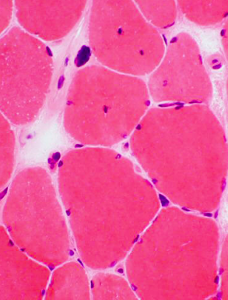
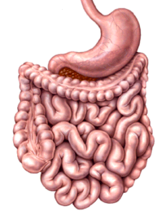
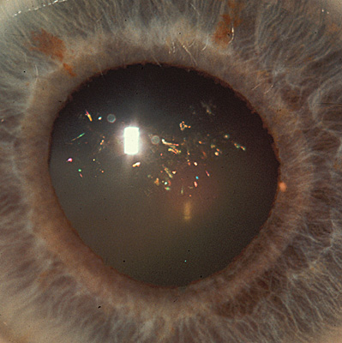
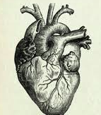
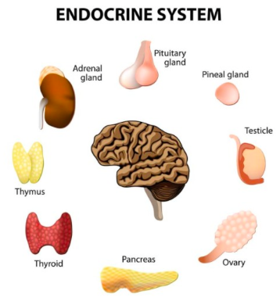
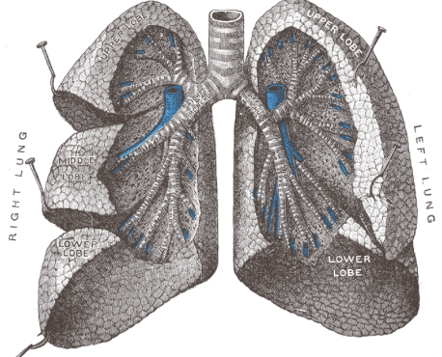

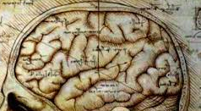
Multi-systemic Disease
Muscle:
Weakness
Pain
Myotonia
Diarrhea
Constipation
Abdominal pain
Cataracts
Abnormal
Heart
Rhythm
Sleep apnea
Daytime Sleepiness
Difficulty
Thinking
Sleepiness
Fatigue
Difficulty
Breathing
Diabetes
Problems with Fertility
Notes:
Most people with DM2 first experience symptoms affecting the muscle, which give the disease its name.
Most common are leg weakness, followed by myalgia and myotonia.
Before I come back to the remaining symptoms, What is myotonia?

Slide 6
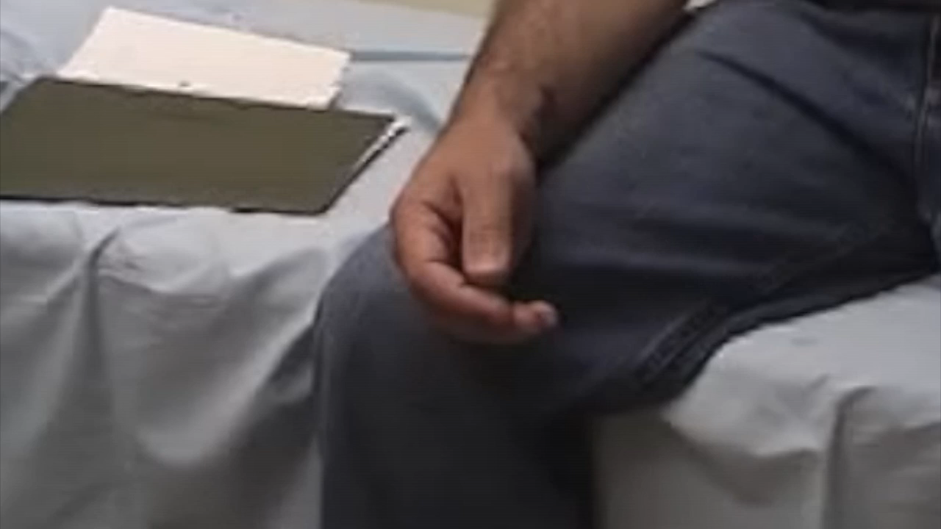
What is Muscle Myotonia?
CONTINUUM 2012
Notes:
Myotonia is delayed relaxation of the muscle, often described as stiffness. It is seen in a few other diseases, including myotonic dystrophy type 1, where it is often more severe. To demonstrate you the concept, I am showing you myotonia in the hand muscles. Note that patients with DM2 often experience it more as a stiffness in shoulder and hip muscles, and less pronounced in hand muscles.

Slide 7
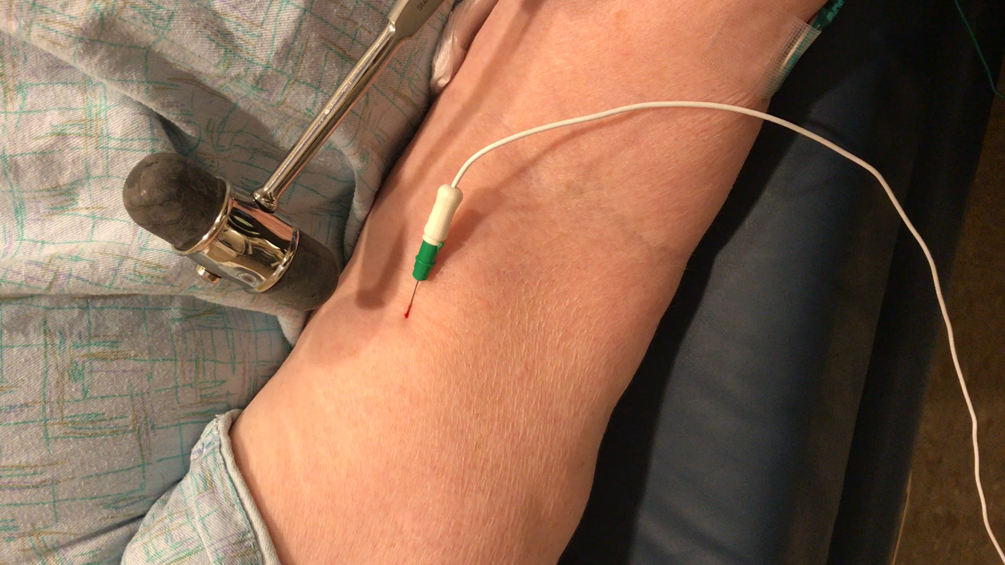
What is Electrical Myotonia?
Provided by Dr. Logigian
Notes:
Electrical myotonia is myotonia that you do not see or experience, but if a specialist sticks a needle in the muscle to record the muscle fiber activity, there is a characteristic sound.
Sometimes you can elicit this sound by percussion of the muscle.

Slide 8
Multi-systemic Disease
Muscle:
Weakness
Pain
Myotonia
Diarrhea
Constipation
Abdominal pain
Cataracts
Abnormal
Heart
Rhythm
Sleep apnea
Daytime Sleepiness
Difficulty
Thinking
Sleepiness
Fatigue
Difficulty
Breathing
Diabetes
Problems with Fertility
Notes:
Other common symptoms include cataracts, diabetes, cardiac issues affecting the rhythm of the heart, issues with sleep, breathing. Other symptoms affect the GI system with constipation, diarrhea, and abdominal pain. Cognitive issues can occur. The endocrine system can be affected, with diabetes, and problems with fertility.

Slide 9
Symptom Management in DM2
What symptoms do patients with DM2 experience?
Why does DM2 cause so many different symptoms?
What testing/monitoring is needed?
How are symptoms of DM2 treated?

Slide 10
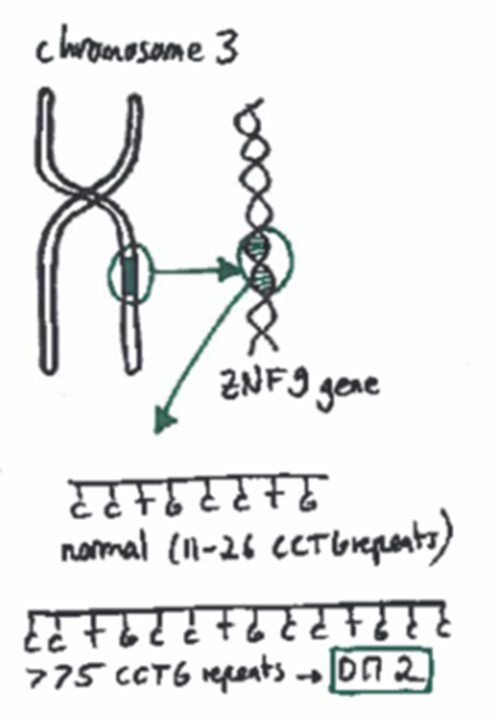
CCTG repeat expansion
DNA
RNA
Protein
Notes:
The answer lies in the root cause of the disease. Myotonic Dystrophy is a genetic condition, which means that there is a problem with genetic material. We all are made out of Genes, that carry instructions how to form proteins, that our bodies are made of and that we need to live, and that determine things as hair color, eye color or other features, but if abnormal, they can cause disease. These genes are made of DNA. The DNA sits on these structures called chromosomes, in the center of each cell, which we call nucleus. The DNA is transcribed into RNA in the nucleus, the RNA travels into the cytoplasm of a cell and provides a template for protein production. DM2 is caused by an expansion of DNA, which means increase in the length of DNA. When researchers use the word “expansion”, they mean that a segment of a chromosome which normally has a repetitive genetic code, for example “CCTG” , becomes much longer, developing hundreds or thousands of repeats. In DM2, the gene with the repeat expansion is located on chromosome 3 and is called Zinc finger 9 gene. If the DNA segment is longer than 75 repeats, it causes DM2.

Slide 11
CCTG repeat expansion
DNA
RNA
Protein
Extended RNA
Mankodi et al. 2001
Notes:
But How? The expanded RNA clumps together. We can see these RNA clumps, we refer to them as toxic RNA or RNA foci.

Slide 12
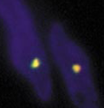
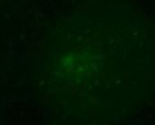
CCTG repeat expansion
DNA
RNA
foci
Extended RNA
DM2 nucleus:
Clumps of RNA and important proteins
Protein
Healthy cell nucleus:
Mankodi et al. 2001
Notes:
Here you see the nucleus in blue of a muscle cell of a patient with DM2, and the yellow bright dots are clumped RNA. In comparison, in a healthy cell, the RNA would be more diffusely spread.
But why are these RNA clumps toxic? They trapps important proteins. These proteins normally clean and cut (splice) multiple RNAs, so RNAs from multiple different genes.

Slide 13
CCTG repeat expansion
DNA
RNA
foci
Abnormal
Extended RNA
DM2 nucleus:
Clumps of RNA and important proteins
Protein
Trapped proteins fail to edit RNAs from other genes and affect their function:
Chloride channel
  → myotonia
Insulin receptor
→ diabetes
Calcium channel → weakness
Sodium channel
→ arrhythmia
Healthy cell nucleus:
Mankodi et al. 2001
Notes:
And because these proetins are not trapped, they lose their function. As a result numerous RNAs are not properly edited and cut (or spliced) anymore., and hence they cannot provide a proper template to make proteins. Depending on which RNAs are affected, various symptoms can occur. For example, when the RNA coding for the chloride channel is not spliced properly, then myotonia occurs.

Slide 14
Multi-systemic Disease
Muscle:
Weakness
Pain
Myotonia
Diarrhea
Constipation
Abdominal pain
Cataracts
Irregular
Heart
Rhythm
Sleep apnea
Daytime Sleepiness
Difficulty
Thinking
Sleepiness
Fatigue
Difficulty
Breathing
Diabetes
Problems with Fertility
Notes:
So the reason why there are so many different symptoms is that RNA foci trapp important proteins, resulting in abnormal splicing of numerous RNAs, originating from different genes.

Slide 15
DM2 Disease Chronicle
Disability due to DM
 | (Average, in years)
Age at symptom onset | 37.9
Age at diagnosis | 49.9
Diagnostic delay | 12.3
Notes:
Now DM2 is typically considered a milder disease, and that holds true in the way that DM1 has a reduced life expectancy.
However, in our experience often times the disease course is shifted to older age. I did a study that is not published yet,
reviewing data form the National Registry for Myotonic Dystrophy, which is supported by the NIH, based on Rochester and was founded in 2001.
I will provide some graphs throughout this presentation illustrating symptoms and signs that patients with DM2 experience throughout their lives, compared to DM1.
In this group of 222 patients with DM2,

Slide 16
Symptom Management in DM2
What symptoms do patients with DM2 experience?
Why does DM2 cause so many different symptoms?
What testing/monitoring is needed?
How are symptoms of DM2 treated?

Slide 17
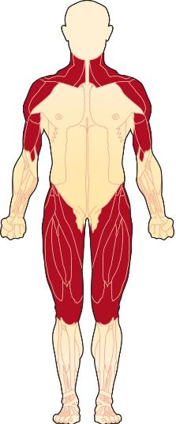
Muscle Weakness
Walker Use
Symptoms:
- Difficulty lifting head from bed
- Difficulty rising from a chair, ground, climbing stairs
- Shoulder weakness
- Difficulty rising in bed from lying to sitting, walking upright
Monitoring:
- Consultation with a neurologist/neuromuscular specialist/physical therapist
Treatment:
- Avoid inactivity: moderate, low- intensity exercise
- Avoid falls: walking aids as needed (walker, cane)
- Physical therapy
- Home modifications
Wheelchair Use

Slide 18
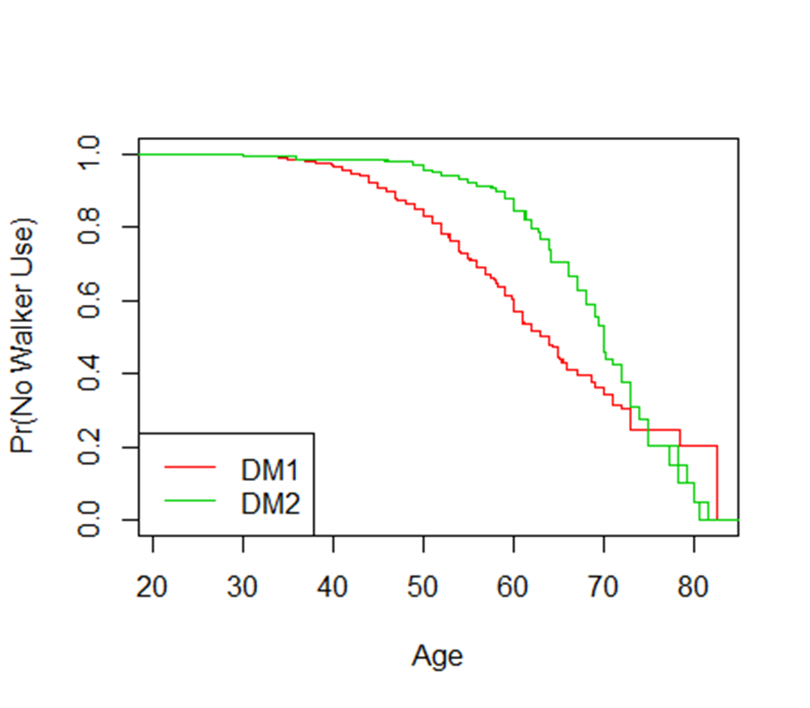
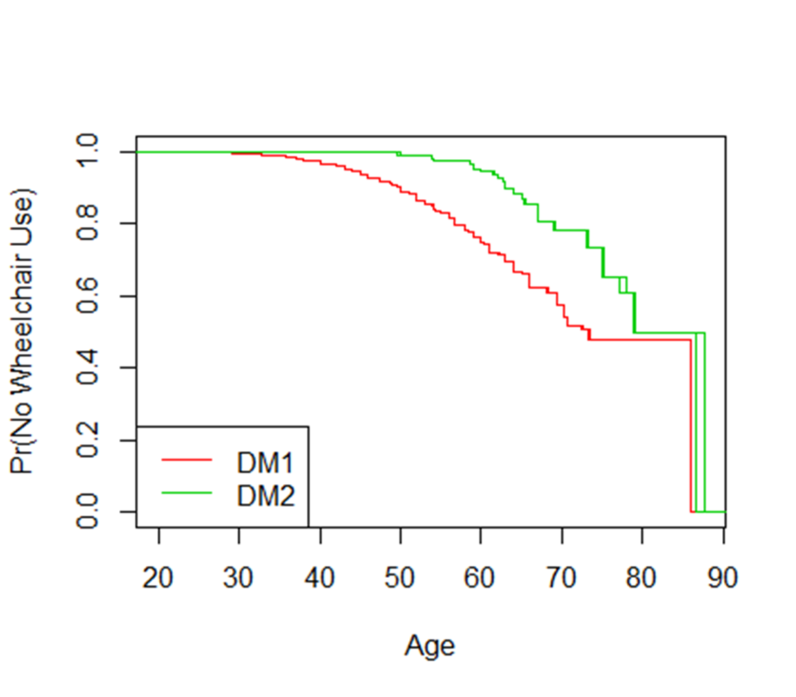
Muscle Weakness
Walker Use
Symptoms:
- Difficulty lifting head from bed
- Difficulty rising from a chair, ground, climbing stairs
- Shoulder weakness
- Difficulty rising in bed from supine to sitting, walking upright
Monitoring:
- Consultation with a neurologist/neuromuscular specialist
Treatment:
- Avoid inactivity: moderate, low- intensity exercise
- Avoid falls: walking aids as needed (walker, cane)
- Physical therapy
- Home modifications
Wheelchair Use

Slide 19
Muscle Pain
Symptoms:
  Muscle pain in thighs, back, neck and shoulders
  Joint pain
Treatment:
  Conventional therapies: Ibuprofen, Tylenol (specifically if joint pain plays a role)
  Duloxetine
  Avoid opioids
  Consult with physical therapist (truncal weakness, high walking sticks etc)
  Discuss with your doctor whether therapy with cholesterol lowering medications (statins) may have worsened symptoms
  Consider treating myotonia, if pain improves with activity and worsens in cold temperatures

Slide 20
Myotonia
Symptoms:
  Muscle stiffness, difficulty opening hands, speaking, chewing
  Muscle stiffness and pain when starting to move after resting or in cold weather
Treatment: (check ECG first)
  Mexiletine
  Ranolazine

Slide 21
Heart Disease
Symptoms:
  There may be none (=asymptomatic)
  Passing out/fainting spells (syncope), dizziness, palpitations (heart racing, skipping beats), chest pain
Monitoring:
  Yearly ECGs
  If ECG abnormal or symptoms or older than 40 years:
    Consult a cardiologist

Slide 22
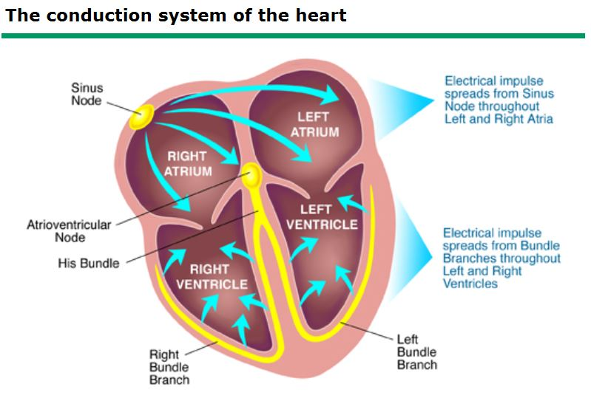
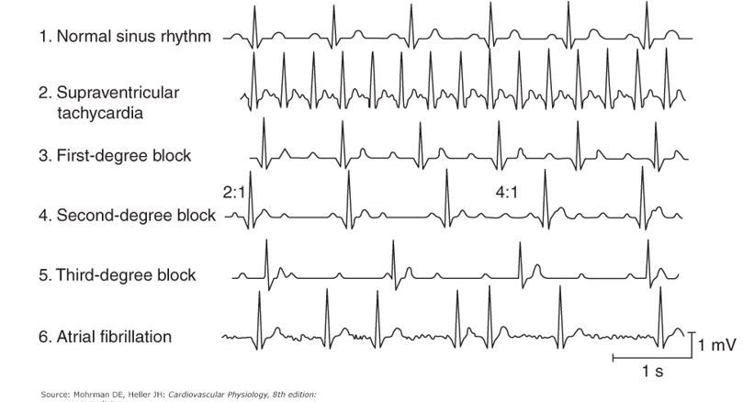
Heart Disease
Symptoms:
  None (=asymptomatic)
  Passing out/fainting spells (syncope), dizziness, palpitations (heart racing, skipping beats), chest pain
Monitoring:
  Yearly ECGs
  If ECG abnormal or symptoms:
    Consider consulting a cardiologist

Slide 23
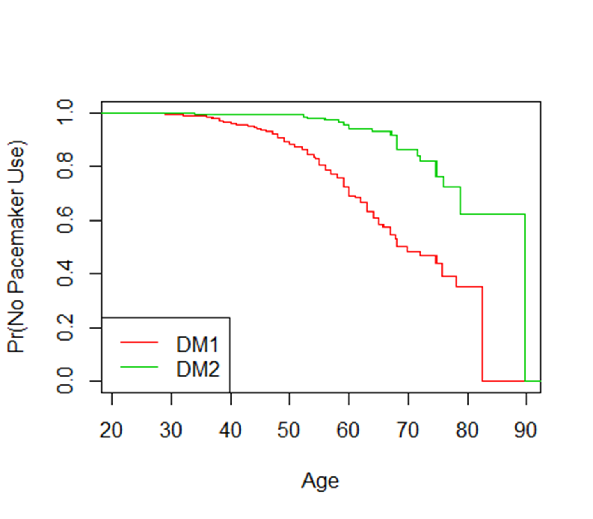
Heart Disease
Symptoms:
  There may be none (=asymptomatic)
  Passing out/fainting spells (syncope), dizziness, palpitations (heart racing, skipping beats), chest pain
Monitoring:
  Yearly ECGs
  If ECG abnormal or symptoms or older than 40 years:
    Consult a cardiologist
Treatment:
  Pacemaker, defibrillator
  Caution with new medications that could affect heart rhythm
Pacemaker

Slide 24
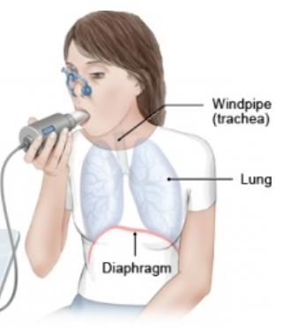
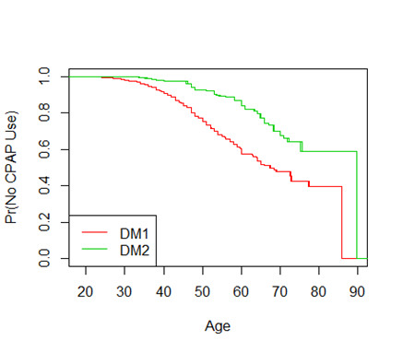
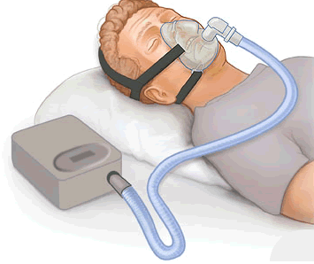
Respiratory Weakness/
Sleep Disorders
Symptoms:
  Shortness of breath with activity or lying flat
  Weak cough
  Frequent respiratory infections
  Daytime sleepiness
  Snoring/morning headaches
Monitoring:
  No symptoms: Pulmonary Function Test (PFT) sitting and lying
  (every 2 years, prior to surgeries)
  With Symptoms: PFTs, sleep study, consult sleep specialist, pulmonologist
Treatment:
  Nighttime non invasive ventilation (CPAP or BIPAP)
  Cough assist device
  Vaccinations for influenza or pneumonia
  Stimulants (Modafinil)
CPAP/BiPAP use

Slide 25
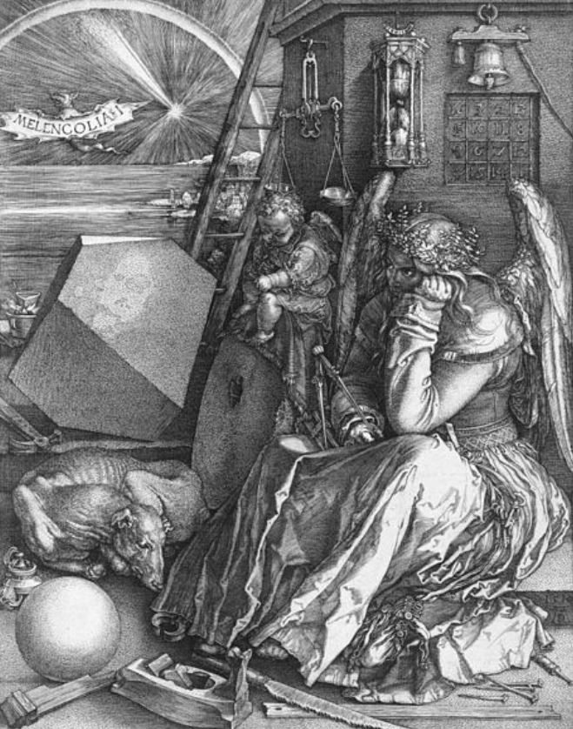
Mood, Energy and Cognition
Symptoms:
  Fatigue
  Depression
  Difficulty with thinking, memory, planning, sensation of “fogginess”
Monitoring:
  Cognitive and mood assessments/questionnaires
Treatment:
  Sleep disorders or respiratory weakness should be excluded/addressed
  Antidepressants (consider Duloxetine if pain is a problem, or stimulating antidepressant if fatigue is a problem)
  Counseling (cognitive behavioral therapy)

Slide 26
Cataracts/ Eye Disease
Symptoms:
  There may be none early on (=asymptomatic)
  Glare and blurred vision, often < 55 years of age
Monitoring:
  Annual eye exams with slit lamp (by an ophthalmologist)
Treatment:
  Cataract surgery

Slide 27
Gastrointestinal Symptoms
Symptoms:
  Difficulty swallowing
  Abdominal pain
  Constipation, bloating
  Diarrhea
  Gallstones
Monitoring:
  With symptoms: assess for gallstones, liver function tests, consult GI specialists
Treatment:
  High fiber diet (15-20 g) and sufficient hydration
  Diarrhea: loperamide
  Constipation: polyethylene glycol, senna, docusate, bisacodyl, lubiprostone, linaclotide
  Dysphagia therapy
  Nutrition consultation

Slide 28
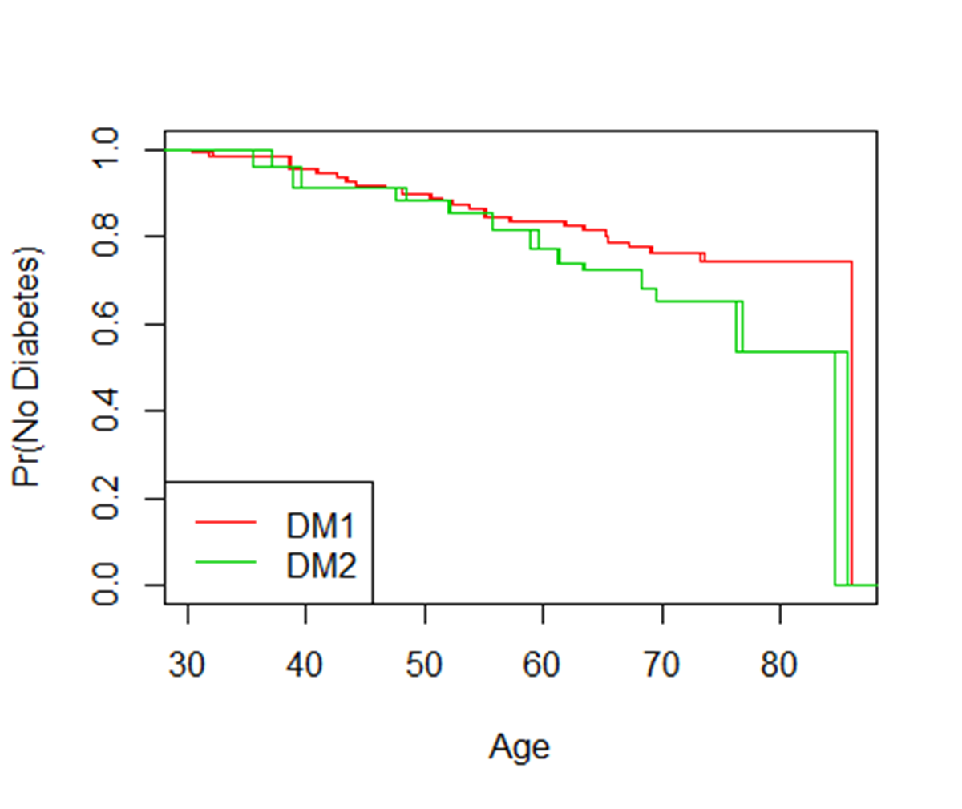
Endocrine System
Symptoms:
  Diabetes
  Hypothyroidism
  Problems with fertility
  Low IgG
Monitoring:
  TSH, fasting glucose, HbA1c
Treatment:
  Treat diabetes
  Treat thyroid disease
  Consultation with fertility clinic
Diabetes

Slide 29
Anesthesia/Surgery
Risk of anesthesia not well established for patients with DM2
BUT Better be safe and prepared:
Inform your doctors about your diagnosis
Possible risks could include
  Sensitivity to sedating medications
  Difficulty breathing or swallowing after a procedure
  More severe GI symptoms, specifically with opioids
  Increase of myotonia
  Cardiac arrhythmia
      → Avoid medications that could do harm and let your doctors be prepared
      https://www.myotonic.org/mdf-releases-updated-anesthesia-guidelines

Slide 30
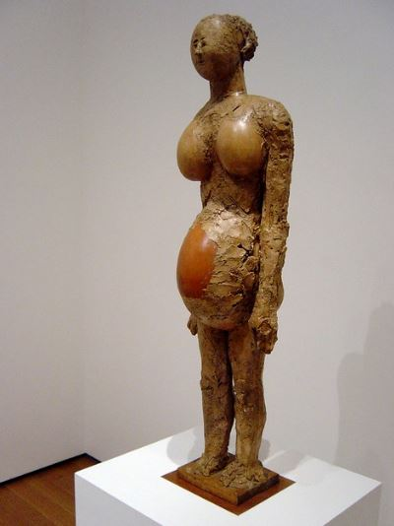
Pregnancy
Information about pregnancy in patients with DM2 is limited
Some women with DM2 experience worsening of symptoms or develop their first symptoms during pregnancy
Miscarriages occur
A subset of women can also develop premature labor
UTIs more frequently
Monitoring:
  Worsening of symptoms
  Treat UTIs
  Early consultation with anesthesiologist: local anesthesia preferred over general anesthesia
  C sections only as needed for medical/obstetric reasons

Slide 31
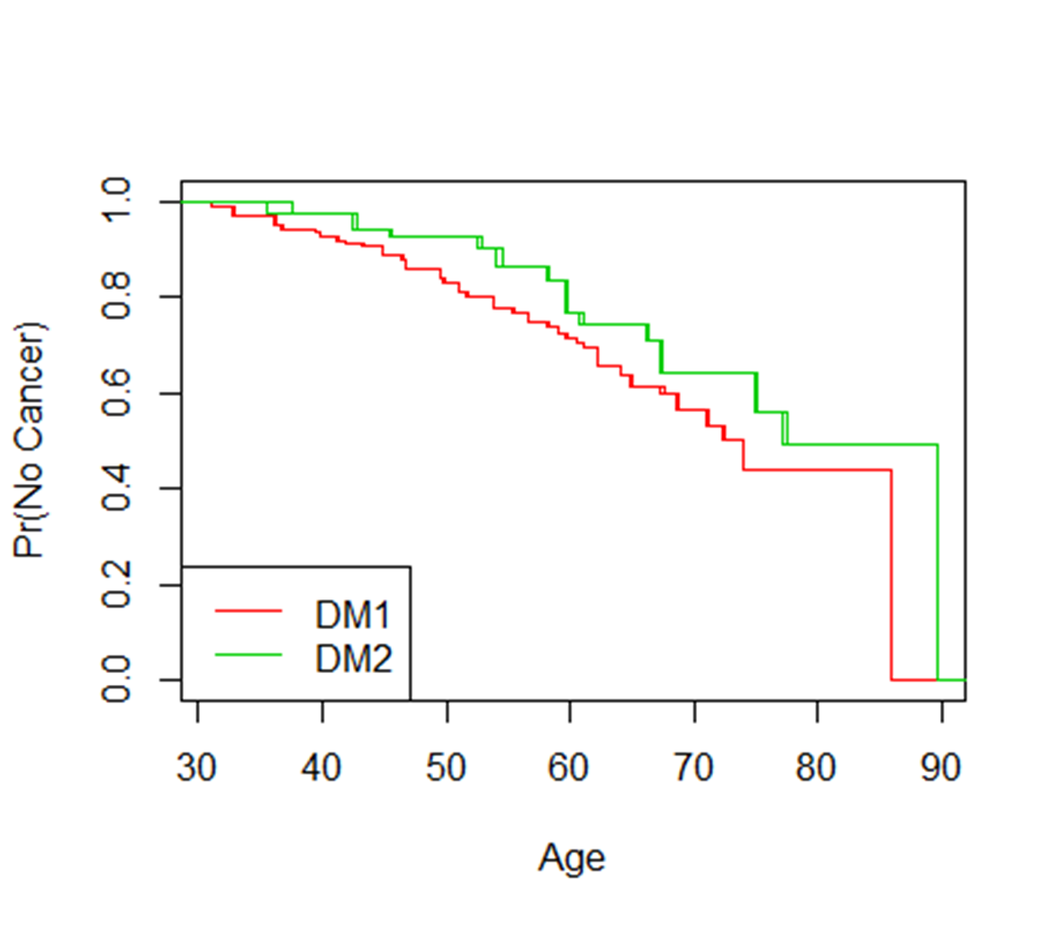
Cancer
Information about cancer risks in patients with DM2 is limited
In DM in general (including mostly patients with DM1) there is an increased risk for
    Melanoma
    Cancer of the uterus (endometrium)
    Thyroid cancer
    Others: e.g. testicular and colon cancer
Monitoring:
  Age appropriate cancer screening
  Follow up with OB/GYN, dermatology annually
  It is not clear whether screening with thyroid
  ultrasound is helpful
Cancer

Slide 32
Questions?
Thank you!

