Slide 1
DM and Genetics: Your Questions Answered
Tiffany Grider, MS, CGC
Certified Genetic Counselor
University of Iowa, Department of Neurology

Slide 2
Plan
Symptoms of Myotonic Dystrophy
Genetics of Myotonic Dystrophy type 1
Genetics of Myotonic Dystrophy type 2
Different types of genetic testing
Diagnostic
Predictive
Prenatal

Slide 3
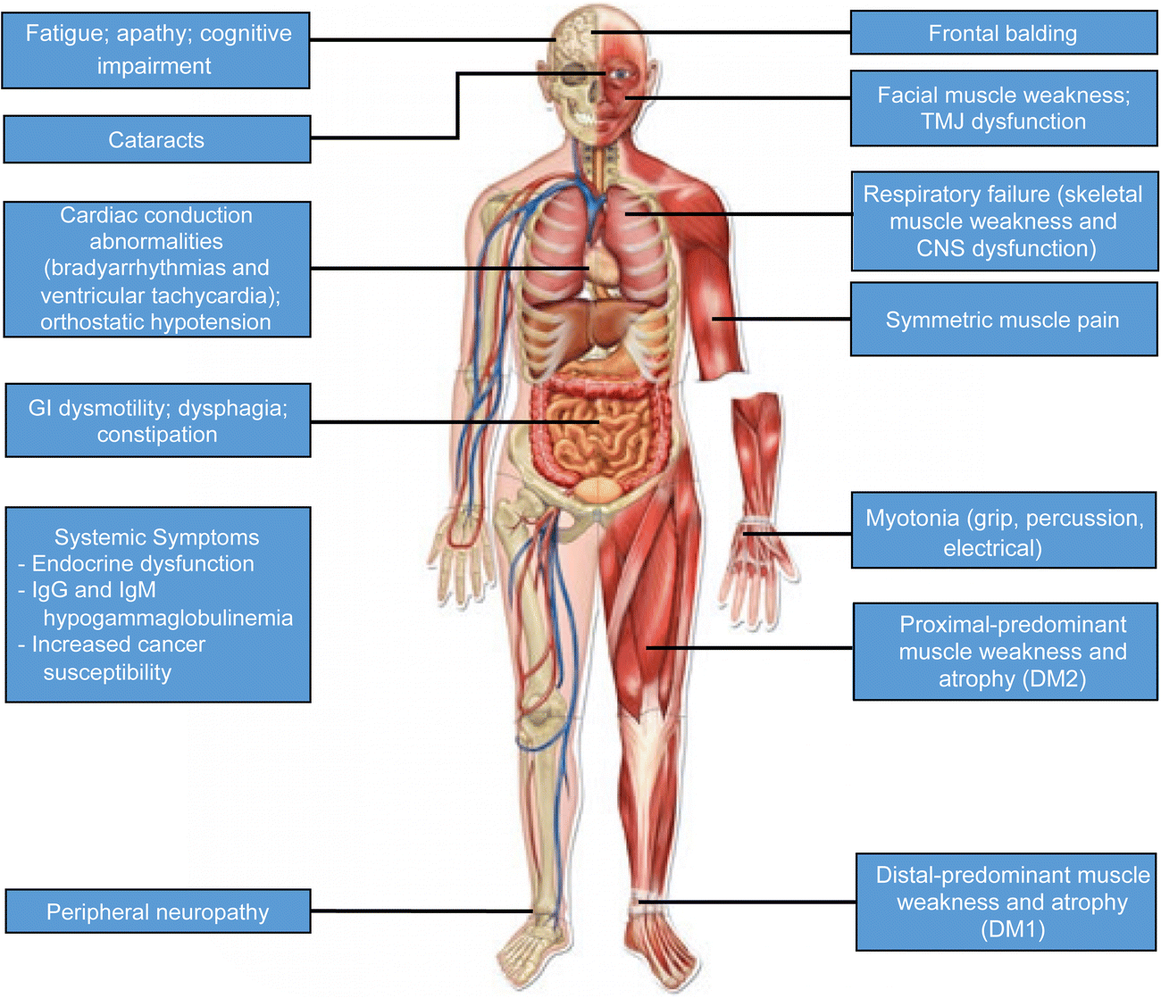
Myotonic Dystrophy
Clinical hallmarks
Muscle Weakness
Myotonia
Cataracts
Cardiomyopathy
Diabetes/Hormone problems
Intellectual disabilities, LD
Early frontal balding

Slide 4
Muscle Weakness
Facts about Myotonic Dystrophy, MDA, Updated December 2009

Slide 5
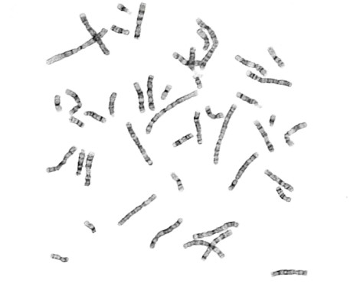
Chromosomes Are Found In Each Cell
Nucleus
Cell
Chromosomes

Slide 6
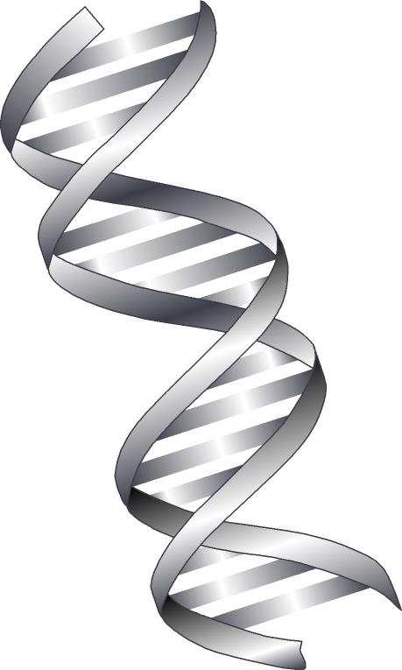
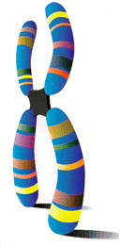
Genes (DNA) Comprise Each Chromosome
Cell
Chromosome
DNA

Slide 7
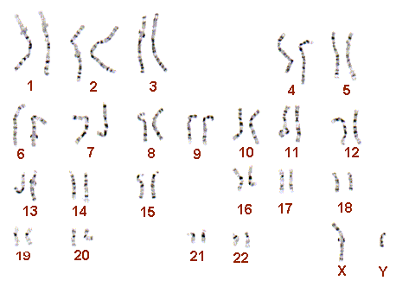
Myotonic Dystrophy (MD)
Myotonin-protein kinase
DMPK Gene
Inheritance
Autosomal dominant, maternal anticipation
Offspring of affected individual have 50% of inheriting the altered DMPK gene

Slide 8
Chromosome 19
Gene DMPK
Gene
…ATCCTGCTGCTG GTG CTC AAG...
Amino Acids
RNA

Slide 9
Myotonic Dystrophy
…ATC CTG CTG CTG CTG CTG CTG CTG CTG CTG GTG CTC AAG...
Amino Acids
Abnormal
RNA

Slide 10
Myotonic Dystrophy (MD)
 | Number of CTG repeats | Implications
Normal | <34 | Not affected with MD; cannot pass on MD
Intermediate (premutation) | 35 to 49 | Not affected with MD; can expand when passed on
Mildly affected | 50 to ~150 | Age of onset: 20 to 70 years Symptoms: Myotonia, cataracts
Classic MD | ~100 to ~1000 | Age of onset: 10 to 30 years Symptoms: Weakness, myotonia, cataracts, balding, cardiac involvement, others -/
Congenital MD | > 2000 | Age of onset: Birth to 10 years Symptoms: Infantile hypotonia, respiratory problems, mental retardation, classic signs in adults, others -/

Slide 11
Chromosome 3
Gene CNBP
Gene
…ATCCCTGCCTGCCTG GTG CTC AAG...
Amino Acids
RNA

Slide 12
Myotonic Dystrophy
ATC CCTGCCTGCCTGCCTGCCTGCCTGCCTGCCTG GTG CTC AAG...
Amino Acids
RNA

Slide 13
Myotonic Dystrophy Type 2 (DM2)
 | Number of CTG repeats | Implications
Normal | <75 | Not affected with MD; cannot pass on MD
Abnormal | 75-11,000 | Affected with MD

Slide 14
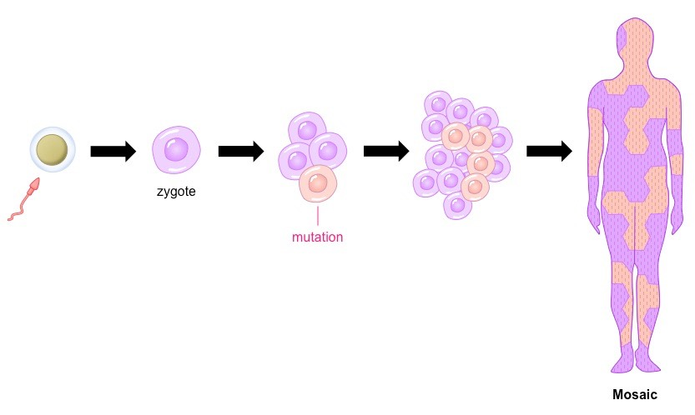
https://ib.bioninja.com.au/standard-level/topic-3-genetics/34-inheritance/mosaicism.html

Slide 15
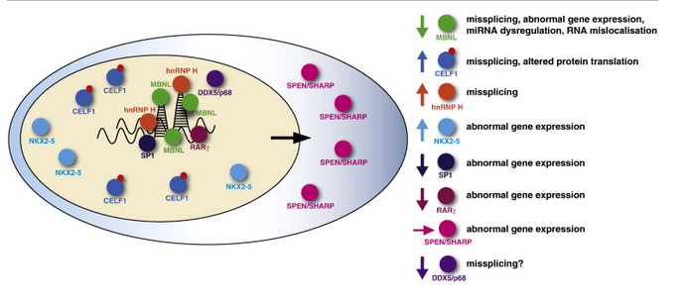
Géraldine Sicot, Mário Gomes-Pereira. RNA toxicity in human disease and animal models:
From the uncovering of a new mechanism to the development of promising therapies
Volume 1832, Issue 9, September 2013, Pages 1390-1409

Slide 16
Myotonic Dystrophy
Presymptomatic Testing
Series of appointments
Genetic counseling about MD
Neurological examination
Psychological evaluation
Blood draw for genetic testing
Results disclosure
Ideally, diagnosis of MD is confirmed in an affected family member first

Slide 17
Small Molecule Treatments
Ms. Alicia Angelbello and Dr. Matt Disney at The Scripps Research Institute, Florida and their colleagues (at University of Florida and Iowa State) have developed a small molecule compound capable of cleaving DMPK expanded repeat RNA.

