Slide 1

2019 Myotonic Annual Conference
September 13-14, 2019
Philadelphia, PA

Slide 2
Planning Your Care Team
Jacinda Sampson MD PhD
Stanford University

Slide 3
What is a Medical Home
Patient centered care for patients with complex medical needs
Focus on prevention, wellness, acute and chronic care
Communication between all care team members
Goals of quality, safety
Health care reform policies are emphasizing medical homes

Slide 4

Who is on your Team?
Myotonic dystrophy is affects multiple organ systems
You may need different specialists for different needs
Identify one doctor as your team “captain”.

Slide 5
Who is on your Team?
Primary care/pediatrician
Neurologist
Cardiologist
Pulmonologist/sleep medicine
Gastroenterologist
OB/GYN
Nurse
Physical Therapist
Occupational Therapist
Social worker
Nutritionist
Speech/swallow therapist

Slide 6
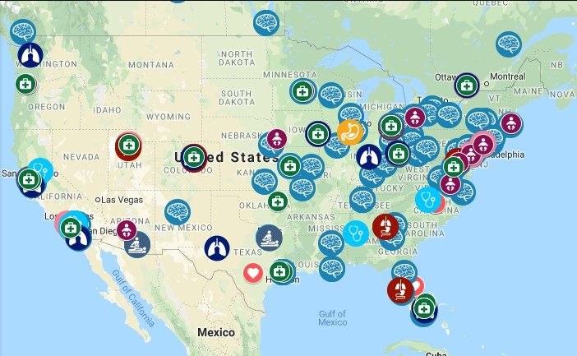
How do I Recruit my Team?
https://www.myotonic.org/find-a-doctor-map
Find your nearest MDA Clinic

Slide 7
Picking and Educating your Team
Network!
  Who do your fellow DM patients recommend? (MDF VIP site)
  They’ve already “broken them in”
  The more DM they see, the more they will learn- from you, and others

Slide 8
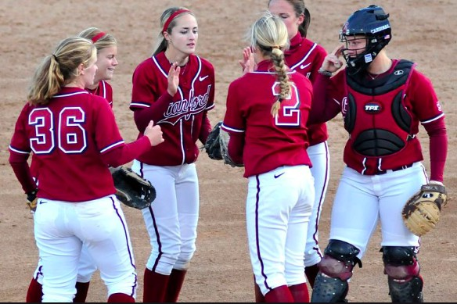
Picking and Educating your Team
Teaching institutions
Spread the knowledge, teach the future docs!
  Residents can be a “2 for 1”

Slide 9
Picking and Training your Team
Ask if they have treated/are familiar with myotonic dystrophy
  (or muscular dystrophies in general)
Medicine is lifelong learning
Ask questions!
Ask team to contact your DM doc with questions
Give them websites, bring in articles you have questions about

Slide 10
Picking and Educating your Team
Distant expert vs. local doc
  Advantages to consultation
  Necessity for local care

Slide 11
Picking and Educating your Team
Insurance and Networks
  Advantages to having all your specialists within one system
    Ease of communication
    Records accessibility
  open enrollment
    Check preferred provider listings when comparing insurance plans during

Slide 12
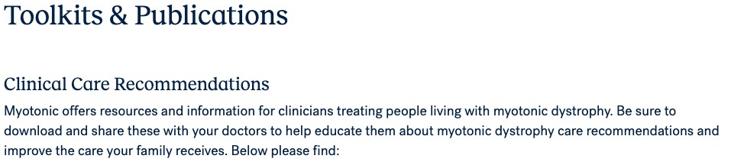
Educating your Team
Share MDF’s clinical care guidelines:
  Myotonic dystrophy type 1
    Available in: English, German, Italian, Spanish, French, French-Canadian
  Children with myotonic dystrophy type 1
  Myotonic dystrophy type 2
  Anesthesia guidelines
https://www.myotonic.org/toolkits-publications

Slide 13
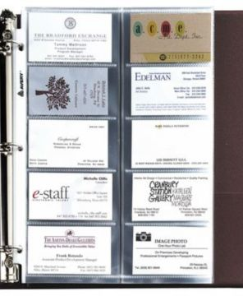
Collect Team Cards
Put contact info in your phone
Share with other providers
CC: your team AND you

Slide 14
Getting the most out of your visit
Muscular system
Central nervous system
Cardio-vascular system
Visual system
Respiratory system
Gastro-intestinal system
Genito-urinary system
Reproductive system
Metabolic & endocrine system
Need all to be reviewed during your follow-up visit
=
54 concerns

Slide 15

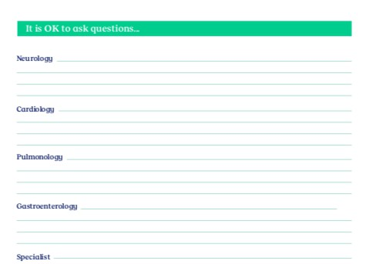
Preparing for your visit
www.myotonic.org
Search
“Myotonic-MyClinicVisitPlanner-2019”
Copies available downstairs

Slide 16
Prepare for your visit:
Bring a list of questions
What changed since your last visit
Your worries
Your families’ worries
Circle the most important question
If your visit is only 20 minutes, where do you want to start?

Slide 17
Know Thyself
know your or your child’s/family member’s needs and baselines:
  Allergies!
  Vital signs --temp, heart rate, blood pressure, weight
  Medications- what, how much, and when
  Equipment-- and its settings (example: BiPAP, cough assist)
  Dietary needs

Slide 18
What is normal for you
Behavior
Cognition: speech, concentration, memory
Sleep
Appetite
Response to pain
Response to illness
Response to medications

Slide 19
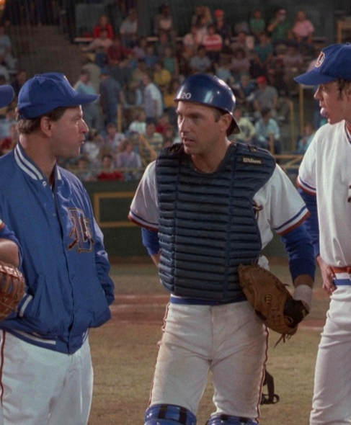
What is the game plan?
Frequency of followup with specialists
  Ask, “When is my next visit?”
Frequency of cardiac assessment
Familiarize yourself with what is standard of care
  ask each specialist

Slide 20

Make a playbook
Binder sections for each system/problem:
For kids
  IEP
Insurance!
Med list
allergies
Appointments
Advance directive /living will

Slide 21
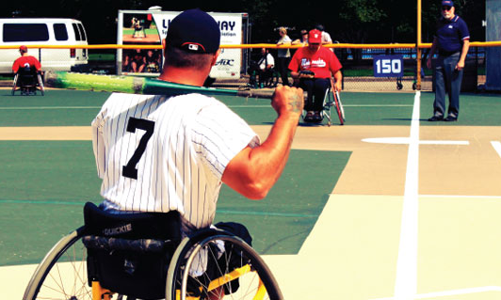
What about equipment?
Durable Medical Equipment (DME)
  Don't settle for no or inferior products!
  Order small item DME on eBay (sensors)
  Ask about your MDA’s loan closet
  Be resourceful!

Slide 22
Use ALL the tools
IHSS
School District
CCS
Regional Center (respite, DME)
Medi-Cal Waiver

Slide 23
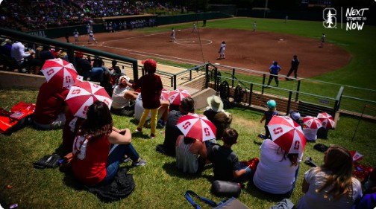
Help in navigating the medical system
Family or friend
Patient advocate
Clinic or school social worker
Hospital discharge manager
Insurance case management
  Medicaid
  Private insurances
  (Blue cross/blue shield, Aetna, Cigna, etc).
    Insurance open enrollment
    “Preferred providers”

Slide 24

One last thing, doc
Don’t save the best for last
  Afraid to ask?
  Genetic counseling question?
If can’t cover it that day,
  Ask for a followup for time!

Slide 25
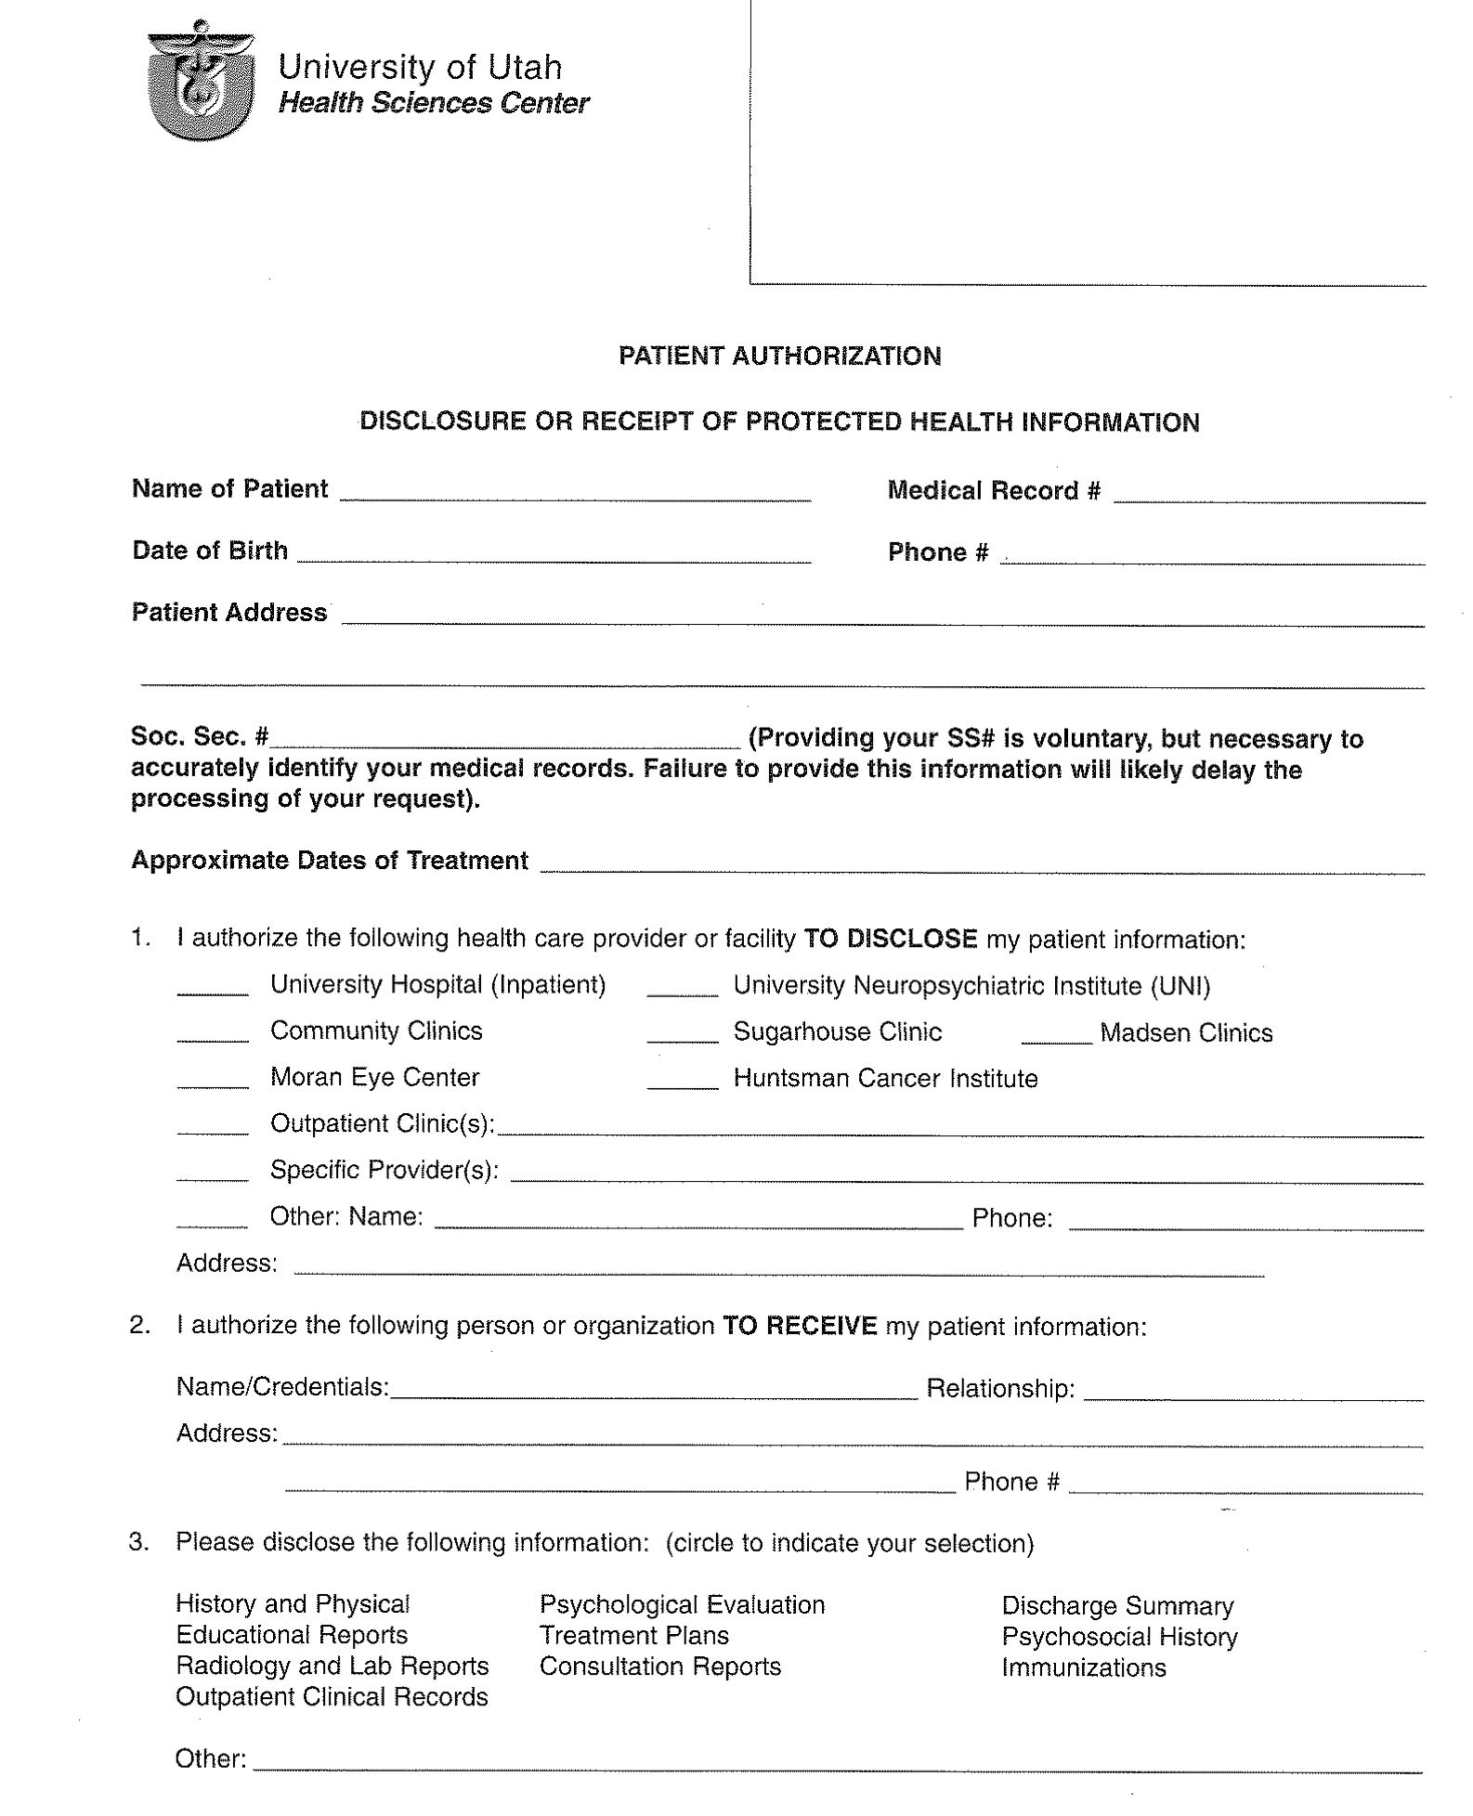
Your medical records
  Release of information form
Fax or send before your visit
  Especially for a new doctor
Electronic medical records (EMR)
  Vary between hospitals
  Multiple doctors at same institution can view same EMR
HIPPA restrictions
  Health insurance privacy and portability
  Be both specific and inclusive: providers, test, image, future dates.

Slide 26
Patient Portal
benefits
limitations
Request appointments
Appointment reminders
View test, lab results, imaging reports
Send messages to your team
Request medication refills
Full records may not be available
Delay in lab result posting
Some note types not accessible
  Genetic, psychiatric

Slide 27

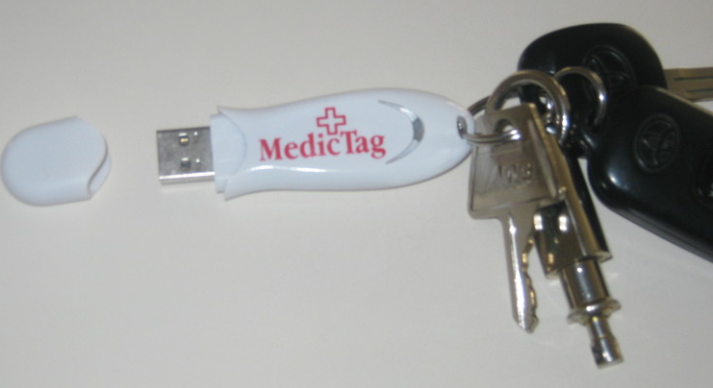
High tech
Pros: immediately available in emergencies
Cons: have to keep them updated

Slide 28

Low Tech
Medical information Jane Doe
Birthdate 1/1/1968
Myotonic dystrophy 1, sleep apnea, atrial fibrillation
Updated 12/1/11
Allergies: penicillin, bees
Warning: anesthesia complications in myotonic dsytrophy
See myotonic.org
Meds: coumadin 2 mg Tues, Thurs, Sat: 1 mg Mon Wed, Fri Sun
levothyroxine 0.125 mg in the morning
oral contraceptive
multivitamin
calcium 500 mg twice a day
vitamin C 1,000 mg a day
ginko biloba
I have a pacemaker-
Model #####
BiPAP settings 10/3
Contact person: John Doe (brother)
Cell 1-801-666-6666
My doctors:
Dr. Pepper- primary care -1-801-777-7777
Dr. Mudd- cardiology 1-801-888-8888
Dr. Sampson- muscular dystrophy 1-801-999-9999

Slide 29
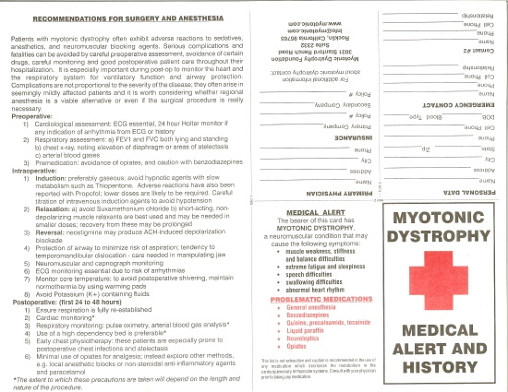
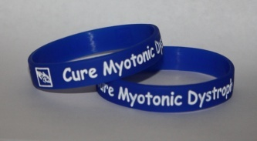
For your wallet

Slide 30
Managing your Medical Records*
Online
  Blue Button
    MyMedicare.gov
    Medicare, Medicaid, Tricare, Aetna, RelayHealth
    Downloads claims
www.freehealthtrack.com
  Online, laptop, or smartphone
Patient Records Doctor (Android)
Capzule PHR (iOS)
My Medical (iOS)

Slide 31
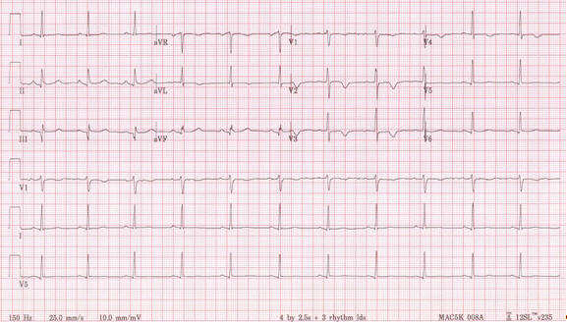
ECG traces- ask for copy

Slide 32

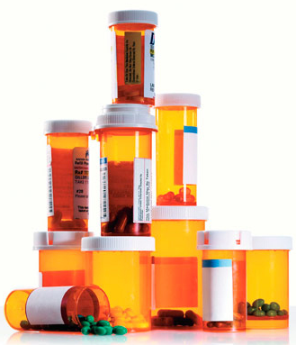
Brown bag your medications
Prescription medications
  Need refills?
  Expired?
  Stopped taking?
Over-the counter
Vitamins
Herbal medicines

Slide 33
Preparing for surgery
Up to date ECG?
Up to date pulmonary function testing?
Talk to your surgeon about DM
Meet with to your anesthesiologist prior to surgery, and not just the morning of!
  Choice of anesthetics
  Respiratory, secretions management
  Cardiac monitoring
  Plan of action in case of complication

Slide 34
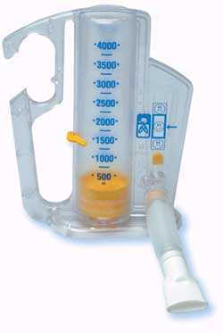
Rehab and Prehab
Surgery, injury or illness
  Slower recovery
  Longer recovery
  New/different baseline?
Prehab?
  If scheduled surgery, get “tuned up” before
  Consult your PT
  Review your medications
Incentive spirometry

Slide 35
What if you are in the hospital?
If you need to be hospitalized, utilize a teaching hospital if at all possible
Ask, ICU or general ward?
If surgery, ask the game plan:
  Anesthesia precautions
  Respiratory precautions
  Pain management plan
  Observation/discharge plan

Slide 36
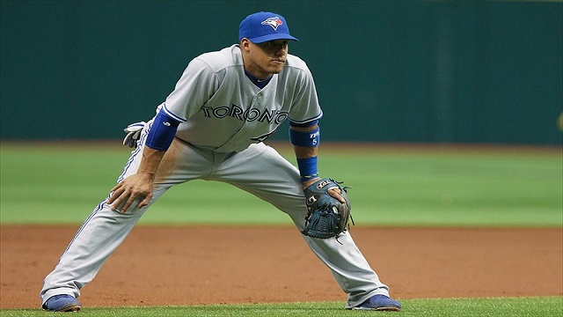
My family member is in the hospital:
What do I do?
YOUR PRESENCE IS THE MOST IMPORTANT THING
  Observe
  Listen
  Share your knowledge
  Ask questions
    Define medical jargon.
    What are tests for?
    What did they show?
    What does it mean?

Slide 37
Getting a second opinion/consultation
Don’t be afraid to ask
doctors generally welcome outside & second opinions
Insurance generally OK with it with preapproval

Slide 38
While in the hospital..
Rules of the road:
  Sanitize EVERYTHING
  Bring comfort items from home with nurse’s OK
    Blanket, toiletries, toys, etc...
  Meet the discharge planner
    Best friend for a quick, effective path home!
  Nurses are busy
    Don’t distract when doing meds, blood draw, etc.
    Your may be helping them

Slide 39
Surgical concerns
Have they talked to your DM doctor?
Post operative plan:
  Same day/outpatient surgery vs. observation overnight?
    Respiratory, cardiac monitoring
    Watch for pain medication side effects
Pain medications- “start low go slow” philosophy
  Worsen sleep apnea
  Constipation
  Can cause delirium

Slide 40
Delirium
Also called altered mental status
  Confused
  Not behaving or thinking normally
  Excessively sleepy
  Hallucinating
Poor prognostic sign
Can be caused by multiple underlying problems: medications, respiratory, metabolic, infection, etc…

Slide 41
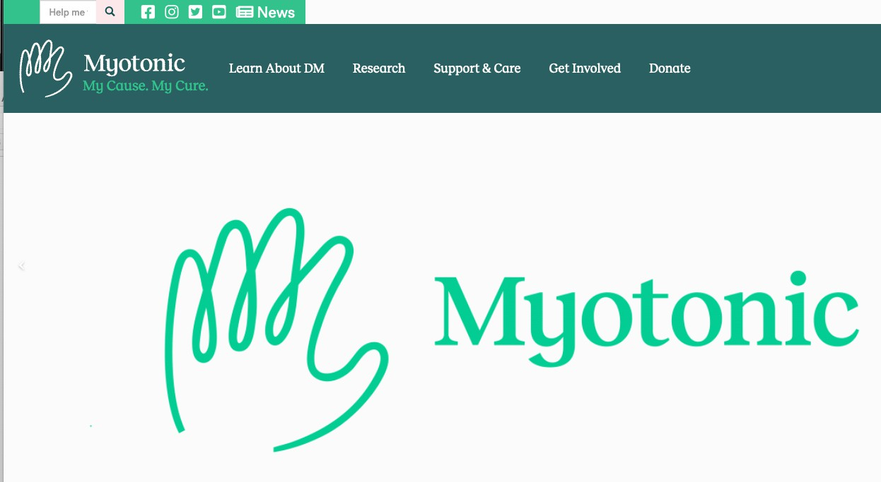
Resources from MDF
Myotonic.org
MyClinicVisit Planner
Clinical care guidelines
Anesthesia management recommendations
Physical therapy section
Occupational Therapy section
Registry section

Slide 42
Thank you!

