Slide 1
MYOTONIC DYSTOPHY: OVERVIEW
S H Subramony M.D.
Professor of Neurology and Pediatrics
University of Florida College of Medicine

Slide 2
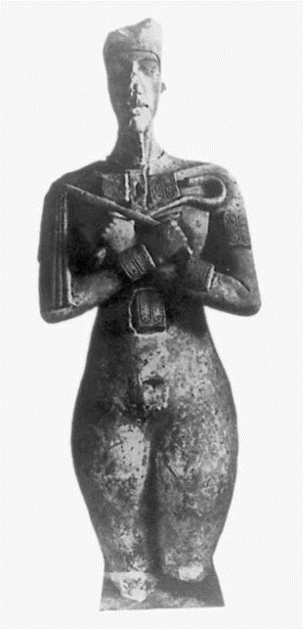
Steinert H (1909) Über das klinische und anatomische Bild des Muskelschwunds der Myotoniker. Dtsch Z Nervenheilkd 37:58–104
Claude Monet's vision.
Lane R, Carey N, Orrell R, Moxley RT 3rd.
Lancet. 1997
Batten, Gibb 1910
Myotonic dystrophy in Ancient Egypt.
Cattaino G, Vicario L.
Eur Neurol. 1999

Slide 3
CHRISTOPHER PROJECT
Survey of >1000 North American patients and > 400 caregivers
Queries designed by expert consensus
Findings
Age at diagnosis: 31± 15 for DM 1 and 44 ± 17 for DM2
Diagnostic delay; 5.7 ± 7.1 for DM1 and 7.9 ± 9.4 for DM 2
Bachelor degree: 45 and 46% DM 1 and DM 2 ( US population 35%)
Fully employed: 17 and 22% for DM 1 and DM 2 (US population >60%)
Unable to work: 46% for both DM 1 and DM 2
Income >40,000: 17 and 29% for DM 1 and DM 2 (30% US households)
>20% felt no assistance after diagnosis
Lack of resources and emotional impact most challenging aspects
Notes:
This is a disorder that is very familiar to all in the audience including patients, their families and health care providers that are specialized in the area. But we are awlays learning and we have become increasingly aware that the perspective of patients and families can often be very different. As such I thought I might summarize my overview using the data from the Christopher project that many of yu may have pertiipated. This project, mainly orgnzied by the Marigold foundation distributed a carefully constructed survey to patients and caregivers across North America and data from >1000 patients and >400 caregivers was analalyzed. One can appreciate the widespread impact of this disease on patients and families. The average dealy from symptom onset to diagnosis was about 6 years, but longer in Dm2 than in DM 1.

Slide 4
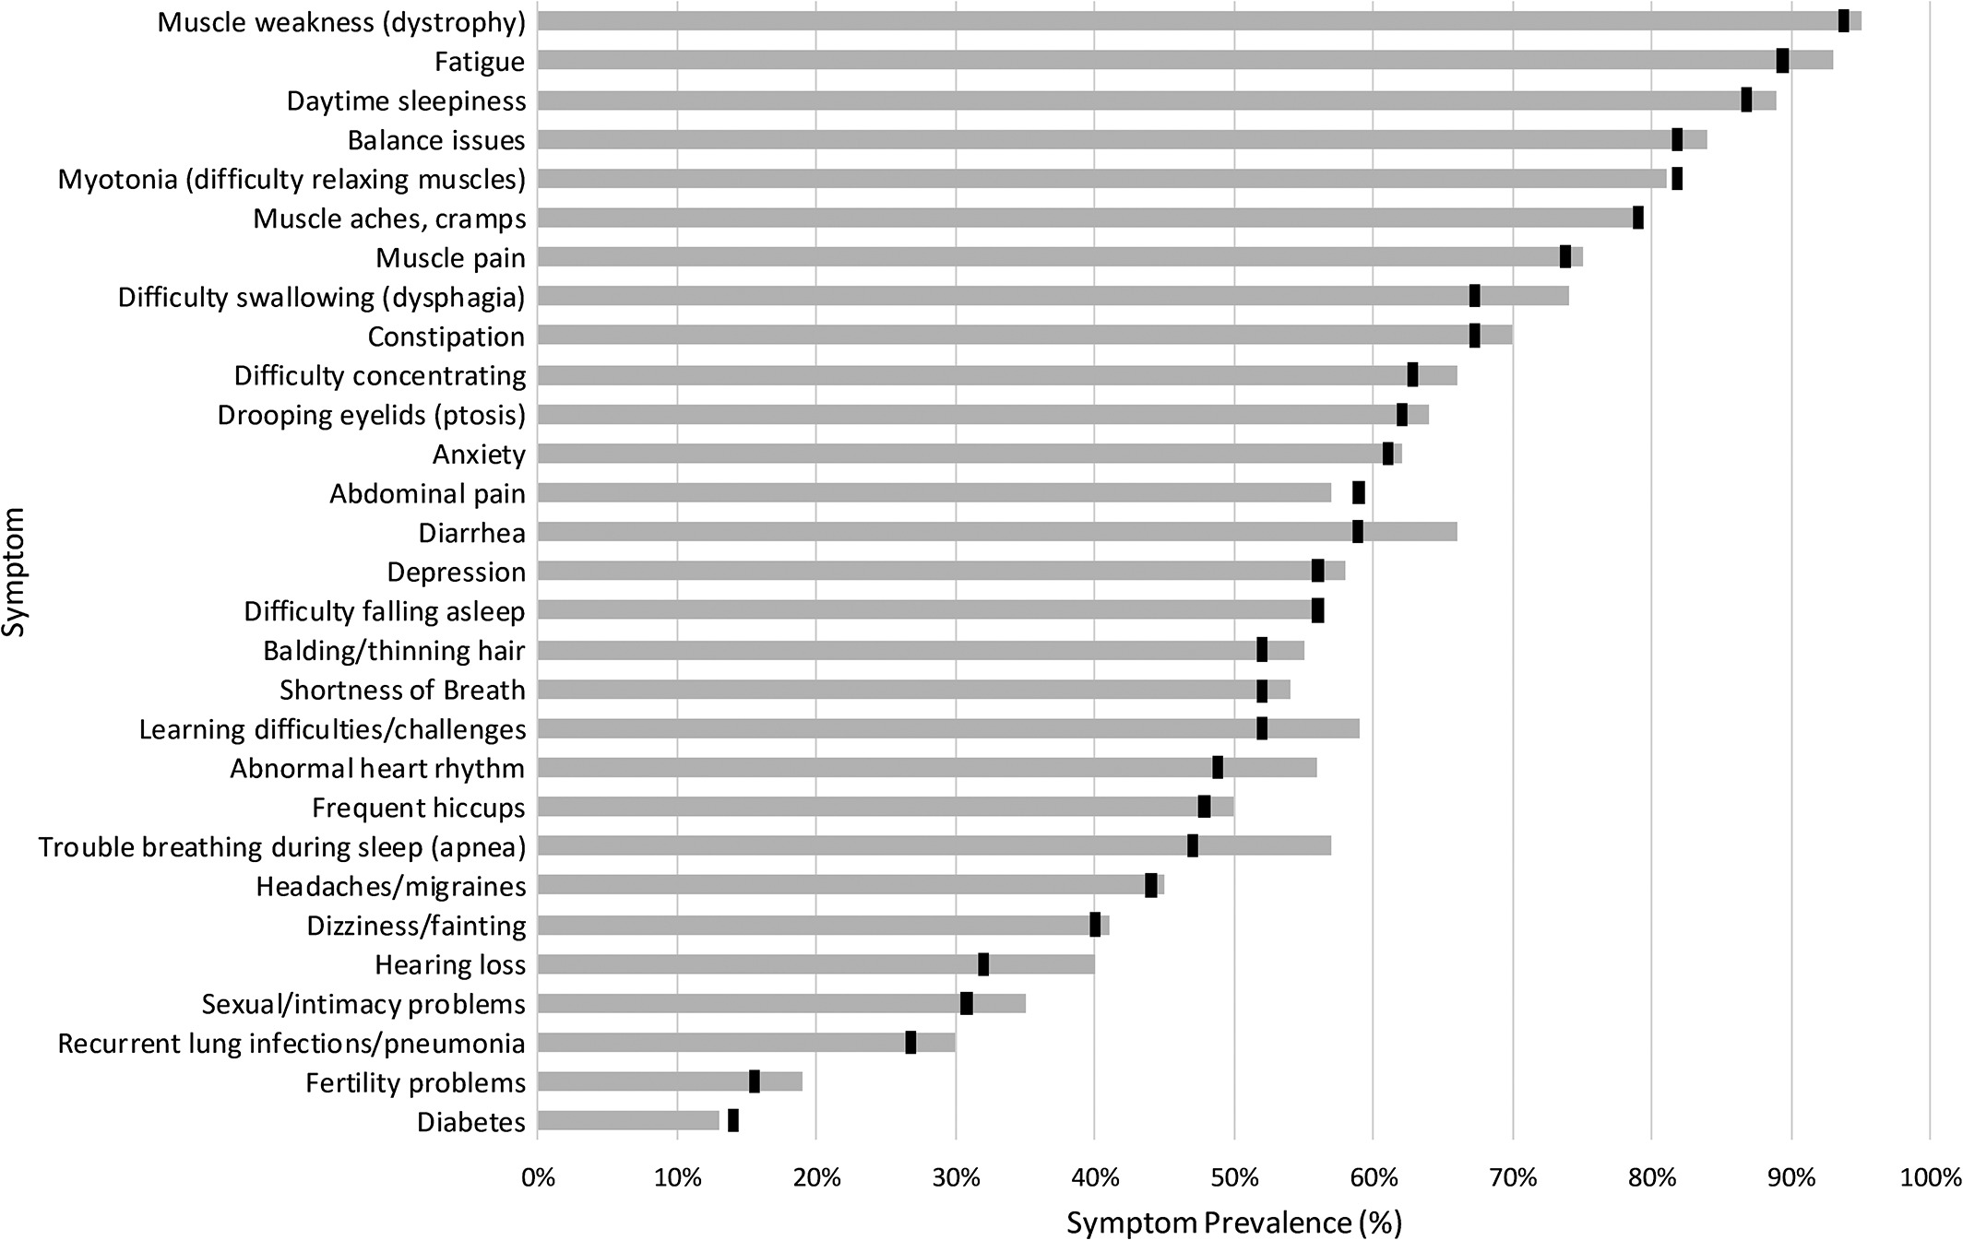
Notes:
This shows the impact of various sympotms as reported bu this large cohort. The black dot represents repot by patients and parallels the information provided by caregivers. While many features are as expected, I can imagine that many physcians including neurologists will not think about and inquire into some of the issues. The labeling of the disease as a dystrophy immediately focuses attention on muscle weaknessa dn myotoniawhich are indeed very common. But many neuromuscular physicians will under appreciate the impact of sleepiness and difficulty concentrating. Ther may be balance issues over and above th muscle weakness. Gastro-intestinal features are indeed very bothersome and something we find difficult to solve. Interestingly headaches, dizziness, hearing loss while listed may not be more frequent than in general populations. Intimayc problems are typically not dealt with by most clinicians.

Slide 5
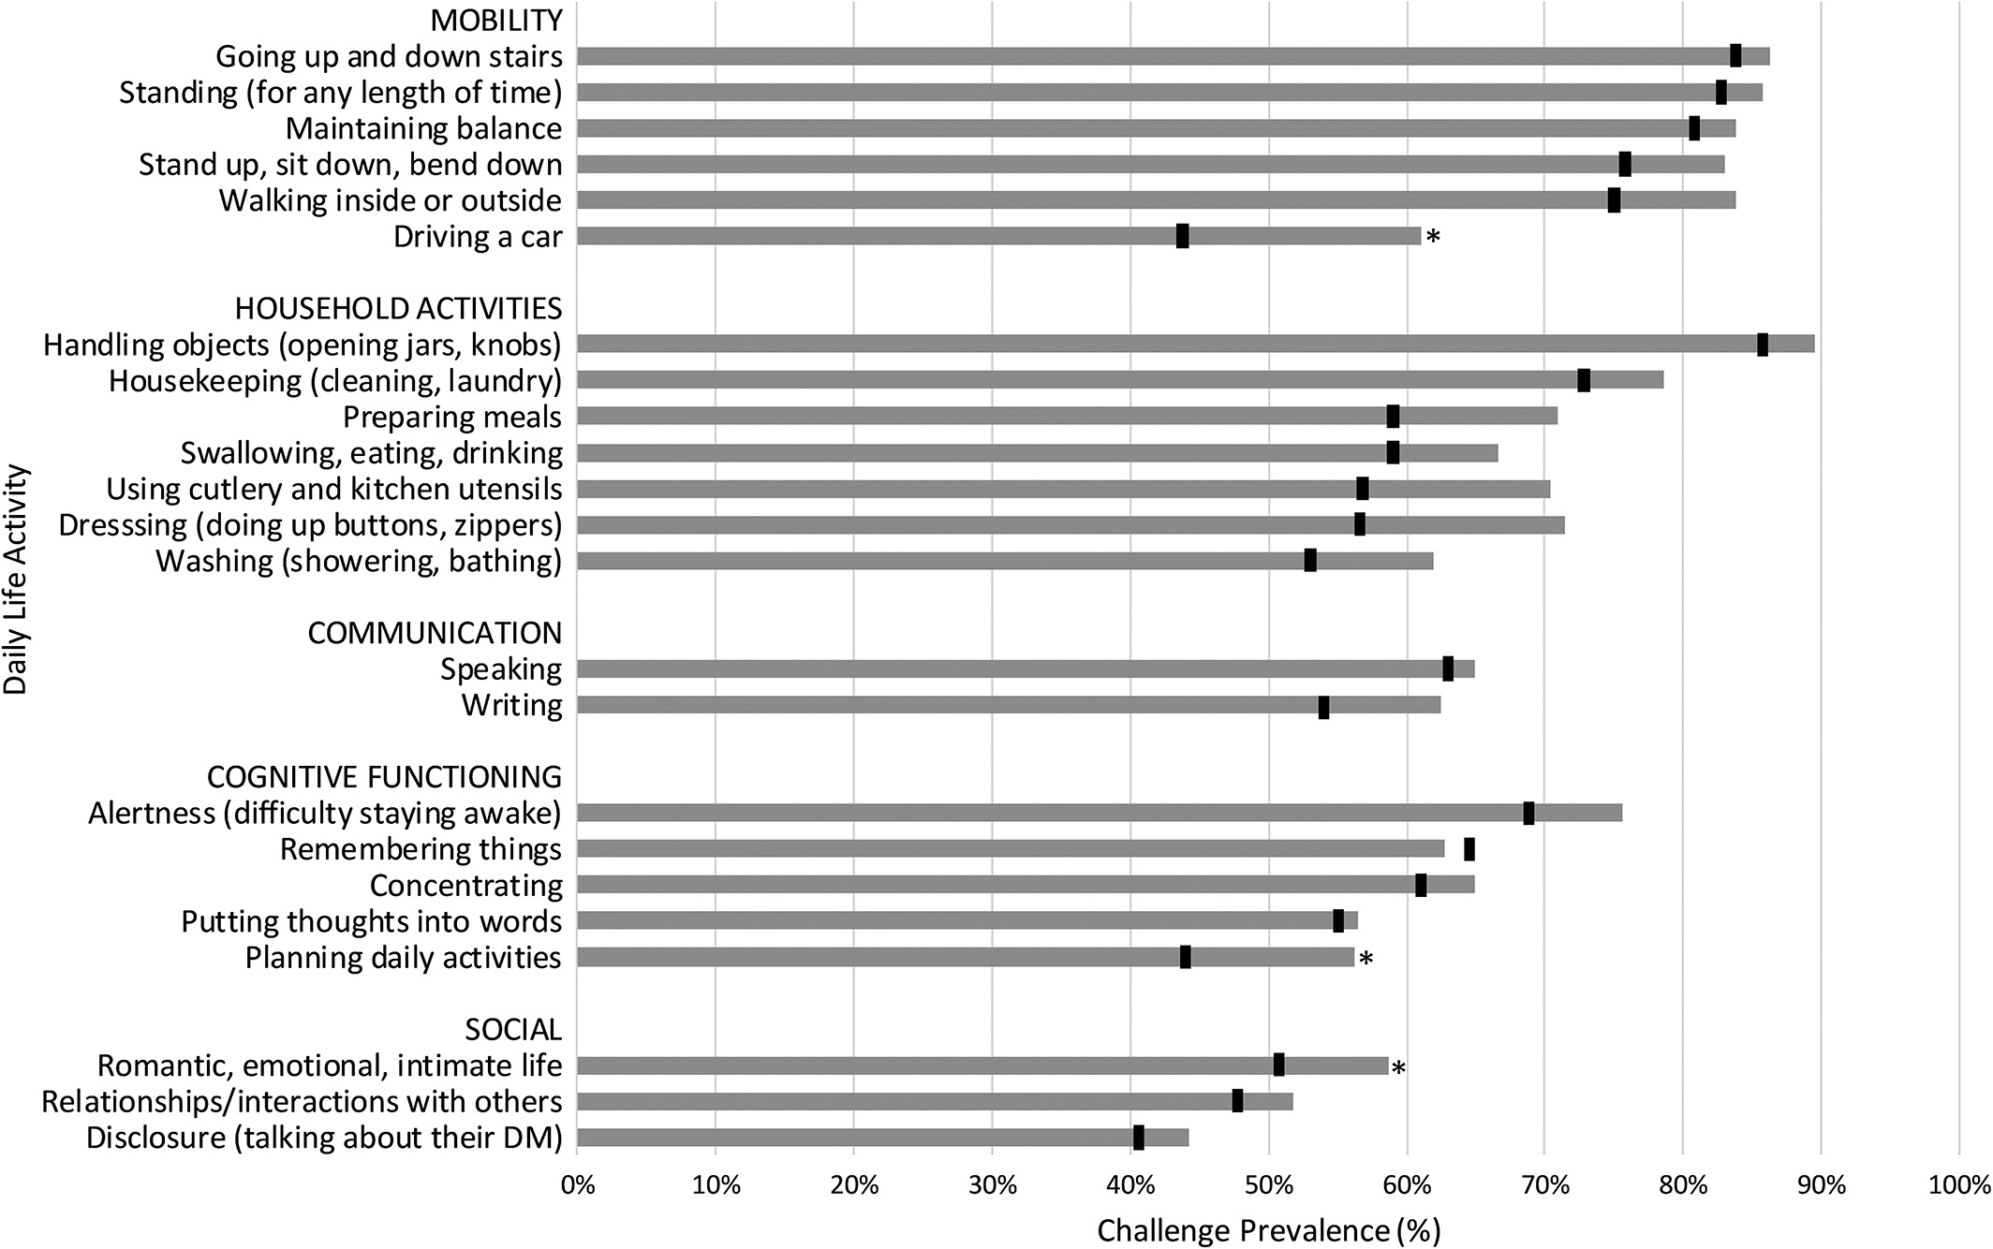
Notes:
The multisystemic nature of the disease has rtemndous impact on many daily activities. Mobility is impaired with early prpoblems ith normal ctivities sucha s athletics and with increasing weakness walking problmes, climbing problems, driving. Household activities become increasingly difficult. This is complicated by added significant CNS problems. Social interactions become more and more impaired.

Slide 6
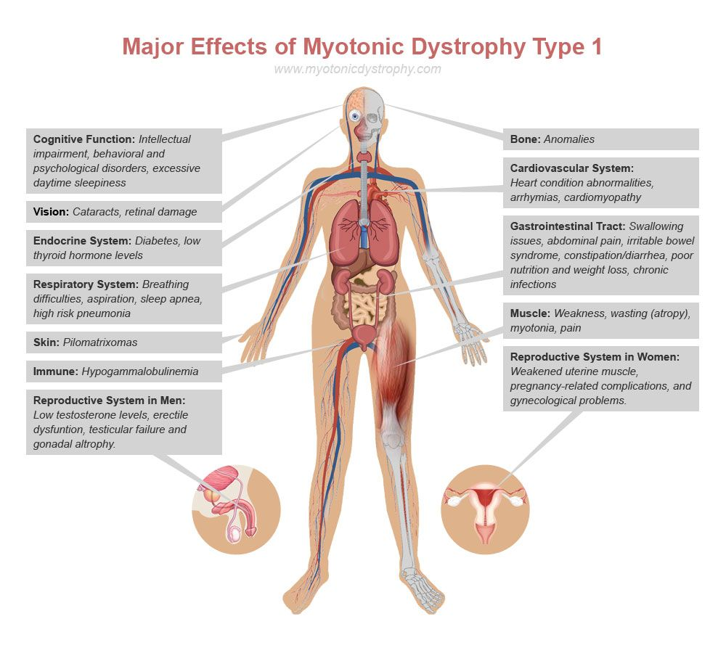
Concentration problems, sleep problems, learning: alertness, planning activities
Heart rhythm, shortness of breath, fainting
Baldness, fertility problems, diabetes
Swallowing, constipation, pain, diarrhea
Shortness of breath, infections
Weakness, aches, droopy lids, myotonia: mobility, driving, ADL
DM 2: similar problems but all less frequent and less severe
Congenital myotonic dystrophy
Notes:
Physicians look at diseases in terms of human biology and organ systems and we atalk about cognitive impairment, visual changes, endocrine dysfunction, cardiomyopathy, restrictive lung disease and GI tract dysfunction and this type of terminology often may not make sens to the non-initiated. But one can take many of the sympotms patient sreported and place them across from this type of biologic perspective.

Slide 7
CARING FOR MYOTONIC DYSTROPHY PATIENTS AND FAMILIES
Life threatening issues
Anticipation and prevention.
Importance of communication between experts, families and primary care
Cardiac disease (prevent rhythm problems)
Neuromuscular respiratory compromise (prevent infections, prevent low oxygen and high carbon dioxide levels)
Anesthetic issues (communication between experts; muscle, heart, breathing, stomach and brain dysfunctions all contribute to potential for complications)
Anesthesia stand-by
Gastric pseudo-obstruction
Medications to avoid?
Statins, other neurotoxins and myotoxins

Slide 8
CARING FOR MYOTONIC DYSTROPHY PATIENTS AND FAMILIES
Many issues can be managed effectively
Heart: W.Miles
Respiration: B.Smith
Swallowing: E.Plowman
Motor rehab: D.Lott
Pregnancy and genetics: D.Barbouth
More difficult issues
Cognition: J. Williamson
Educational access/ social issues: E Conte and B Roland
GI issues

Slide 9
Lancet Neurol. 2018 Aug;17(8):671-680. Cognitive behavioural therapy with optional graded exercise therapy in patients with severe fatigue with myotonic dystrophy type 1: a multicentre, single-blind, randomised trial. Okkersen K¹, Jimenez-Moreno C², Wenninger S³, Daidj F⁴, Glennon J⁵, Cumming S⁶, Littleford R⁷, Monckton DG⁶, Lochmüller H⁸, Catt M⁹, Faber CG¹⁰, Hapca A⁷, Donnan PT⁷, Gorman G¹¹, Bassez G⁴, Schoser B³, Knoop H¹², Treweek S¹³, van Engelen BGM¹⁴; OPTIMISTIC consortium.
All patients started with psycho-education and goal formulation. Patients were then offered a tailored CBT intervention consisting of a maximum of six modules: 1) Learning to compensate for a reduced initiative; 2) Optimize social interactions with caregivers;3) Regulation of sleep-wake pattern; 4) Reformulation of dysfunctional beliefs with respect to fatigue or DM1; 5) Activity regulation and graded activity; 6) Coping with pain
Improved DM Activ score
Improved 6 MWT
Improved accelerometry
Improved fatigue score

Slide 10
CARING FOR MYOTONIC DYSTROPHY PATIENTS AND FAMILIES
Novel, disease altering therapies being rapidly developed
Participating in clinical research
May include both treatment trials and non-intervention studies such as natural history, COA and biomarker studies
Varying length and visit schedules
Varying “inclusion and exclusion “ criteria
Travel costs, payment to participate, drug costs
Time between participation and result availability
Risks of intervention, procedures, confidentiality issues
Genetic tests

Slide 11
ONGOING CLINICAL RESEARCH STUDIES AT UF
END-DM1 Myotonic Dystrophy
Brain imaging and Social Cognition in myotonic dystrophy
Studies of skeletal muscle and gastrointestinal dysfunction in myotonic dystrophy and controls
CNG Biobank
Contacts
S H Subramony M.D., Stephen Gullett, Victoria Hope, Amanda Cowsert
352 273 5550

