Slide 1


Cardiac Involvement in
Myotonic Dystrophy
William M Miles, MD, FHRS
Professor of Medicine
Silverstein Chair for Cardiovascular Education
University of Florida College of Medicine

Slide 2
Cardiac Involvement in Neuromuscular Diseases
  Cardiomyopathy
    Heart muscle disease
  Conduction defects with arrhythmias
    Heart rhythm (electrical) abnormalities

Slide 3
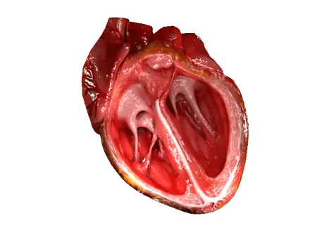
Normal Cardiac Contraction

Slide 4
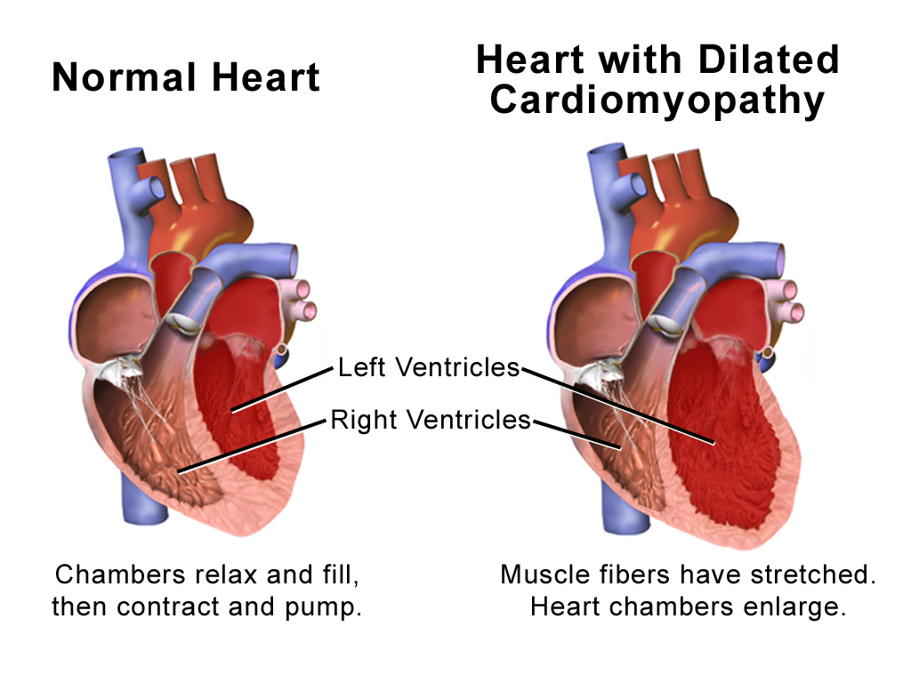
Blausen.com staff (2014). "Medical gallery of Blausen Medical 2014". WikiJournal of Medicine 1 (2). DOI:10.15347/wjm/2014.010. ISSN 2002-4436.

Slide 5
Cardiac Involvement in Neuromuscular Diseases:
  Cardiomyopathy
    Gradual weakening of heart muscle
    Symptoms:
      Exercise intolerance
      Shortness of breath
    Treatment:
      Medications
      Left ventricular pacing for resynchronization
      In very select patients, ventricular assist devices and/or cardiac transplant

Slide 6

Cardiac Involvement in Neuromuscular Diseases:
  Conduction defects with arrhythmias
    Slow heart rhythms---bradycardia
      Diagnosed on ECG
      Symptoms:
        Dizziness, passing out, shortness of breath
      Treatment:
        Pacemaker

Slide 7
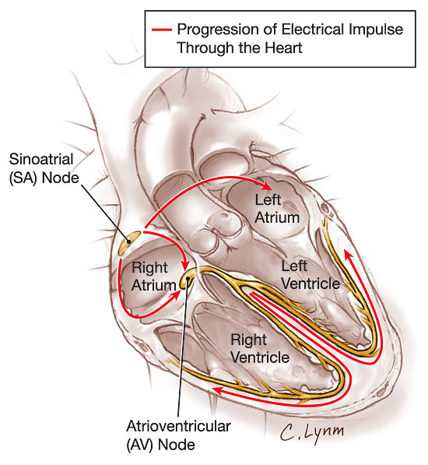
JAMA 2006;296:1314

Slide 8
Bundle Branch Block
JAMA 2006;296:1314

Slide 9
Atrio-Ventricular (AV) Block
JAMA 2006;296:1314

Slide 10

Cardiac Involvement in Neuromuscular Diseases:
  Conduction defects with arrhythmias
    Rapid heart rhythms---tachycardia
      Diagnosed on ECG
      Atrial or ventricular origin
      Symptoms:
        Palpitations, shortness of breath, dizziness, passing out
      Treatments:
        Medications
        Ablation
        Implantable cardioverter/defibrillator (ICD)

Slide 11
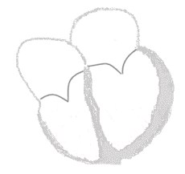
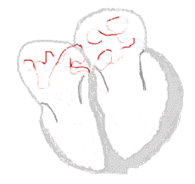
Sinus Rhythm Atrial Fibrillation
From Wikopedia

Slide 12
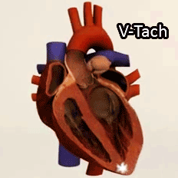
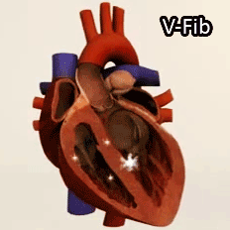

Slide 13
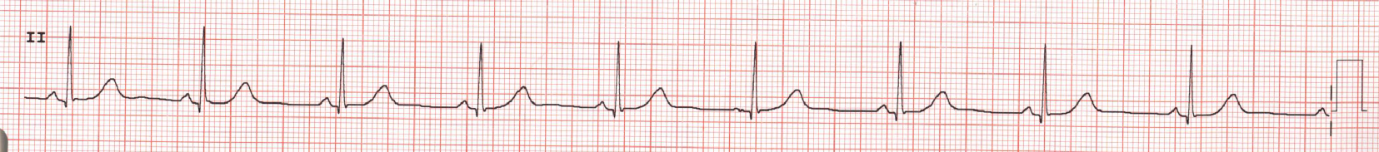
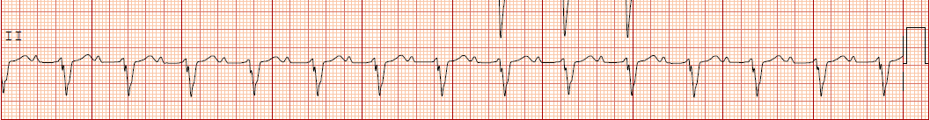
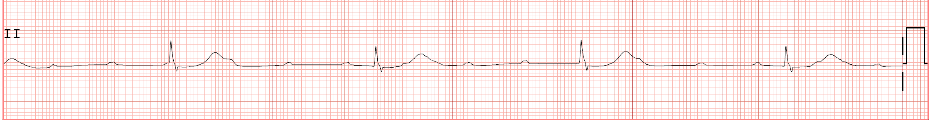
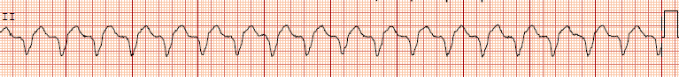
Normal
Bundle Branch Block and 1st Degree AV Block
Complete AV Block
Ventricular Tachycardia

Slide 14
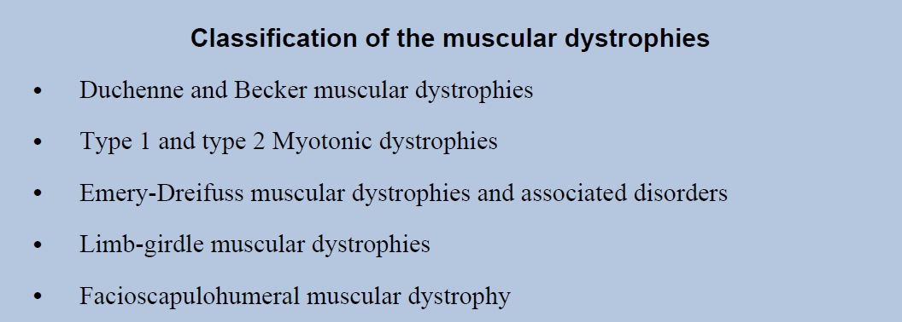
Rajdev and Groh. Card Electrophysiol Clin. 2015 June ; 7(2): 303–308

Slide 15
Myotonic Dystrophy
Often abbreviated as DM:
Dystrophia Myotonica (Greek)

Slide 16
Cardiac Manifestations in Myotonic Dystrophy
 | Heritance | Cardiac Manifestations | Cardiomyopathy | Arrhythmia | Conduction
DM1 | Autosomal Dominant | 80% (high in younger pts) | Occasional (DCM,HCM) | Common (Afl, Afib, VT) | Common (SD)
DM2 | Autosomal Dominant | 10-20% | Rare in childhood | Rare in childhood | Rare in childhood
Management of Cardiac Involvement Associated With Neuromuscular Diseases
A Scientific Statement From the American Heart Association. Circulation 2017

Slide 17
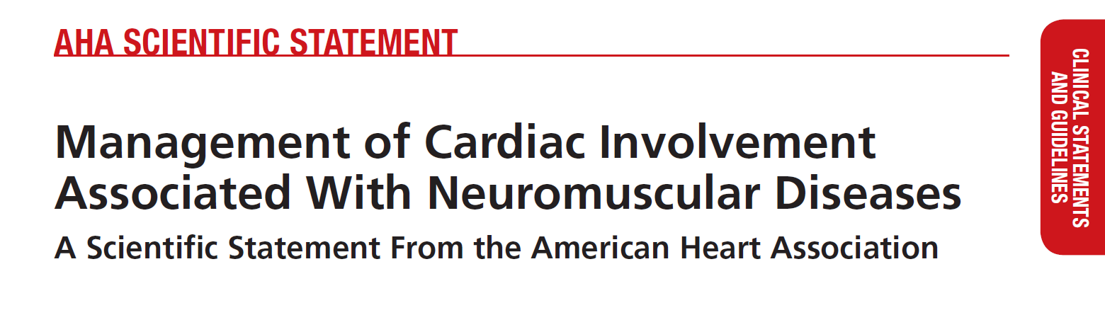
Guideline Classifications
Class I Recommended
Class IIa Reasonable
Class IIb May be considered
Class III Not recommended or potentially harmful
Feingold et al. Circulation 2017

Slide 18
Approach to Cardiac Evaluation in Neuromuscular Diseases (NMD)
NMD providers and patient organizations should promote education regarding the importance of a proactive approach to screening, diagnosis, and management of cardiovascular complications of NMDs and the ideal care team required (Class I; Level of Evidence B)
All neurologists diagnosing and managing NMDs should work to identify either a cardiologist with expertise in these conditions or at minimum a collaborative electrophysiologist or HF specialist, depending on the condition being evaluated (Class I; Level of Evidence B)
For conditions diagnosed in childhood, referral to a pediatric HF specialist, when practicable, is reasonable because of evolving diagnostic and management recommendations within pediatric cardiomyopathies (Class IIa; Level of Evidence B)
Management of Cardiac Involvement Associated With Neuromuscular Diseases
A Scientific Statement From the American Heart Association. Circulation 2017

Slide 19
Approach to Cardiac Evaluation in Neuromuscular Diseases
Cardiac evaluation should be performed before anesthesia or sedation in any patient with NMD at risk for cardiac involvement. For those with a history or symptoms suggestive of cardiac involvement, cardiac evaluation should be in close proximity (3–6 months) to the anesthesia/sedation event (Class I; Level of Evidence C)
For NMD patients believed to be at increased cardiac risk during surgery, cardiac monitoring by an anesthesiologist experienced in the care of patients with NMDs should occur during major surgery, and the procedure should take place in a center with appropriate intensive care facilities (Class I; Level of Evidence C)
Management of Cardiac Involvement Associated With Neuromuscular Diseases
A Scientific Statement From the American Heart Association. Circulation 2017

Slide 20
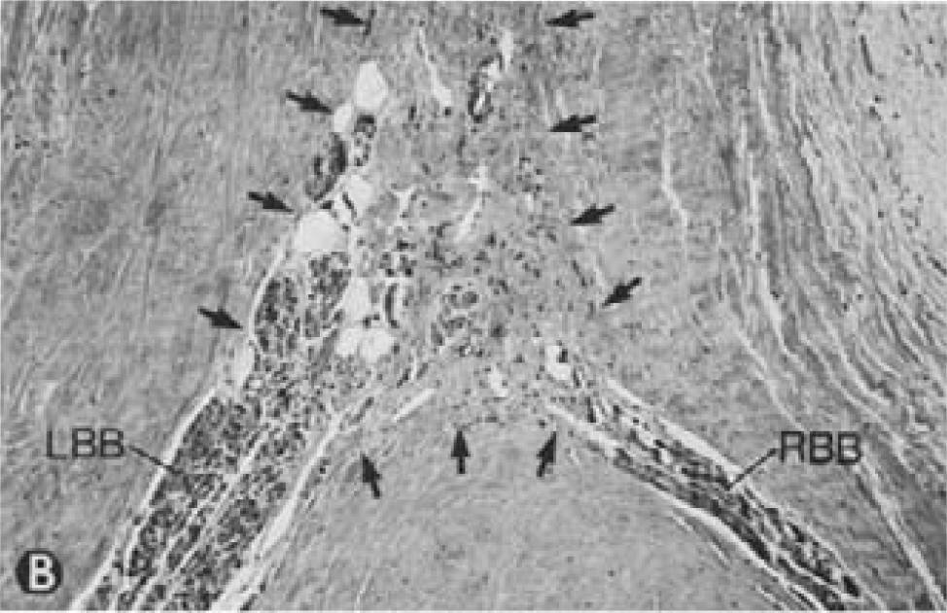
Cardiac Pathology in DM1
Cardiac pathology involves degeneration, fibrosis, and fatty infiltration preferentially targeting the specialized conduction tissue including the sinus node, atrioventricular node, and His-Purkinje system.
Degenerative changes are observed in working atrial and ventricular tissue but only rarely progress to a symptomatic dilated cardiomyopathy.
Nguyen et al. JACC 1988;11:662
Rajdev and Groh. Card Electrophysiol Clin. 2015 June ; 7(2): 303–308

Slide 21
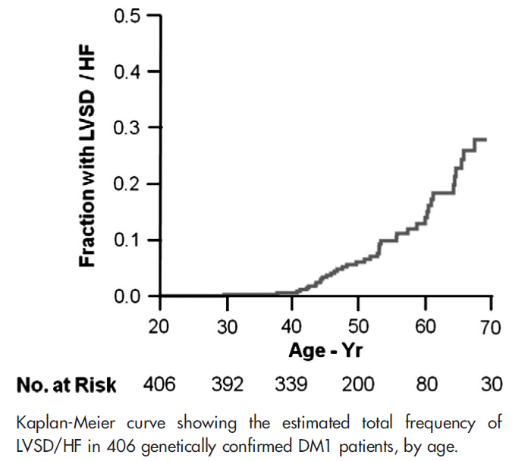
Left Ventricular Systolic Dysfunction and Heart Failure in Adults with Myotonic Dystrophy Type 1
Bhakta et al. Am Heart J 2010;160:1137-1141

Slide 22
Therapy for Cardiomyopathy,
Reduced Ejection Fraction
Medication Guidelines
ACE inhibitors or ARBs (Class I)
  e.g. lisinopril
Beta blockers (Class I)
  e.g. metoprolol
Aldosterone antagonist (Class IIa)
  e.g. spironolactone
Diuretics for fluid retention (Class I)
  e.g. furosemide

Slide 23
Electrocardiography in DM1
A majority of adult patients with myotonic dystrophy type 1 exhibit electrocardiographic abnormalities (65%):
  first-degree atrioventricular block: 42%
  right bundle branch block: 3%
  left bundle branch block: 4%
  nonspecific intraventricular conduction delay: 12%
  Q waves not associated with a known myocardial infarction are common.
Conduction disease worsens with advancing age
Electrocardiographic abnormalities are less common in myotonic dystrophy type 2, occurring in approximately 20% of middle-aged patients.
Groh WJ et al. N Engl J Med. 2008; 358:2688

Slide 24
Arrhythmias in DM1
Conduction system disease can progress to symptomatic atrioventricular block and necessitate pacemaker implantation
Updated practice guidelines have recognized that asymptomatic conduction abnormalities in neuromuscular diseases such as myotonic dystrophy may warrant special consideration for pacing
Rajdev and Groh. Card Electrophysiol Clin. 2015 June ; 7(2): 303–308

Slide 25
Arrhythmias in DM1
Atrial arrhythmias, primarily fibrillation and flutter, are common
  Patients with atrial arrhythmias are often asymptomatic possibly because of a controlled ventricular response from concomitant conduction disease
Up to one third of individuals with myotonic dystrophy type 1 die suddenly
  Related primarily to arrhythmia
  Sudden death can occur despite pacemakers, implicating ventricular arrhythmias
Arrhythmias are observed in patients with myotonic dystrophy type 2, but are less frequent and occur later in life
Rajdev and Groh. Card Electrophysiol Clin. 2015 June ; 7(2): 303–308

Slide 26
Cardiac Evaluation in
Myotonic Dystrophy (DM)
1. Cardiology evaluation with examination, ECG, echocardiogram, and ambulatory electrocardiographic monitoring should occur at the time of DM diagnosis, regardless of symptoms (Class I; Level of Evidence C)
2. DM patients with palpitations, dizziness, syncope, non–sinus rhythm, PR interval >240 ms, QRS duration >120 ms, or second- or third-degree atrioventricular block should be evaluated at least annually and also considered for invasive electrophysiology study for possible pacemaker or ICD placement (Class I; Level of Evidence C)
Management of Cardiac Involvement Associated With Neuromuscular Diseases
A Scientific Statement From the American Heart Association. Circulation 2017

Slide 27
Cardiac Evaluation in
Myotonic Dystrophy (DM)
3. For DM patients with normal LVEF who lack the features listed in recommendation 2, it is reasonable to reassess by examination, ECG, and ambulatory electrocardiographic monitoring annually and by echocardiogram every 2 to 4 years (Class IIa; Level of Evidence B)
Management of Cardiac Involvement Associated With Neuromuscular Diseases
A Scientific Statement From the American Heart Association. Circulation 2017

Slide 28
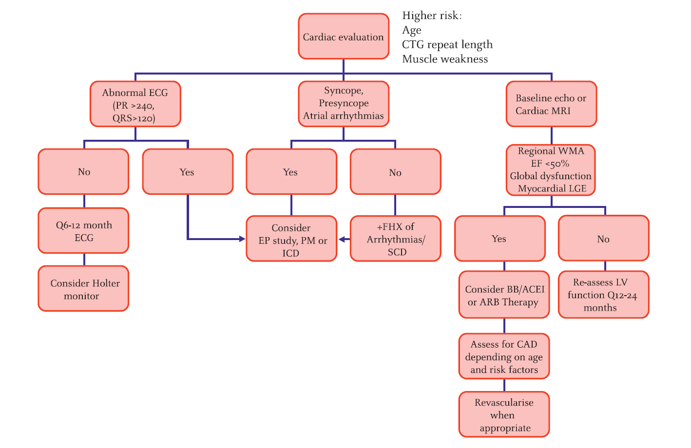
Proposed Algorithm for Cardiovascular Management in Myotonic Dystrophy
McNally and Sparano. Heart 2011;97:1094

Slide 29
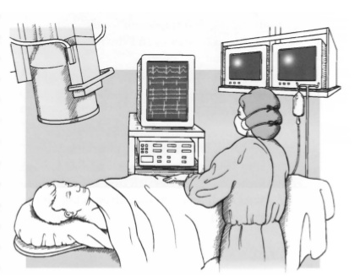
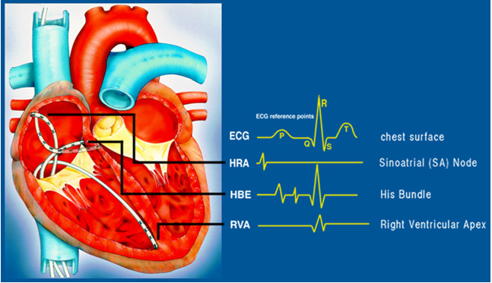
Electrophysiology Study

Slide 30
Indications for Electrophysiology Study
Patients with pre-syncope or syncope believed to be arrhythmic in origin but without clear evidence of underlying conduction disease by ECG
Patients with evidence on the ECG of conduction disease
  To clarify the site and degree of conduction abnormality and guide decisions regarding device implantation
  Ventricular stimulation should include protocols for the induction of bundle branch re-entry
Ismail et al. JACC Electrophysiol 2017;3:1069

Slide 31
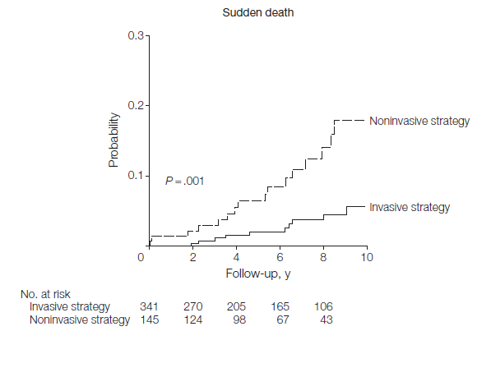
Electrophysiological Study With Prophylactic Pacing and Survival in Adults With Myotonic Dystrophy and Conduction System Disease
Wahbi et al. JAMA 2012;307:1292

Slide 32
Cardiac Implantable Electronic Devices
Pacemakers
  Patients with or at risk of AV block, or other bradycardias
Cardiac resynchronization pacing therapy (CRT)
  Patients with bundle branch block and congestive heart failure
Implantable cardioverter-defibrillators (ICDs)
  Patients having had or at risk of ventricular tachycardia or ventricular fibrillation

Slide 33
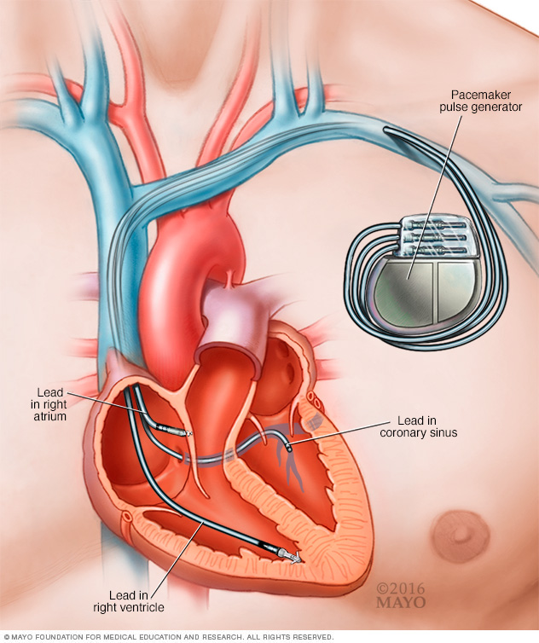
Pacemaker

Slide 34
Pacing Guidelines in Myotonic Dystrophy
Permanent pacemaker implantation is recommended for 3rd degree and advanced 2nd degree AV block at any anatomic level, with or without symptoms (Class I)
Permanent pacemaker implantation may be considered with any degree of AV block (including 1st degree AV block), with or without symptoms, because there may be unpredictable progression of AV conduction disease (Class IIb)
Permanent pacemaker implantation may be considered with bifascicular block or any fascicular block, with or without symptoms (Class IIb)
Adapted from Epstein et al. ACC/AHA/HRS 2008 guidelines for device-based therapy of cardiac rhythm abnormalities. Circulation 2008;117:e350–e408

Slide 35
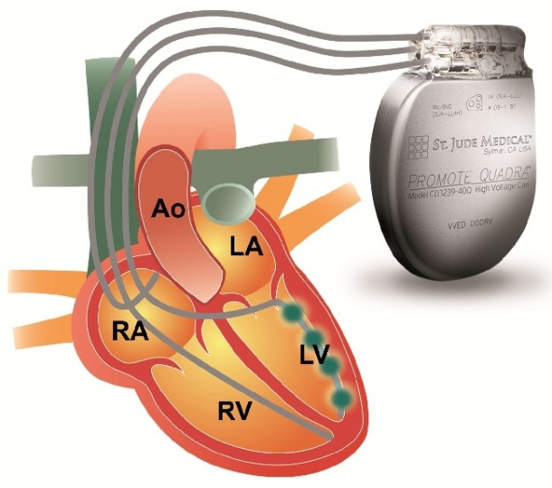
Cardiac Resynchronization Therapy: for congestive heart failure due to dyssynchrony caused by bundle branch block
healthcare-in-europe.com
CRT Off
CRT On

Slide 36
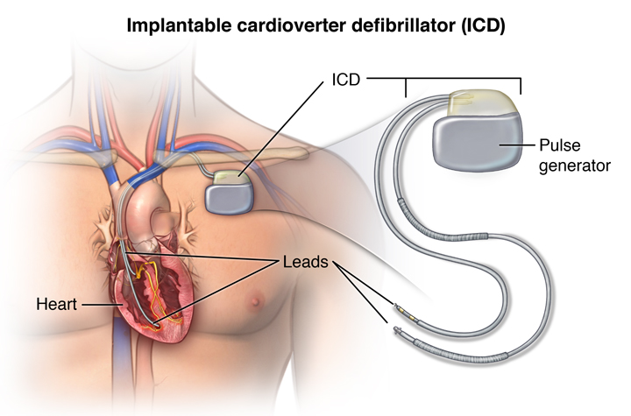
Implantable Cardioverter-Defibrillator
Courtesy Johns Hopkins
Delivers a shock to terminate ventricular tachycardia and ventricular fibrillation, potentially life-threatening arrhythmias

Slide 37
Cardioverter-Defibrillator Therapy
It is reasonable to consider ICD placement in select NMD patients, particularly in NMDs in which arrhythmia may be a predominant feature (DMD, BMD, EDMD, DM1, FA, LGMD1B), after thoughtful discussion and decision making, which should be individualized and based on the overall medical status and options for management (Class IIa; Level of Evidence C).
Management of Cardiac Involvement Associated With Neuromuscular Diseases
A Scientific Statement From the American Heart Association. Circulation 2017

Slide 38
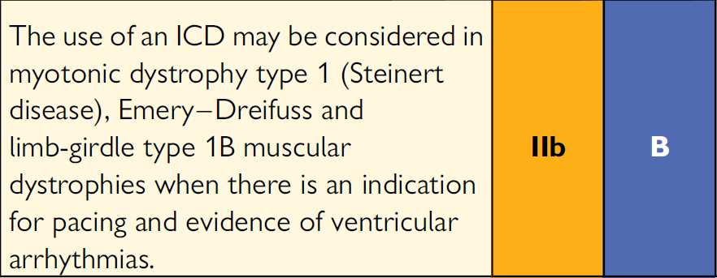
2015 ESC Guidelines for the management of patients with ventricular arrhythmias and the prevention of sudden cardiac death
Priori et al. European Heart Journal (2015) 36, 2793–2867

Slide 39
What Are the Drawbacks of ICD vs. Pacemaker?
Larger generator size
Possibility of inappropriate shocks
ICD may not be appropriate in patients with advanced underlying myotonic dystrophy or advanced heart disease

Slide 40
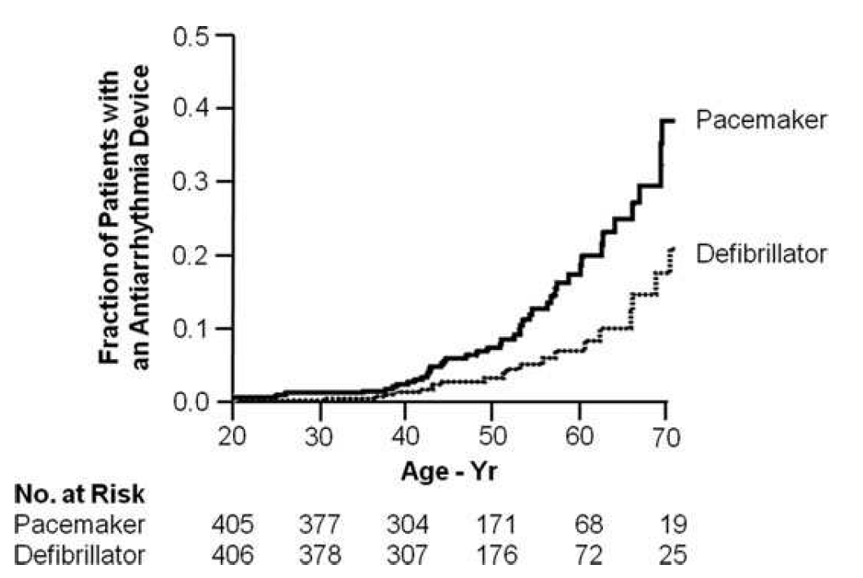
Pacemaker and Implantable Cardioverter-Defibrillator Use in a US Myotonic Dystrophy Type 1 Population
The risk of VT/VF and sudden death in patients with pacemakers suggests that the ICD may be a preferred device.
Bhakta et al. J Cardiovasc Electrophysiol, Vol. 22, pp. 1369-1375, December 2011

Slide 41

Questions?

