Slide 1
Who is on your team?
General practitioner/pediatrician
Neurologist
Cardiologist
Pulmonologist
Gastroenterologist
Sleep medicine
Speech/swallow therapist
OB/GYN
Nurse
Physical Therapist
Occupational Therapist
Social worker
Nutritionist
And so on...
Notes:
In addition, several healthcare providers
After do a verbal recap of what has been said
Stating we need tools for diffrents needs

Slide 2
Who is team captain?
Who to call with DM questions?
Who to direct you to consultants?
Who to coordinate care?

Slide 3
Picking and Educating your team
Ask if they have treated/are familiar with myotonic dystrophy (or muscular dystrophies in general)
Medicine is lifelong learning
Ask questions!
Ask team to contact your DM doc with questions
Give them the websites, bring in the article you have questions about
Network!
Who do your fellow DM patients recommend? (MDF VIP site)
They’ve already “broken them in”
The more DM they see, the more they will learn- from you, and others
Teaching institutions- spread the knowledge, teach the future docs!
Residents can be a “2 for 1”

Slide 4
What is a medical home
Patient centered care for patients with complex medical needs
Focus on prevention, wellness, acute and chronic care.
Communication between all care team members
Goals of quality, safety
Health care reform policies are emphasizing medical homes

Slide 5
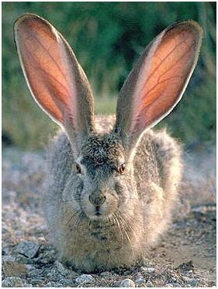
Help in navigating the medical system
family or friend
Patient advocate
Clinic or school social worker
Hospital discharge manager
Insurance case management
Medicaid
Private insurances (Blue cross/blue shield, Aetna, Cigna, etc).
Insurance open enrollment
“Preferred providers”
Notes:
Medicare: comprehensive primary care initiative

Slide 6
Prepare for your visit: Bring a list of questions
What changed since your last visit
Your worries
Your families’ worries
Circle the most important question
If your visit is only 20 minutes, where do you want to start?

Slide 7
One last thing, doc
Don’t save the best for last
Afraid to ask?
Genetic counseling question?
If can’t cover it that day,
Ask for followup for time!

Slide 8
Getting the most out of your visit
Muscular system
Central nervous system
Cardio-vascular system
Visual system
Respiratory system
Gastro-intestinal system
Genito-urinary system
Reproductive system
Metabolic & endocrine system
Need all to be reviewed during your follow-up visit
=
54 concerns
Notes:
Apart from your regular cold or your arthritis...

Slide 9
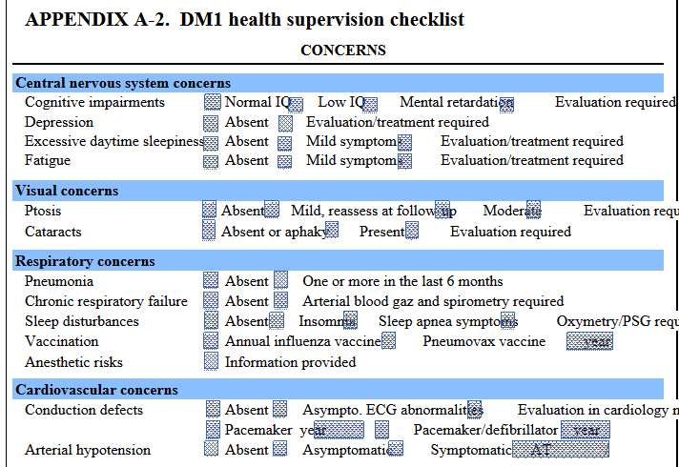
Health Supervision Checklist
Gangon et al, Neuromsucular Disorders, 2010: p 347; MDF website

Slide 10
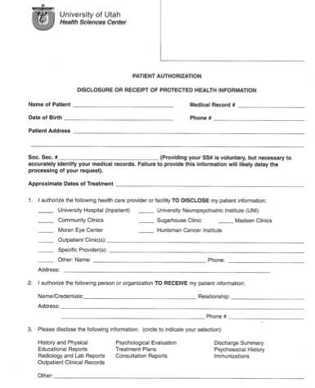
Your medical records
Fax or send before your visit
Especially for a new doctor
Electronic medical records (EMR)
Vary between hospitals
Multiple doctors at same institution can view same EMR
HIPPA restrictions
Health insurance privacy and portability
Be both specific and inclusive: providers, test, image, future dates.
Release of information form

Slide 11
Patient Portal
benefits
limitations
Full records may not be available
Delay in lab result posting
Some note types not accessible
Genetic, psychiatric
Request appointments
Appointment reminders
View test, lab results, imaging reports
Send messages to your team
Request medication refills

Slide 12
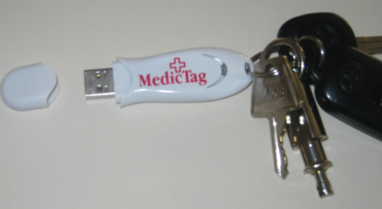
High tech
Pros: immediately available in emergencies
Cons: have to keep them updated

Slide 13
Low tech
Medical information Jane Doe
Birthdate 1/1/1968
Myotonic dystrophy 1, sleep apnea, atrial fibrillation
Updated 12/1/11
Allergies: penicillin, bees
Warning: anesthesia complications in myotonic dsytrophy
See myotonic.org
* I have a St. Jude’s heart valve
Meds: coumadin 2 mg Tues, Thurs, Sat: 1 mg Mon Wed, Fri Sun
levothyroxine 0.125 mg in the morning
oral contraceptive
multivitamin
calcium 500 mg twice a day
vitamin C 1,000 mg a day
ginko biloba
I have a pacemaker-
Model #####
BiPAP settings 10/3
Contact person: John Doe (brother)
Cell 1-801-666-6666
My doctors:
Dr. Pepper- primary care -1-801-777-7777
Dr. Mudd- cardiology 1-801-888-8888
Dr. Sampson- muscular dystrophy 1-801-999-9999

Slide 14
Managing your Medical Records*
Online
Blue Button
MyMedicare.gov
Medicare, Medicaid, Tricare, Aetna, RelayHealth
Downloads claims
www.freehealthtrack.com
Online, laptop, or smartphone
Patient Records Doctor (Android)
Capzule PHR (iOS)
My Medical (iOS)
*Check security measures; regular Dropbox and gmail are not secure for health information

Slide 15
Make a binder
Sections for:
Heart
Lungs
GI
Sleep
PT
Etc..
For kids
IEP

Slide 16
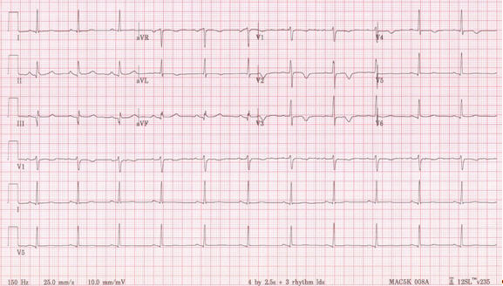
ECG traces- ask for copy

Slide 17
Collect team cards
Circle best contact number for questions
Share with other providers
cc: your team AND you

Slide 18
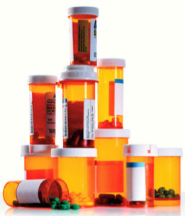
Brown bag your medications
Prescription medications
Need refills?
Expired?
Stopped taking?
Over-the counter
Vitamins
Herbal medicines

Slide 19
Preparing for surgery
Up to date ECG?
Up to date pulmonary function testing?
Talk to your surgeon about DM
Meet with to your anesthesiologist prior to surgery, and not just the morning of!
Choice of anesthetics
Respiratory, secretions management
Cardiac monitoring
Plan of action in case of complication

Slide 20
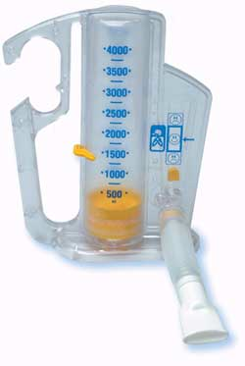
Rehab and Prehab
Surgery, injury or illness
Slower recovery
Longer recovery
New/different baseline?
Prehab?
If scheduled surgery, get “tuned up” before
Consult your PT
Review your medications
Incentive spirometry

Slide 21
Surgical concerns
Have they talked to your DM doctor?
Post operative plan:
Same day/outpatient surgery vs. observation overnight?
Respiratory, cardiac monitoring
Watch for pain medication side effects
Pain medications- “start low go slow” philosophy
Worsen sleep apnea
Constipation
Can cause delirium

Slide 22
Delirium
Also called altered mental status
Confused
Not behaving or thinking normally
Excessively sleepy
Hallucinating
Poor prognostic sign
Can be caused by multiple underlying problems: medications, respiratory, metabolic, infection, etc…

Slide 23
Getting a second opinion/consultation
Don’t be afraid to ask
A doctors generally welcome outside opinions
Insurance generally OK with it with preapproval

Slide 24
In an emergency
What is an emergency?
Heart symptoms
dizziness, fainting
Lung symptoms
Abdominal symptoms
Medication side effect
Ask you doctor–
when should I call you?
When should I call 911?
When should I go to emergency room?

Slide 26
Resources from MDF
Anesthesic risks
Anesthesia management recommandations
Physical therapy section
Occupational Therapy section
Registry section

