Slide 1

Facilitating
Social Interaction In
Myotonic Dystrophy
Melissa M. Dixon, PhD, MS
MDF Support Group Facilitators Presentation
March 28, 2019

Slide 2
Disclosures
I have no known financial interests or relationships to disclose that are related to this presentation.

Slide 3
The Importance of Social Connection
Central to well-being
Fulfills a natural human need to belong
Provides sense of purpose, feelings of being supported and valued
Interpersonally connected
Broadens social network/meet new people
Positively impacts quality of life
Opportunities to laugh
Gives Partner/Parent/Caregiver a break
Health benefits

Slide 4
Mental Health Benefits of Social Connection
Improved mental health
Lower rates of depression and anxiety
Perceived lower level of stress
Increased sense of happiness
Increased self-worth and confidence
Greater empathy for others
Better emotional regulation
Decreased risk of suicide
Wider range of coping skills
Notes:
Individuals with social connections have:
Improved mental health
Lower rates of depression and anxiety
Perceived lower level of stress
Increased levels of happiness
Increased self-worth and confidence
Greater empathy for others
Better emotional regulation
Decreased risk of suicide
Wider range of coping skills to address stress and manage life changes such as divorce, moving house, death of a loved one

Slide 5
Physical Health Benefits of Social Connection
Better physical health
  Boost immune system (Cole, 2013)
  Decreased inflammation (Cole, 2013)
  Decreased cardiovascular problems
  Lower blood pressure
  Improved nutrition
Lack of social connection greater detriment to health than obesity, smoking and high blood pressure (House et al., 1988)
Stronger social connection mitigates mortality (Tanskanen & Anttila, 2016)
Feelings of loneliness increase risk of mortality in men (Holwerda et al., 2018)
Social connection creates a positive feedback loop of social, emotional, and physical well-being
Notes:
Steve Cole reported that social isolation is associated with diseases that involve both up-regulated immune function and down-regulated immune function.
Landmark study of social connection and health conducted by House and colleagues identified a lack of social connection to be a greater detriment to health than obesity, smoking or high blood pressure.
Other researchers reported individuals who have stronger social connections have increased likelihood of survival.
Social connection creates a positive feedback loop of social, emotional, and physical well-being.

Slide 6
Myotonic Dystrophy: A Multisystemic Disease
Physical, emotional, and cognitive symptoms
DM Across the Lifespan
Developmental
Degenerative
0:0
CDM
1:0
Childhood
18:0
Adult
Onset:
Notes:
Established that social connection is beneficial to health. How do we apply what we know about social connection to individuals with DM? First, we need to identify DM ss and place them in the context of the affected person’s illness experience.
Physical: Muscle weakness, Myotonia, falls, GI, fatigue, cardiac symptoms, sleep problems, respiratory symptoms
Emotional: depression, anxiety, mood lability/ emotion regulation, personality changes, apathy
Cognitive
Executive function: attention, working memory, set-shifting, initiating behaviors, planning/organizing, monitoring behaviors, inhibitory responses, organizing self and materials,
Slowed processing speed, low IQ, intellectual delay, impaired adaptive abilities
Symptoms developmental at birth and in childhood; degenerative in adult-onset
Symptoms may change/increase across the lifespan

Slide 7
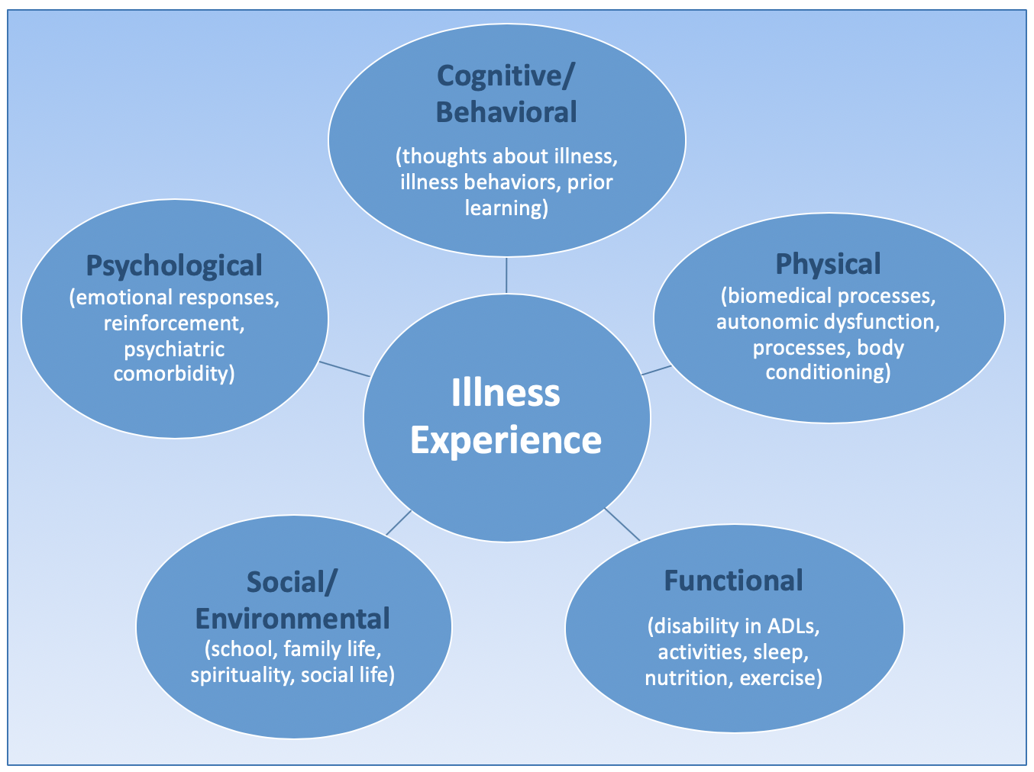
Illness Experience
Notes:
The biopsychosocial impact of living with DM.

Slide 8
Impact of DM on Social Status and Identity
Ascribed Social Status
(given regardless of abilities)
  Mother
  Wife
  Daughter
  Female
  44 year-old
  Latina
Achieved Social Status (gained through effort, talent, accomplishments)
  Friend
  Colleague
  Accountant
  Professor
  Athlete
  Author
Person with DM

Slide 9
Impact of DM on Social Status and Identity
DM contributes to identity and how one thinks about one’s self and who they are in their context of their social environment and in relationships
Diagnosis of DM after identity formation
  Difficulty accepting DM
  Cognitive symptoms may impact acceptance of DM/disability
Factors contributing to how much of an impact having DM plays on identity
  Watching others experiences of living with DM, symptoms, and change
  Social support system
  Frame of reference: illness defines/ does not define individual
  Resources
  Symptoms

Slide 10
Facilitating Social Interaction
Needs and expectations for social activities
  Caregiver
  Affected individual
Strategies for Success
  Identify and understand limitations
    Barriers
    Symptoms
    Expectations
    Communication

Slide 11
Facilitating Social Interaction
Strategies for Success
  Communication
  Planning
  Problem solving
  Goal setting
  Flexibility

Slide 12
Needs and Expectations
Caregiver needs (affected individuals do to!)
  Reasonable to need to spend time with loved ones
  Not selfish
  Health benefits
  Meaningful and important
Caregivers and affected individuals have expectations
  Normal
  Healthy
  Okay
Notes:
It is normal, healthy, and okay for a caregiver/partner/parent/sibling to want to socially interact and engage in social activities with their loved one who has DM.
Identify what’s important to you and why; communicate this in order to strategize/plan successful activities/opportunities. Expect for things to go awry. When they do, communicate how the situation impacted you and how you feel about it.

Slide 13
Strategies for Facilitating Successful
Social Interactions
Chose activities together
Flexibility
Switching between C/P
Activities are important and meaningful
  What activities are important?
  Why?
  To whom?
  Alternatives and modifications
Notes:
Chose activities together and take turns engaging in social activities. Be flexible.
Identify what you like to do, used to do, would like to do to be social with your partner/child/sibling. Name why it is important/meaningful.
Is this a reasonable activity for you both to participate?
If no, is there something similar or an alternative?

Slide 14
Strategies for Facilitating Successful
Social Interactions
Communication
Identify barriers
Planning
Problem solving
Goal setting
Flexibility

Slide 15
Communication Strategies For Success
Communication is key
  Early and frequent conversations
  Discuss expectations, needs, what you value
  Avoid surprises
  Identify disappointments outside of activity itself
  Avoid operating in “Crisis Mode”
    Heightened emotions
    Limited problem solving
    Disappointments
    Hurt feelings and misunderstandings

Slide 16
Communication Strategies For Success
“I don’t know response”
Ask for a reframe or different response
Caregivers are not mind readers
Open-ended questions instead of giving yes/no options
Give 1-2 options that work for both parties
Back-up plan if life intervenes so opportunity is not lost

Slide 17
Identify Barriers to Social Interaction
Physical barriers
  Physical symptoms
  Loss of function
  Environmental barriers
  Weather-related
  Activities are not appropriate
  Limited suitable opportunities
Can accommodations be made?
Notes:
Symptoms such as fatigue, weakness, GI, myotonia
Locations: stairs, environment too loud, too busy
Time of day
Weather

Slide 18
Identify Barriers to Social Interaction
Emotional and Cognitive Barriers
  Depression
  Anxiety
  Apathy/motivation
  Personality
  Changes in thinking, attention, processing, executive function
Changes in peer relationships
Caregiver/Partner barriers
Identity changes
Grief
What accommodations can be made?
Don’t take things personally
  Working memory- repeat
  Taking initiative- don’t wait around to be disappointed
  Alternative plans
Notes:
Depression symptoms- feeling tired, apathetic (unconcerned, unmotivated), anhedonia (no longer experiences joy from activities that once did)…. Keep asking/planning to reduce feelings of isolation
Anxious: fear of falls, saying the wrong thing, not thinking fast enough, not keeping up with conversation, difficulty eating/swallowing, hard to hear, feels overwhelmed, fear of what others will think of him/her
Does not feel like they can contribute to conversation because does not partake in certain physical activities
Cognitive barriers: changes in thinking, attention, processing speed, executive function- working memory, initiating activities, set-shifting (mental and activities)
Changes in peer relationships- friends moving on
Identity changes: diagnosis and loss of function changes how you view yourself- lowered self-esteem, lower self-efficacy
Grief- process with stages that are not linear- can move back and forth through them with every loss of function or change in relationship

Slide 19
Careful Planning is Crucial to
Successful Social Interactions
Early planning/intervention
Operating in ”Crisis Mode”
Potential possibilities
  Problem solve early
  Flexibility
Age/Developmentally-appropriate plan
Potential outcomes
  Plan solutions
  Identify alternatives

Slide 20
Facilitating Social Interaction Though
Planning and Problem Solving
Early planning/intervention
Operating in ”Crisis Mode”
Potential possibilities
  Problem solve early
  Flexibility
Potential outcomes
  Goes accordingly
  Identify alternatives

Slide 21
Facilitating Social Interaction Though
Planning and Problem Solving
Planning is an iterative process: it may take many tries
Social interaction is a developmental process
  Developing social skills may be harder for children with developmental delays
  Social skills are learned behavior and dependent on reciprocal relationships
  Inclusive activities and environments are important
Plan with interests, personalities, physical/mental abilities in mind
Beneficial to all parties
Genuine opportunities to participate
May require direct instruction or suggestions
Don’t give up too easily- avoid creating learned helplessness
Notes:
Planning is an iterative process: it may take many tries
Social interaction is a developmental process
Developing social skills may be harder for children with developmental delays
Social skills are learned behavior and dependent on reciprocal relationships
Inclusive activities and environments are important- provide opportunities for children and adults with dev. Delay or disability to learn from pears and for adults to enhance intrpersonal skills and increase social interactions
Plan with interests, personalities, physical/mental abilities in mind
Plans should be beneficial to all parties
Genuine opportunities to participate- not just off to side (kids/video games)
May require direct instruction or suggestions for activities
Children and adults with DM (and perhaps parents, partners, caregivers) need additional gentle insistence (don’t give up too easily or quickly).
Don’t give up too easily- avoid creating learned helplessness

Slide 22
Goal Setting
Make goals broad so that can be successful
Be open to change- flexible
Make short and long term goals
Define success (e.g., participate in social activity once a week, once a month)
Re-evaluate goals and success definitions with new information and/or changes in circumstance
Don’t engage in either/or thinking, ”I have to,” or “I should” (that’s being too hard on yourself and others!)
  When X does not occur, there is a negative impact and it sends the message to self/others of failure, which can be internalized
  Leads to “Why bother” thinking
Identify at least one positive related to every stage/attempt at social activity
  Always a success
  Allows for forward movement and additional opportunities
Avoid comparing interactions/activities and circumstances to previous interactions/circumstances/people- this is not helpful

Slide 23
Facilitating Social Interaction
Flexibility is an important aspect when adapting to change
Lower expectations
Repeat, repeat, repeat!
Try out different strategies- not everything works for everyone

Slide 24
Questions?
Thank you
Missy Dixon, PhD, MS
Visiting Assistant Professor
University of Utah | Department of Pediatrics
Missy.dixon@genetics.Utah.edu

