Slide 1
MDF Myotonic Dystrophy Day Management of Breathing
Ericka Simpson, MD
In honor of
Venessa Holland MD MPH PA
May 18, 2019
Houston Methodist Neurological Institute

Slide 2

Venessa Holland, MD

Slide 3
RESPIRATORY MUSCLE IMPAIRMENT
Early identification of weakness
  Provide symptom relief
  Improve quality of life
  Prolong life

Slide 4

Mechanics of Respiration
<iframe width="560" height="315" src="https://www.youtube.com/embed/MPovpAXcmIU" frameborder="0" allow="autoplay; encrypted-media" allowfullscreen></iframe>
https://youtu.be/MPovpAXcmIU
Notes:
The diaphragm is the major muscle of inspiration and accounts for approximately 70% of the inhaled tidal volume in the normal individual.
Contraction of the diaphragm results in a downward piston motion of the muscle as well as outward and upward movement of the ribs through the zone of apposition
The intercostal muscles are thin sheets of muscular fibers that run between the ribs in the costal spaces. 8 There are 2 sheets of muscle fibers, the external and internal intercostals. The external intercostals function to expand the rib cage during inspiration. The internal intercostals are deeper and function to decrease rib cage size during expiration. The orientation of the muscle fibers with respect to the ribs results in the increase or decrease in the size of the rib cage, as the muscles contract (The abdominal muscles (rectus abdominis, internal
oblique, external oblique, and transversus abdominis) serve several functions in respiration that mainly assist expiration but also can function in inspiration.
The muscles of the upper airway are also considered muscles of respiration because they maintain patency of the upper airway and allow air to flow into and out of the lungs without interruption. 10 These muscles are innervated by cranial nerves V, VII, and IX–XII. The central control centers for these muscles are the same as those described previously for the more commonly considered ventilatory muscles.

Slide 5
MOST COMMON SYMPTOMS OF RESPIRATORY WEAKNESS
Feeling like you can not get enough air
Shortness of breath and sweating
Speech problems
Coughing when eating or swallowing

Slide 6
MOST COMMON SYMPTOMS OF RESPIRATORY WEAKNESS
Weak cough with increased secretions
Inability to clear secretions
Feeling tired and fatigued
Waking up often when you sleep

Slide 7
CLINICAL SIGNS OF INSUFFICENT VENTILATION
Dyspnea - shortness of breath
Orthopnea - shortness of breath when lying flat
Rapid shallow breathing
Accessory muscle use
Thoracoabdominal paradox - inward movement of abdomen during inspiration
Hypercapnia - elevated carbon dioxide in blood
Hypoxemia - low oxygen level

Slide 8
CLINICAL SIGNS OF INSUFFICENT VENTILATION
NOCTURNAL HYPOVENTILATION
  Choking
  Insomnia - can not sleep
  Daytime Hypersomnolence - excessive sleepiness during the day
  Morning Headaches
  Fatigue
  Impaired Cognition

Slide 9
CLINICAL SIGNS OF OROPHARYNGEAL MUSCLE IMPAIRMENT
  Difficulty swallowing
  Difficulty clearing throat or coughing
  Nasal regurgitation of food or liquids
  Weak chewing
  Protruding tongue

Slide 10
CLINICAL SIGNS OF OROPHARYNGEAL MUSCLE IMPAIRMENT
Difficulty speaking
  Nasal speech (palatal muscle weakness)
  Low Intensity ( hypophonia)
  Prolonged speech intensify symptoms

Slide 11
CLINICAL SIGNS OF RESPIRATORY MUSCLE IMPAIRMENT
INEFFECTIVE COUGH (COMPLICATIONS)
  Aspiration of contents in mouth/throat into lungs
  Retention of secretions or inability to swallow (drooling)
  Pneumonia due to accumulation of secretions/bacteria
  Atelectasis or Lung collapse with poor oxygen intake and poor carbon dioxide exit

Slide 13
Pulmonary Functions at Onset of
Breathing Weakness
Cho, et al. Ann Rehabil Med 2016;40(1):74-80
Notes:
A total of 156 patients were included in the present
study, of which 94 had DMD, 41 had ALS, and 21 had
MMD. The mean age of the patient groups was 18.1, 55.9,
and 42.7 years, respectively, with significant differences
among the 3 groups (Tables 1, 2). There were 17 male patients
with ALS (41.5%) and 11 with MMD (52.4%) (Table 1).
The maximal value of pCO2 throughout the continuous
monitoring during nighttime sleep showed no significant
group-wise differences. The mean saturation of peripheral
oxygen was lower in the MMD group than in the
other 2 groups. The mean saturation of peripheral oxygen
was significantly lower in MMD patients than in DMD
patients (p=0.045).
MIP and MEP were also significantly higher in MMD
patients than in the other groups. MEP was significantly
lowest in DMD patients, followed by ALS patients, and
MMD patients, in order.
In DMD patients, MEP was significantly lower than
MIP regardless of the position (MEP in sitting position
=15.4―
In the present study, MMD patients showed earlier
ventilatory insufficiency than the other 2 patient groups
despite their well-preserved pulmonary functions. This
result is in agreement with that of a previous study, which
suggested that ventilatory insufficiency could occur when
respiratory muscle weakness is not pronounced in MMD
patients [11]. Our study also showed that many parameters
other than FVC (e.g., MEP, MIP, or PCF) are better
preserved in MMD patients, as compared with the other
2 patient groups.
There are 2 main reasons other than respiratory muscle
weakness for such disproportionate rates of ventilatory
insufficiency in MMD patients. First, delayed relaxation
may occur in the respiratory muscles as it does in other
muscles in MMD patients. One study verified the delayed
relaxation of the diaphragm using fluoroscopy [12], and
another confirmed the myotonic movement of the respiratory
muscles, including the diaphragm, through electromyography
[11,13]. Another possibility is that MMD
patients have trouble with central respiratory control [14].
One study suggested that the high incidence of ventilatory
insufficiency in MMD patients is related to a decreased
hypoxic ventilatory response due to an underlying neurogenic
deficit [15]. Another study suggested that neuronal
loss in the medullary arcuate nucleus is associated with

Slide 14
DIAGNOSTIC STUDIES
Blood Gas
Imaging Testing
  Chest x-ray
  CT of chest
  MRI
  Doppler of lower extremities

Slide 15
DIAGNOSTIC STUDIES
Most common diagnostic tool to evaluate respiratory muscle weakness
Pulmonary Function Testing
  FEV1, FVC, FEV1/FVC
  NIF and VC
  MIPS and MEPS

Slide 16
PULMONARY FUNCTION STUDIES
Forced Expiratory Volume 1 (FEV) - the amount of air that can be exhaled in 1 second
Forced Vital Capacity (FVC) - the maximum amount of air blown out from full inspiration with maximal speed and effort
Vital Capacity (VC) - the maximum amount of air blown out from full inspiration

Slide 17
PULMONARY FUNCTION STUDIES
Negative Inspiratory Force (NIF) - measurement of respiratory muscle weakness
Maximum Inspiratory Pressure (MIP) - measures strength of diaphragm
Maximum Expiratory Pressure(MEP) - measures strength of abdominal muscles and other expiratory muscles

Slide 18
NONINVASIVE VENTILATION
DURING RESPIRATORY COMPROMISE

Slide 19
RESPIRATORY SUPPORT
BIPAP – Bilevel Positive Airway Pressure
BIPAP/ST- Bilevel Positive Airway Pressure/Spontaneous - Timed
AVAPS – Average Volume Assured Pressure Support (Set by the operator)
IVAP – Intelligent Volume Assured Pressure Support (Height, RR and Target Alveolar ventilation)

Slide 20
TREATMENT GOALS NIV
LUNG VOLUME RECRUITMENT
Problem | Solution
Slow decline in VC | Augment lung volumes
Prevent microatelectasis | Positive pressure to recruit alveoli
Improve lung compliance | Decrease atelectasis
Improve cough effectiveness | Volume expansion and increase peak expiratory flow
Correct V/Q mismatch | Through alveolar recruitment
Notes:
When treating ALS with NIV, you are trying to expand the lungs. Any of these 5 problems may cause the lungs to not expand enough. With the addition of NIV, you will then be providing a solution for each issue.

Slide 21
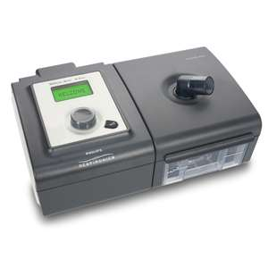
BIPAP/AVAPS

Slide 22
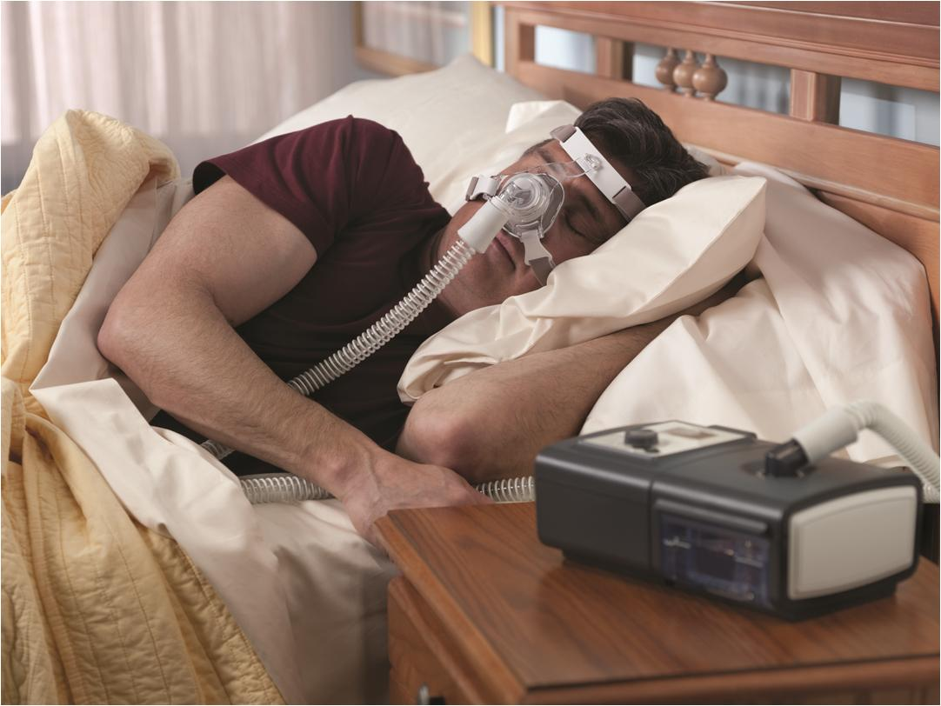
Notes:
Most of those that are surviving greater than 10 years have chosen to use NIV when offered NIV therapy as an early option.

Slide 23
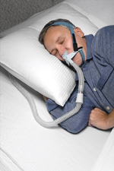
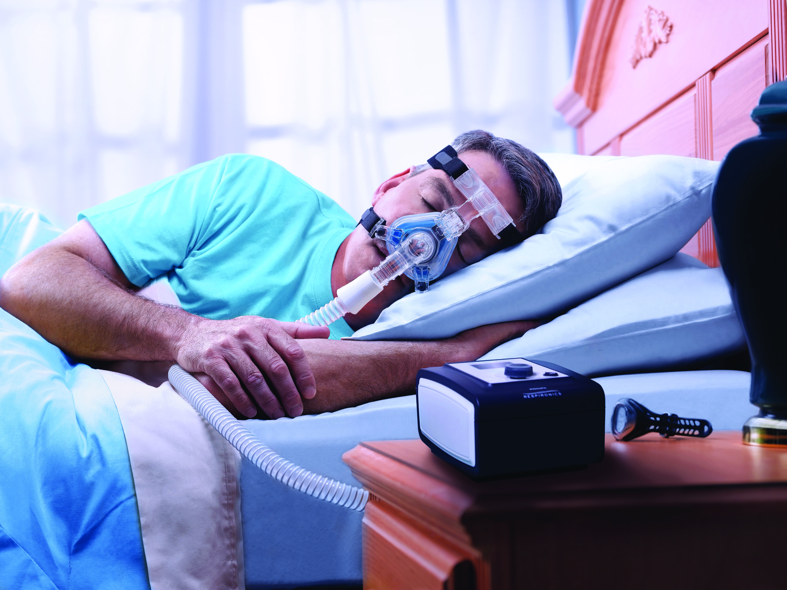
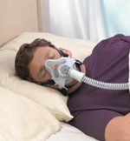
MASK SIZE AND FIT
Properly size and fit the patient
Nasal pillows
Nasal mask
Full-face masks
Notes:
Proper selection and fitting of the patient interface is extremely important. There are several types of interfaces that are available, from nasal pillows to nasal and full face masks. Nasal masks are the most commonly used mask and generally well tolerated for nocturnal noninvasive ventilation. There are numerous brands and sizes available to choose from. The choice of interface depends on many dynamics, including patient and clinician preferences, patient facial characteristics and mask availability and costs. Many times, patients will need to try several options before they find the interface that provides the best fit.

Slide 24
RESPIRATORY FAILURE
ELECTIVE INTUBATION
VC less than 15 - 20 ml/kg
NIF less than - 25 – 30 cm H20 pressure
Unable to clear secretions - poor cough
Clinical signs of respiratory distress
Difficulty swallowing or speaking
PCO2 above 50

Slide 25
WEANING FROM INTUBATION
Muscle strength has to be improved
VC is > 15 ml/kg and NIF > 30 after improvement with treatment
Able to handle oral secretions
Ability to follow commands
Ability to cough
Satisfactory weaning parameters
Cuff leak

Slide 26
FACTORS CONTRIBUTING TO REINTUBATION
Lower VC at time of extubation
Atelectasis
Underlying lung disease
Need for continuous noninvasive ventilation after extubation due to exacerbation of MG
Aspiration
Ineffective cough
High oxyen requirement
Elevated pCO2

Slide 27
RESPIRATORY SUPPORT
SYSTEMS
Airway Clearance
  Suction machine
  Cough assistance device
  Vest
  Metaneb
  Bronchodilators with nebulizer or metaneb
  Albuterol
  Mucolytics

Slide 28
METANEB SYSTEM

Slide 29
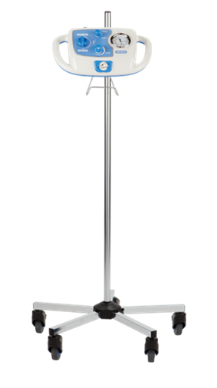
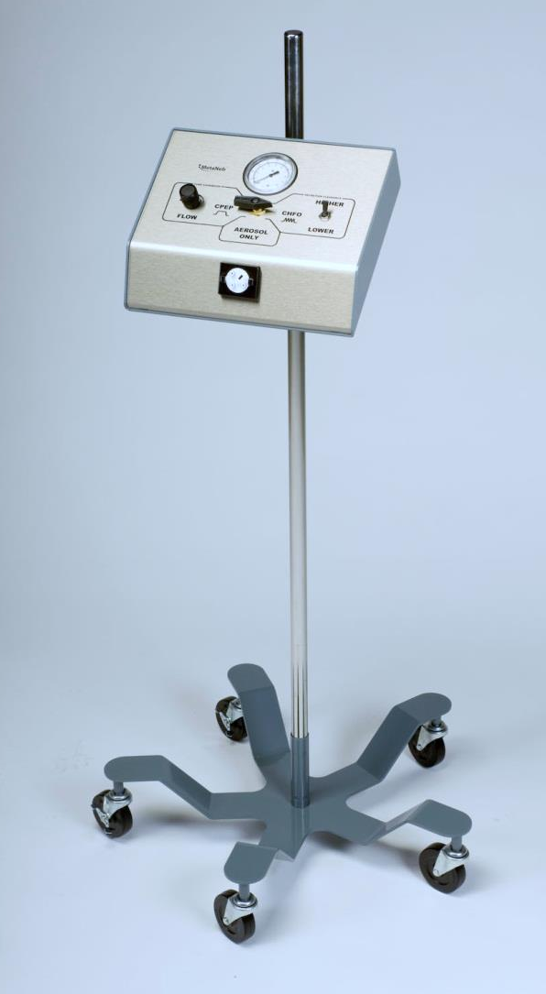
The MetaNeb® Systems
The MetaNeb® 3.0 System
The MetaNeb® 4.0 System
Page
29
Notes:
Here is the original MetaNeb® 3.0 System that’s currently being utilized by our customers.
We are excited to announce the Launch of our newest generation device, The MetaNeb® 4.0 System, which offers a number of advantages as compared to The MetaNeb® 3.0 System. Throughout this presentation, I’ll point out differences between the two devices.

Slide 30
METANEB THERAPIES
Continuous Positive Expiratory Pressure
  Lung expansion for treatment and prevention of atelectasis
Continuous High Frequency Oscillation
  Secretions mobilization therapy
Aerosol Mode
  Aerosol therapy (inhalers or nebulizers)
  Provides supplemental oxygen when needed

Slide 31
The MetaNeb System
Absolute Contraindications
Relative Contraindications
Possible Adverse Reactions
Untreated tension pneumothorax
Untrained or unskilled operator
History of pneumothorax
Pulmonary air leak
Recent pneumonectomy
Pulmonary hemorrhage
Myocardial infarction
Vomiting
Hyperventilation
Gastric distension
Decreased cardiac output
Increased intracranial pressure
Increased air trapping
Hyperoxygenation
Pneumothorax
Pulmonary air leak
Pulmonary hemorrhage
Notes:
There are absolute contraindication for airway clearance which are listed
And for the MetaNeb System which are listed
We have listed some relative contraindications specific to the MetaNeb System
These reflect conditions that should cause pause since it is a prescription device the physician must weigh the benefit against any risk to the patient.

Slide 32
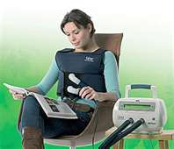
THE VEST

Slide 33
VEST THERAPY
Increase airflow in lungs
Creates cough like forces
Decrease secretion thickness
Helps move secretions from smaller airway to large airways for clearance

Slide 34
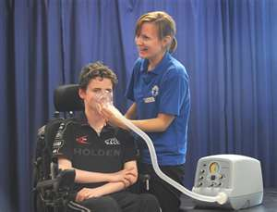
COUGH ASSIST DEVICE
MECHANICAL INSUFFLATOR- EXSUFFLATOR

Slide 35
RESPIRATORY PROTECTION
MECHANISMS
VACCINATIONS( if not contraindicated)
  FLU
  PNEUMOVAX( Pneumovax 23 and Pneumovax 13)
  SHINGLES
HAND WASHING
AVOID OF CROWDS - during respiratory season

