Slide 1
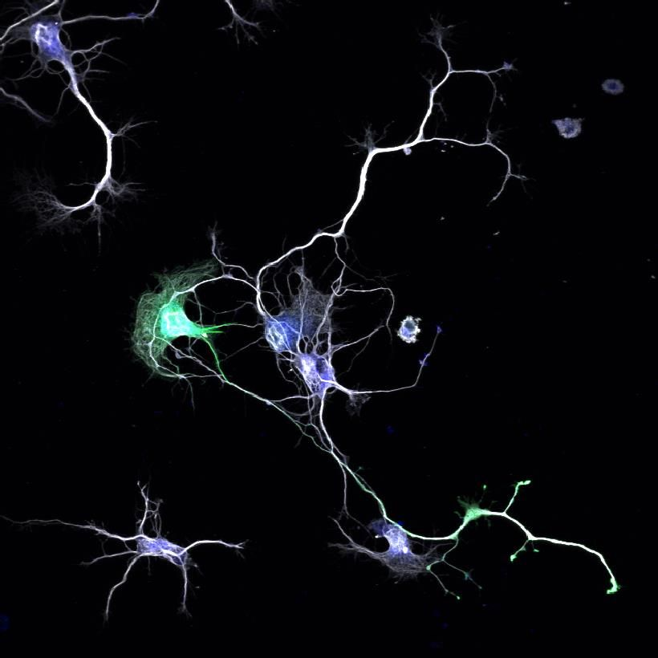
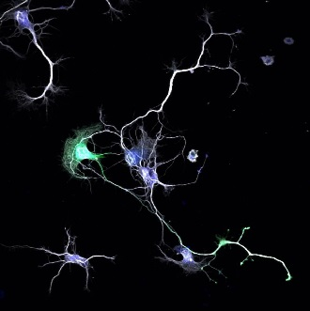
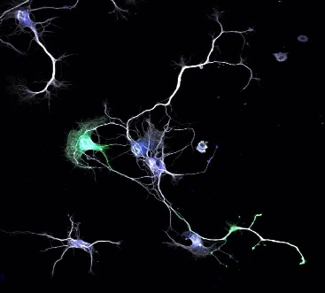
Serendipity, Security, Survival
Optimizing the evaluation & management of the Myotonic Dystrophy Patient
Ericka Simpson, MD
Director, DM Multidisciplinary Clinic
Director, Neuromuscular Clinical Research
May 18, 2019

Slide 2
Never again….
42y.o DM 1 patient brought for follow up by non affected father to clinic. In wheelchair but unable to wake up for evaluation.
Slurred speech, lid drooping and general weakness. Had not seen cardiologist or pulmonologist as referred, nor had lab work completed.
Exam significant for “blue’ fingers and lips, lower extremity +++ edema and heart rate in 40’s (normal is >60)
Refused admission to hospital for expedited work up. Died in sleep a few days later.

Slide 3
Myotonic Dystrophy Multidisciplinary Care Clinic (MDMCC)
Mission and Vision
Improve Access to Care
Improve Quality of Life and Survival
Excellence in
Clinical Care
Clinical/Translational
Research
Education/Training
Notes:
To provide high quality, cost-effective health care that delivers the best value that delivers the best value to the people we serve in a spiritual environment of caring in association with internationally recognized teaching and research”
“People will seek Methodist as a globally recognized leader of pioneering medical expertise and innovative, personalized care.”

Slide 4
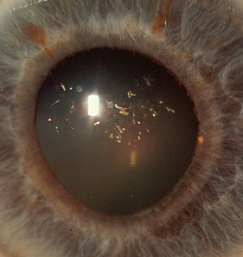
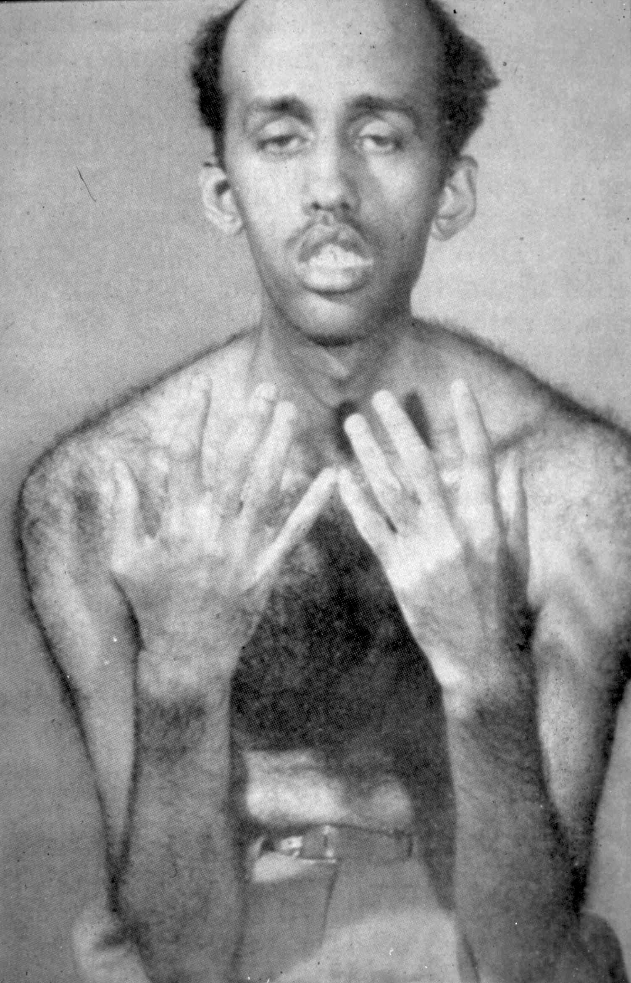
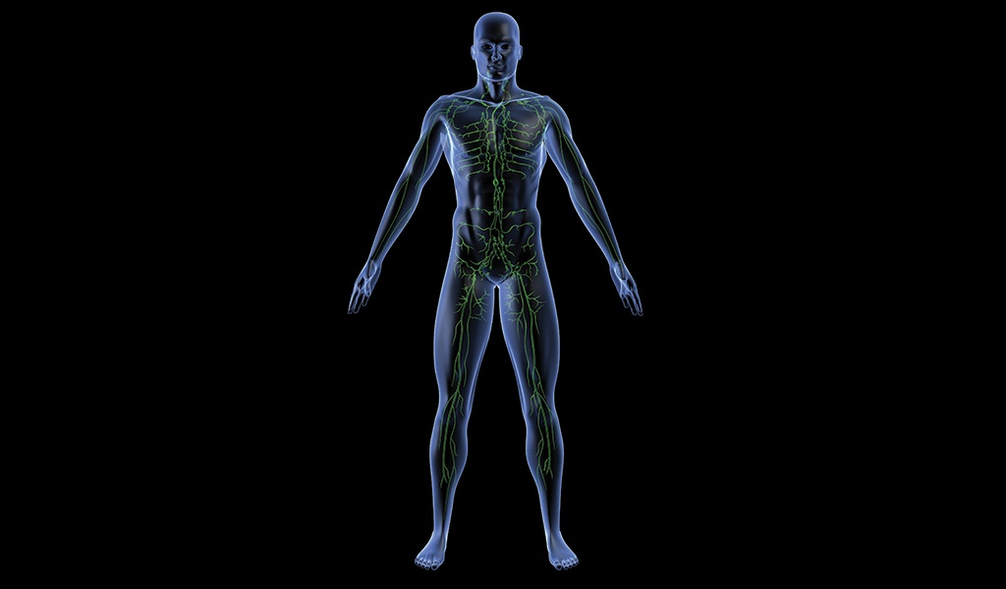
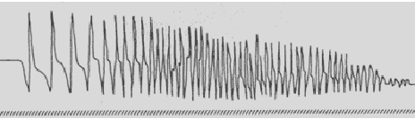
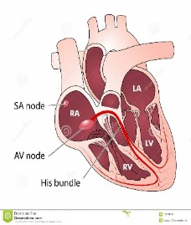

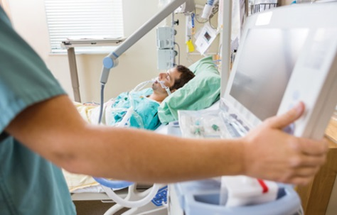
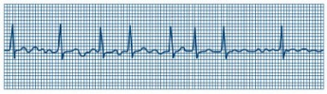
Myotonic Dystrophy is a Multisystemic Disease
Cataracts
Facial weakness/ptosis
Temporalis & neck muscle atrophy
Bulbar muscle weakness
Distal muscle weakness and atrophy
Percussion or grip myotonia
Muscle
Gastrointestinal System
Dysmotility, cholelithiasis
Endocrine System
Insulin insensitivity, testicular atrophy
Immune System
Hypogammaglobulinemia
Bone
Hyperostosis frontalis
Skin
Multiple pilomatricoma
Others
Peripheral neuropathy, Hearing loss
Other Tumors/Cancer
EMG
Internal nuclei, Fiber size variation,
Type 1 atrophy, Sarcoplasmic mass
Ring fibers
Myotonia, Myopathic units
Respiratory
Weak breathing muscles, decreased respiratory drive (enhanced by anesthesia)
Cardiac
Cardiac arrhythmias and CHF
Notes:
70% of mortality attributed to cardiorespiratory dysfunction in DM1.
Up to 32% of MD patients with a normal ECG may have arrhythmias
and conduction abnormalities detectable on Holter monitoring

Slide 5
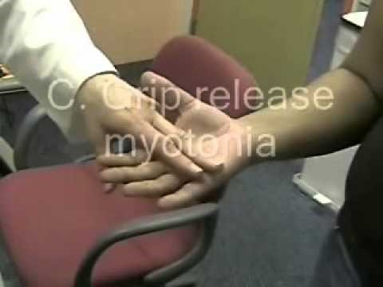
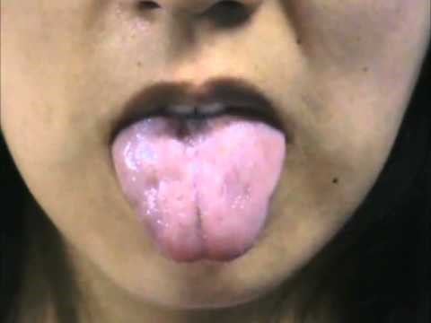
Myotonia：
ミオトニー

Slide 6
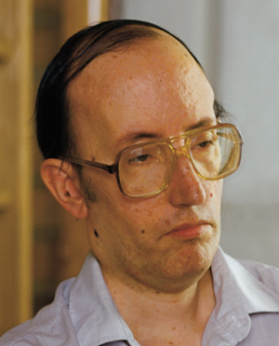
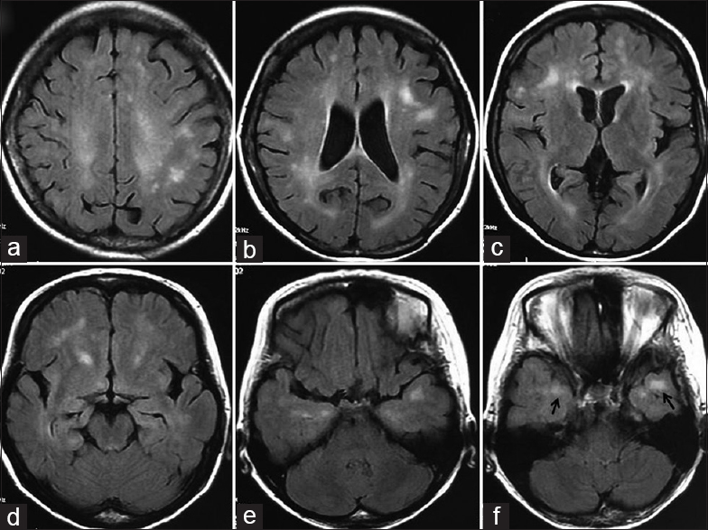
Brain：
Frontal lobe dysfunction
  Judgment
  Memory speed/concentration
Intellectual development in congenital & childhood cases)
Sleep disorders (excessive sleepiness)
  Central & obstructive sleep apnea

Slide 7
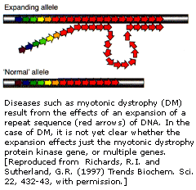
Myotonic Dystrophy
Gene mutations
Two known mutations
  DM 1 : expansion of CTG repeats of DMPK gene
  DM 2 : expansion of CCTG repeats within the first intron in the ZNF9 gene.
Normal CTG repeat size : ≤ 35
Notes:
Steinert discovered in 1992 –expansion of an unstable CTG repeat in the 3’untranslated region of the MD proteinkinase gene which codes for myosin kinase expressed in skeletal muscle on Chrom 19. DM2 CCTG discovered in 1994=unstable tetranucleotid repeat in intron 1 of nucleic acid binding protein CNBP gene (or zinc finger nine gene ZNF9) on chrom 3.
DM1 most common in European descent , is present in Japan half frequency, and rare still in India.
DM1 50-4000 repeat size symptomatic (some <60 are asymptomatic) and other >500 asymptomatic until later age.
Premutation alleles 38-50 and Protomutation 50-100-*instability toward expansions and at high risk for having children with large expanded repeats. >2000-CDM
Repeats are unstable
variation in different tissues and cell types –somatic mosaicism
size of repeat tends to increase over time in same individual and across generations (anticipation) *especially from mother
may have contraction in about 6.4% of transmissions-commonly in paternal transmission.
Because of somatic mosaicism, repeat size correlates more with age of onset and severity when below 400. This correlation is seen in blood PBML repeats than other tissues. (muscle lengths much longer than PBML”s length w/o correlation with repeat size in muscle with degree of weakness)
DM2
CCTG tract is normally interrupted by 1 or more CCTG, TCTG, ACTG motifs. Not interrupted in diseased expanded alleles.
<30 CCTG normal
Huge repeats in patients with sizes >11-15,000.
Marked somatic instability
Increase in size over time in same individual so not sure what threshold is for disease causing size
Somatic mosaicism over time across and within tissues, cells
These repeats typically contract in next generations and may explain no Congenital forms, no anticipitation and later onset.
Size of repeat in PBML seems to correlate with age of onset and not severity
Most European causcasions and northern European & Eastern europena descent.

Slide 8
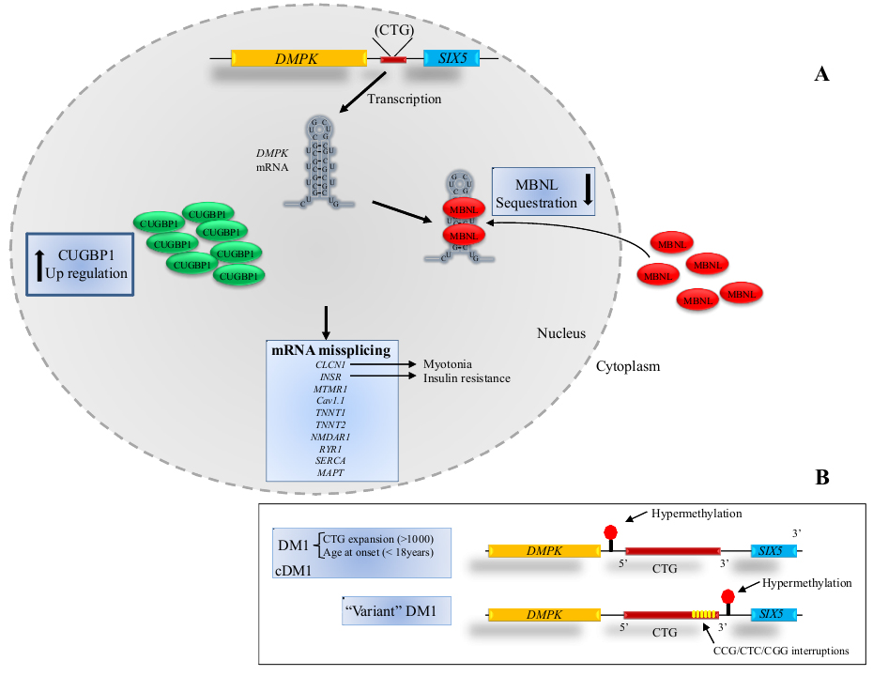
DM 1
Myotonia
Insulin resistance
Cardiac conduction defects
CNS-cognitive, MR
Muscle weakness/wasting
Myotonia
Insulin
resistance
Cardiac
Conduction
defects
Cognitive
Mental Retardation
Muscle weakness/
wasting

Slide 9
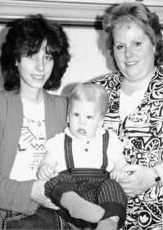
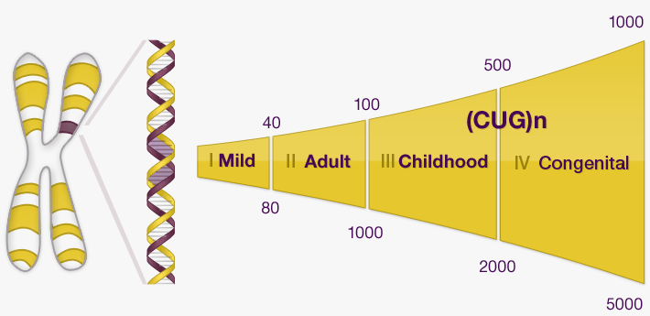
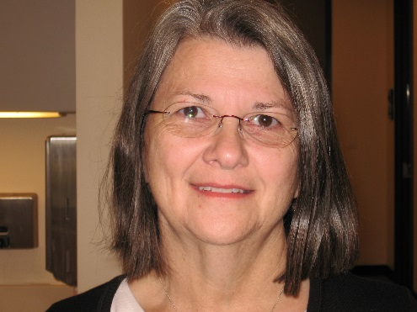
Myotonic Dystrophy
Age of onset and severity related to size of CTG repeat at birth or “anticipation”
Congenital (maternal)
Childhood
Adulthood
Late Adulthood/asymptomatic
Cataracts, myotonia
60 CTGs
Adult-onset
160 CTGs
Congenital
983 CTGs
Age of Onset Inversely Correlates with CTG Repeat Size
(CTG)n
3000
2000
1000
0
64 CTG repeats
+ family history
0 10 20 30 40 50 60 70 80
Age of onset
Notes:
Congenital DM1 pre-polyhydramnios, reduced fetal movements, post-hypotonia, weakness, respiratory issues. Fished shaped mouth or inverted V shaped upper lip
Mortality is high initially but if survive improve in motor function and all end up able to walk. Significant cognitive /motor delays with LD, special education. Mytonia not a feature clinically or electrically. Severe cardiorespiratory dysfunction in 3rd, 4th decade of life.
Childhood DM1: onset is often missed in adolescents due to ‘negative’ family history or uncharacteristic features. Cognitive deficits, learning abnormalities. Heart conduction abnorm. And annual EKG and EP stuies are routine.
Adult onset DM1: core feature is distal weakness, myotonia with difficulties performing fine motor dexterity and foot drop. Facial weakness with ptosis, ‘hatchet’ face, NF, FF,WF weakness
DCM, arrhythmias, conduction block, posterior subcapsular cataracts. CNS- changes with neuroimaging are common. Hypersomnolence, apenea. GI –IBS, symptomatic gall stones, fatty levier, endocrine w/ testicular atrophy, low T, insulin Resistance
Late onset myotonia, weakness, EDS are rarely present
DM1 most common in European descent , is present in Japan half frequency, and rare still in India.

Slide 10
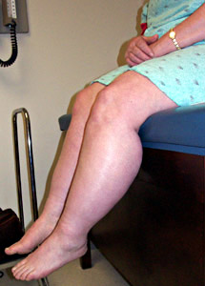
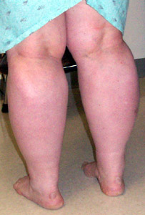
DM2
Adult onset: median age 48 (13-67 yrs)
Early shoulder and hip involvement; No facial weakness or atrophy. Calf enlargement
Muscle Pain or Discomfort in 56%
Extramuscular involvement (milder)
Notes:
Prevalence is not well established estimated as similar to DM1 in European populations (no congenital forms)
DM 2 : expansion of CCTG repeats within the first intron in the ZNF9 gene on chromosome 3.
Most families European, especially German/Polish
Anticipation⁶
Mild: 0.5 to 1.9 decades (vs 2.9 decades in myotonic dystrophy)
Unclear correlation between repeat length & disease severity
Homozygous for CCTG repeats: Not different from heterozygotes²⁸
Respiratory is not major problem
Clinical myotonia 75%; electrical myotonia 95%; Greater complaint of muscle pain, (yield for e- myotonia best if test proximal muscles
Endocrine abnl common (↑ diabetes in DM2-20%)
Incidence of cardiac disease is less than DM 1 but still requires surveillance (arrythmias 20%)-limited to 1st heart block or bbb
CNS disease less common and association with mutation not defined (increased somnolence)-less.
Cataracts same as in DM1(100% in 2 yrs) early onset <50yrs
*Large phenotypic variability, large number undiagnosed, or misdiagnosed as fibromyalgia. And if after age 70, may never be referred to neurology
CCTG tract is normally interrupted by 1 or more CCTG, TCTG, ACTG motifs. Not interrupted in diseased expanded alleles.
<30 CCTG normal
Huge repeats in patients with sizes >11-15,000.
Marked somatic instability
Increase in size over time in same individual so not sure what threshold is for disease causing size
Somatic mosaicism over time across and within tissues, cells
These repeats typically contract in next generations and may explain no Congenital forms, no anticipitation and later onset.
Size of repeat in PBML seems to correlate with age of onset and not severity
Most European causcasions and northern European & Eastern europena descent.

Slide 11
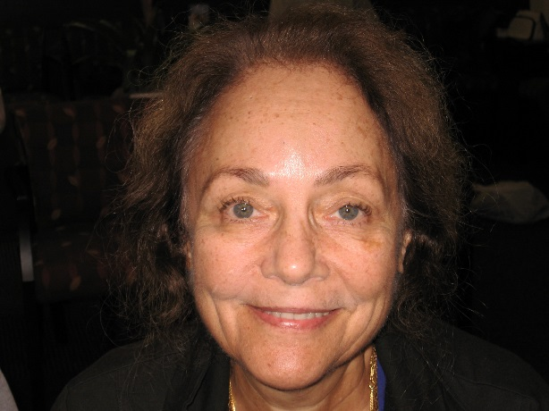
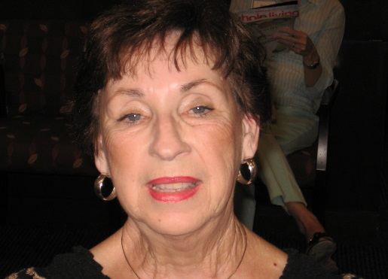
DM1 DM2
Inheritance dominant dominant
Anticipation +++ +(?)
Congenital form Present Absent
Childhood form Present Rare
Hatchet face Present Rare
Muscle weakness
facial ++ +
neck ++ ±
distal limb ++ +
proximal leg + ++
Progressive weakness + +
Muscle pain ± +
Calf hypertrophy - +
Distal muscle atrophy ++ ±
DM1 DM2
Cardiomyopathy + +
Cataracts + +
Frontal balding ++ +
Testicular atrophy ++ +
Insulin insensitivity ++ +
Gall bladder disease ++ +
Other GI dysmotility + +
CNS dysfunctions ++ +
Brain WM disease + +
Elevated CK + +
Elevated GGT + +
Immunoglobulin↓ ± -
Autoimmunity - +
Hair follicle tumors ± -
Cancer + +
DM2
DM1
CCTG 15,720 repeats
Myotonia in hands age 56
246 CTG repeats
-calf pain age 61

Slide 12
Prognosis
Cardiorespiratory failure 70%
  Mean age at death 53
  40% Respiratory Failure (Lungs)
  30% Cardiac (Heart)
  Predictors: older age, male gender, ECG conduction defects
  *Arrhythmias most common cardiac manifestation
Surface ECG findings correlate most closely to clinical events and can predict sudden death
Notes:
Meta – analysis of 1828 MD patients.

Slide 13
Myotonic Dystrophy
Recognize, Diagnose, Treat
“The faculties developed by doing research are those most needed in diagnosis.” Frances. Heed Adler
“Nowadays the clinical history too often weighs more than the man.” Martin Fischer

Slide 14
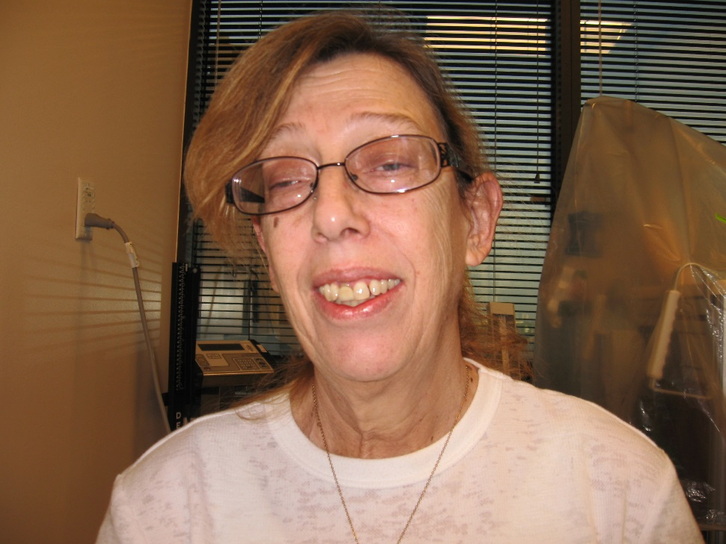
Serendipity
The Undiagnosed
57y.o presented to charity clinic for groin pain.
  impaired grip release since childhood, inability to walk on toes x 7 yrs., and choking.
  Father with DM1, daughter with ptosis, grandson with Asperger’s
Referred to multidisciplinary MDA clinic for care and evaluation of newly diagnosed DM. EMG in clinic showed myotonia.
Enrolled in Transcranial Magnetic Stimulation Study at HMH

Slide 15
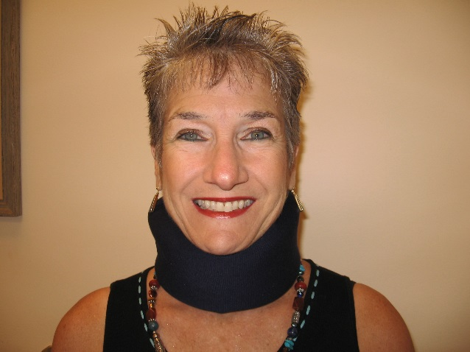
Serendipity
“Never heard of it…”
55y.o patent lawyer without symtpoms had incidental elevated liver function tests in 2001. History of congenital cataracts & unable to conceive
Had liver biopsy. Muscle biopsy ( CK) & EMG (myotonia) led to diagnosis of DM2 2008
Family history-father with pacemaker, cataracts & died in 40’s and uncle with pacemaker in 40’s
Now has neck weakness, fatigue. Cataract removal 2013
>15,000 CCTG repeats
-elevated liver enzymes age 48

Slide 16
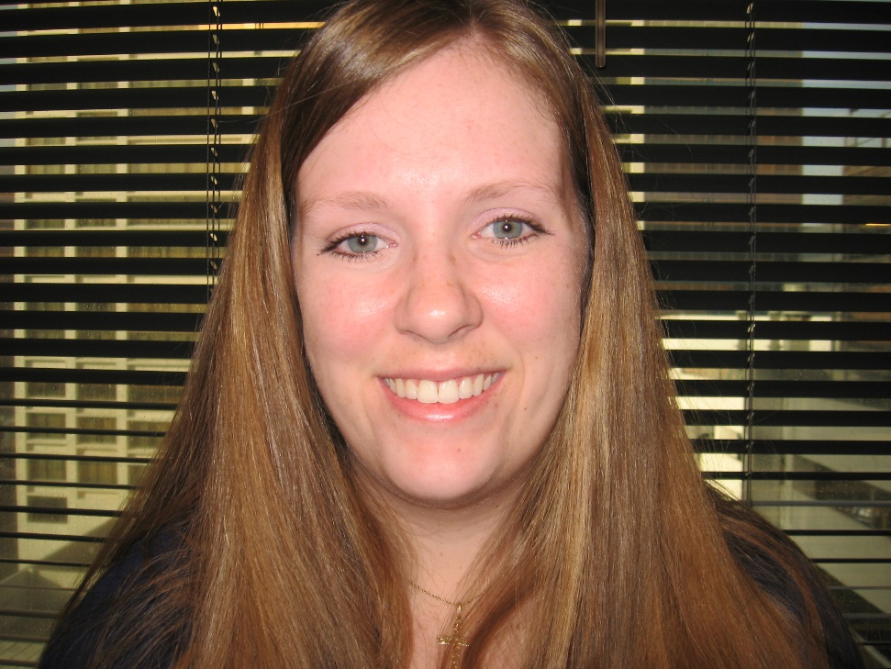
Security
Loss to Follow up
26.yo. Diagnosed with DM age 16 due to myotonia. No known family history
First evaluated at 21yr while in school.
Returned 2yrs later married. Working at physical therapist.
Pregnant with twins through in vitro selection for unaffected embryo’s
314 CTG repeats

Slide 17

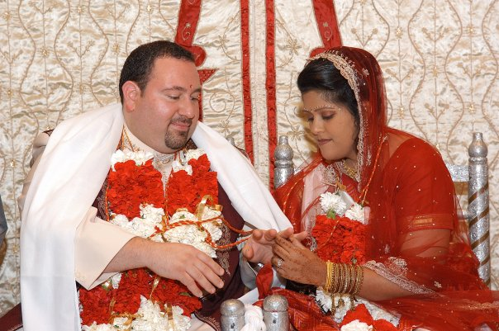
Security
A child is born….
37y.o woman diagnosed after giving birth to son with congenital DM
Had grip myotonia in 20’s. and cataract removal age 34
Mother (67) –diabetes, cardiac arrhythmia
Terminated 2nd pregnancy (CTG>2,500)
Trying to adopt
400 CTG repeats

Slide 18
Recognize, Diagnose, Treat
The Challenges
Patient
Nonspecific, minimal symptomatology
No known family history
Access to general care, resources
Physician/Health Care
Clinical experience, knowledge, time
Access/knowledge of diagnostic resources
Referral to specialty clinic/physician/research centers

Slide 19
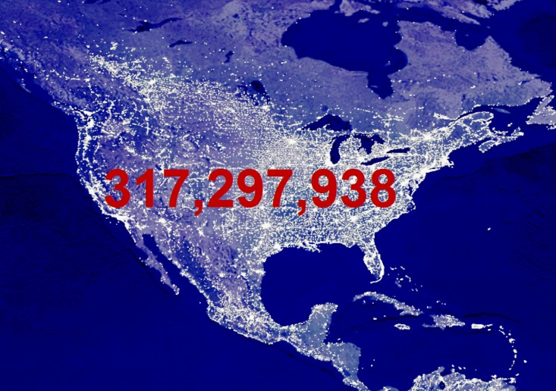
US Prevalence Estimate
Prevalence 15 out of 10³
≈ 50,0000 US
≈ 4000 Texas
≈ 400 Houston
Estimated large number of undiagnosed and/or unmanaged patients
Notes:
Estimated prevalence is 1/8000
DM1: congenital, childhood, adult onset, late onset/asymptomatic

Slide 20
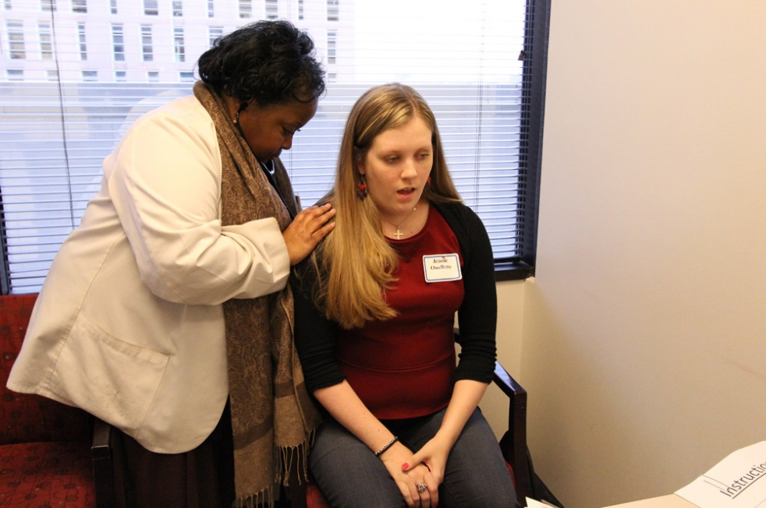
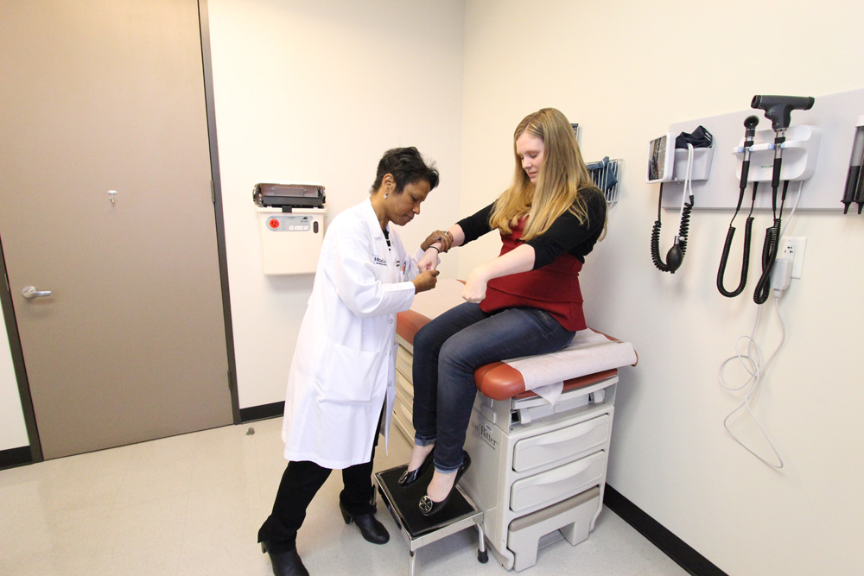
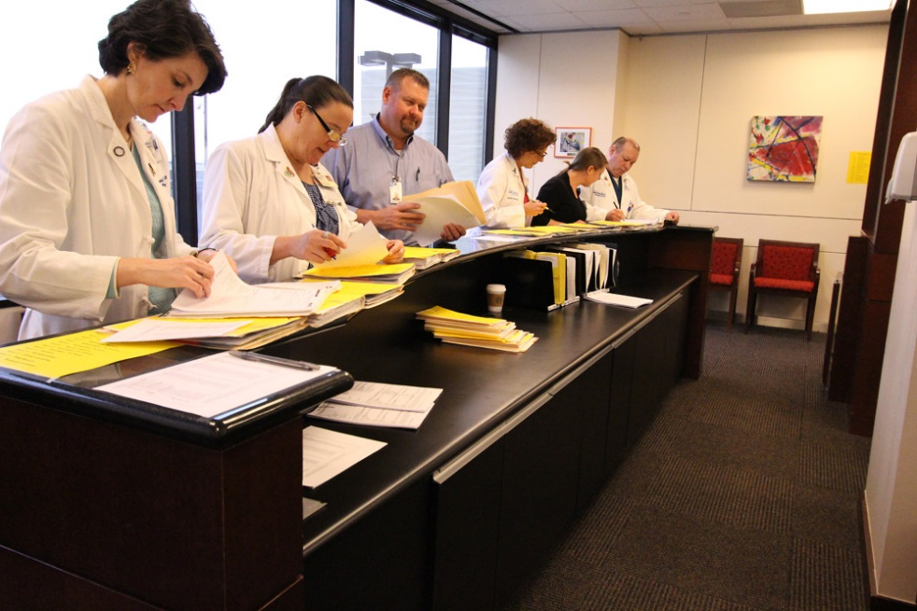
Myotonic Dystrophy Multidisciplinary Care Clinic (MDMCC)
14 Team Members
-Neurology (3)
-Cardiology
-Pulmonology
-Neuropsychology
-Allied Services (SW, OT, PT, RT, Nutrition)
-Research
-MDA HSR

Slide 21
Clinical Care Guidelines
Annual ECG, Echo/Holter/Imaging (q2-3yrs)
Biannual PFT (MIP, MEP)
Baseline Sleep study screen
Annual FBS, HbA1C, Thyroid function
Promote general health, cancer screen
Speech/Swallowing/Nutrition
Social services and rehab/DME
Research

Slide 22
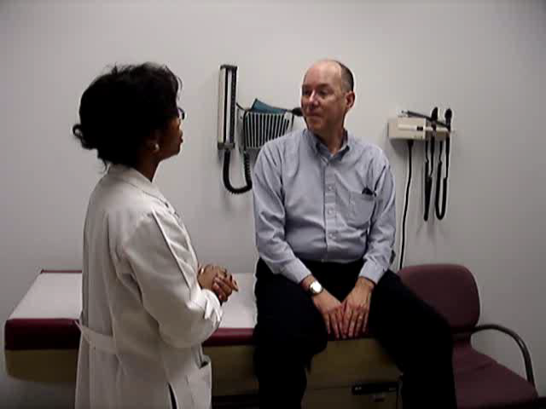
Progress
Clinic occurs quarterly
22-30 patients/ clinic (two cohorts)
Increased numbers related to family members, referrals, etc.
42% increase in # of patients evaluated since 2007

Slide 23
Cohort of 37 patients (22-female; 15-male, average age 48.8 years)
94% have DM1

Slide 24
Impact?
35 y.o man with DM 2 dx 1999
Father died dementia; brother died 50’s from chest pain, falls
  2005-Substitute teacher, married, smoker; EKG LBBB, TSH, A1c nl. FVC 64%
  2006-pizza delivery, FVC 57%
  2008-OSA; EKG LBBB, 1◦ block, GTT nl; night store manager
  2009-Gallstones, fatty liver, elevated LFT’s. FVC 45.7%
  2010-AFO’s cane, falls, cataracts
  2011- FVC 39%; uses BIPAP 2-3hrs/day; +chest pain, DOE; DM II; applying for disability; EKG IVCD, LBBB, 1◦ block
  2012: cholecystectomy, jaundice, DM II , not using BiPAP, multiple falls, not working; EKG IVCD, LBBB, 1◦ block
  2012-2015 lost to follow up
  2015-seen in clinic wheelchair dependent; EKG, Holter + brady cardia & 2 ◦ block-Pacemaker placed April 2015.
2016-diagnosed with parathyroid cancer; w/c dependent. Continues follow up with wife in clinic

Slide 25
Research Progress
Research Updates
  Tetsuo Ashizawa, MD
Clinical Natural History Study
  Sharon Halton, CRC

