Slide 1

2019 Myotonic Annual Conference
September 13-14, 2019
Philadelphia, PA

Slide 2
Advocacy 101
Jenn Dale, Advisor, Faegre Baker Daniels Consulting

Slide 3

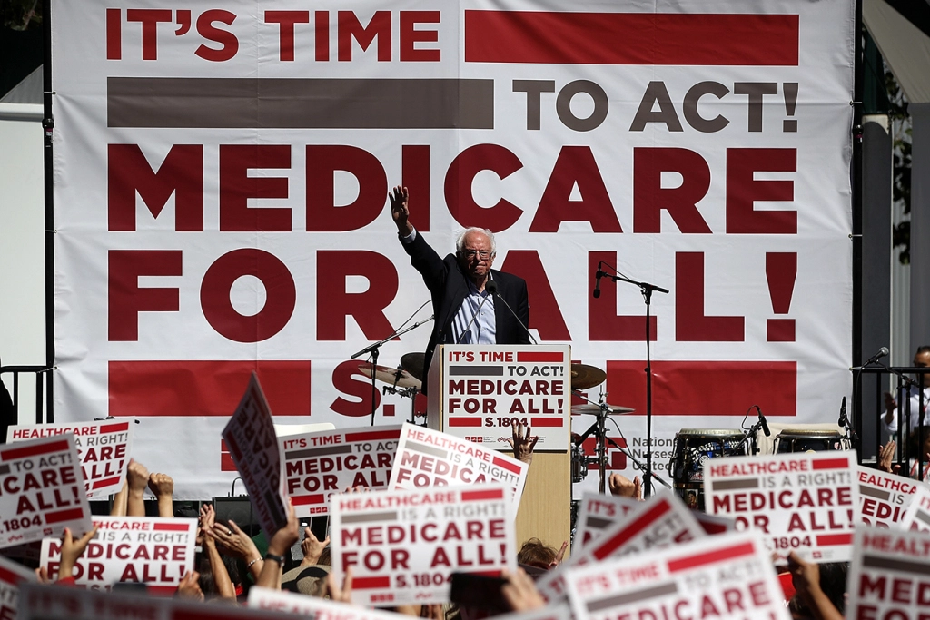

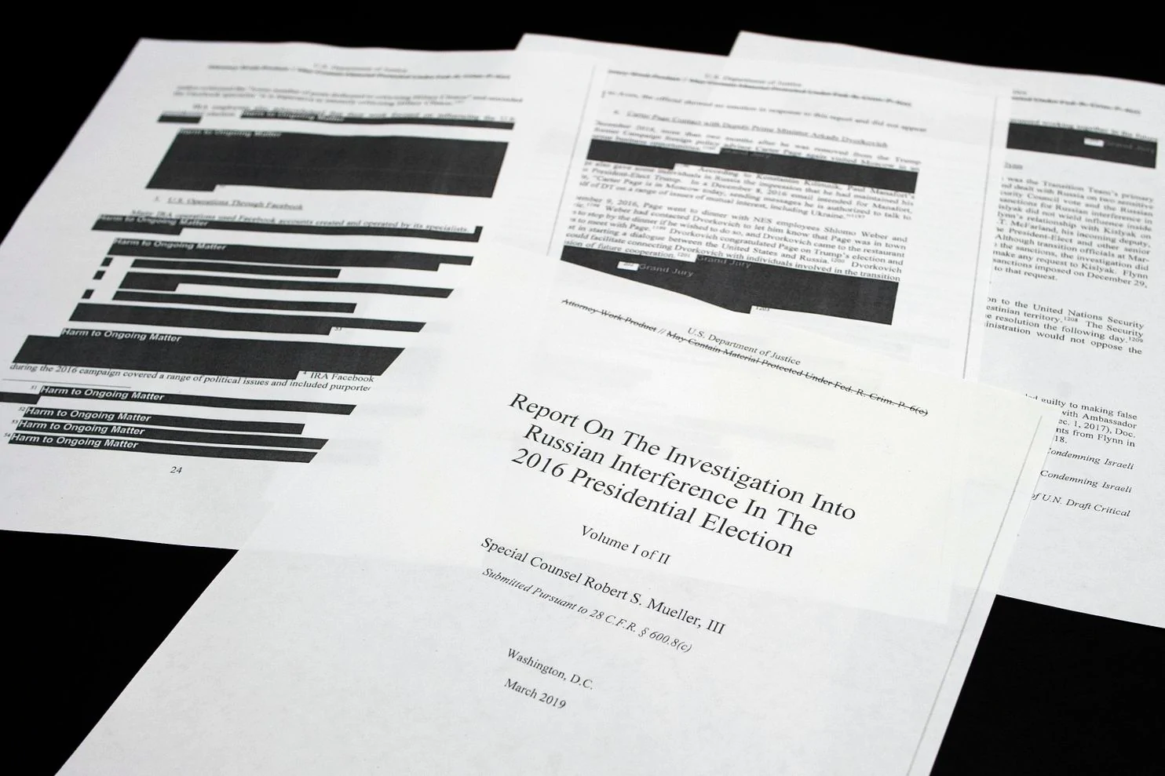
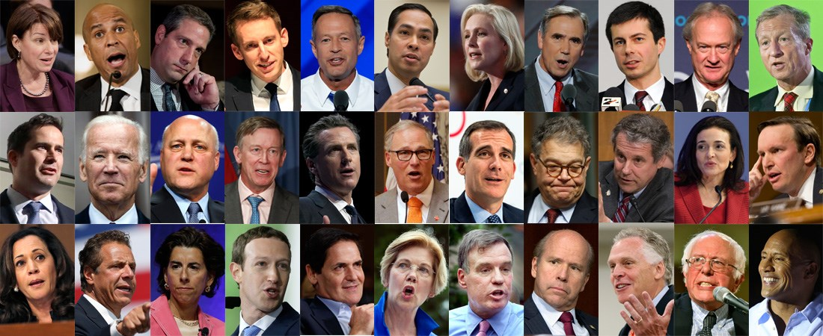
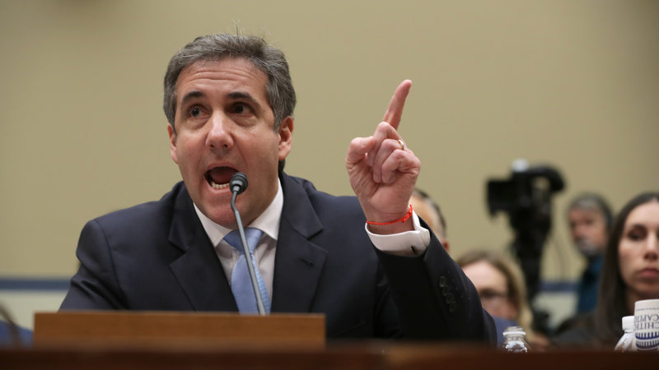
What’s Going on in Washington
3

Slide 4
Three Realities of Washington Today
Lots of “new” on Capitol Hill, particularly the House
  ~100 freshmen members of Congress, including many first-time officeholders.
  Democrats navigating their version of “Tea Party” challenges.
  Slow start given government shutdown early in the year.
A highly polarized and divisive environment
  Divided Congress (Democratic House, Republican Senate).
  Significant discord between the White House and House of Representatives.
Energy and resources increasingly focused on the future
  23 Democrats currently running for President.
  Diverse field ranges from former VP and current or former Senators and governors to rank-and-file members of Congress, mayors (big city and small) and first-time candidates.

Slide 5
What Congress is Focused on Right Now
Appropriations (spending) bills to keep the government funded after Sept. 30th
Nominations, such as judges and department or agency leaders (Senate only).
Drug pricing, balance billing and proposals to address costs of healthcare
Mueller Report follow-on activities.
  More hearings, subpoenas and related actions.
  Possible “I” word activities.

Slide 6
What MDF is Focused on in Washington
The Peer Reviewed Medical Research Program (PRMRP) that is part of the Defense Appropriations Bill
Newborn Screening –
Congress has asked the CDC to review how it can advance education, knowledge, and related outreach activities to foster myotonic screening for newborns
Supporting the Newborn Screening Saves Lives Reauthorization Act
Funding for medical research and public health policies
Patient protections – keeping the ACA intact and preventing any undoing of critical patient protections

Slide 7
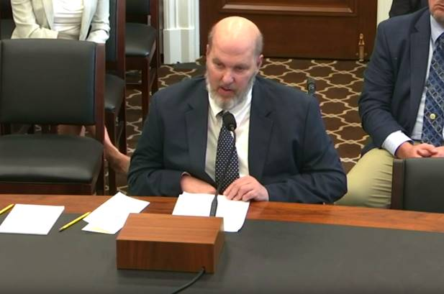
Appropriations Hearing April 9, 2019

Slide 8
Department of Defense
Congressionally Directed Medical Research Programs (CDMRP)
Defense Health Program that invests In High Impact, High Risk, High Gain Research
Congress allocates over $1 Billion Annually
Has funded over 50 Diseases, Conditions & Areas of Research
House Bill Includes Disease Specific Line Item Funding
Senate Bill Includes Pool of Funding (PRMRP) & Disease Line Item Funding
GOAL: Continue inclusion of DM in the Peer Reviewed Medical Research Program (PRMRP) that is part of the CDMRP

Slide 9
PRMRwhaaat?
The PRMRP is essentially just a list of diseases that are eligible for research grants
Every year, as part of the Defense Appropriations bill, the Senate releases the list of eligible diseases to apply for PRMRP funding
Once the appropriations bill becomes law, then interested parties apply for a research grant
It is not guaranteed that each disease will receive funding
Peer-reviewers and consumer reviewers are nominated for each eligible research area

Slide 10

PRMRP Fiscal Year 2018
$3.1 MILLION DOLLARS….

Slide 11
Why We Focus on the Senate for PRMRP
The PRMRP is a Senate program, therefore only the Senate Defense Appropriations bills contain its funding
As legislation is being crafted, members of the Senate Defense Appropriations Committee are given the opportunity to weigh in on PRMRP eligible disease areas
Senators Feinstein and Durbin in particular have been incredibly helpful in renewing DM’s PRMRP designation

Slide 12
How YOU can get Involved
Call or write your Senator to tell them you support the PRMRP, and specifically DM inclusion in the program.
If your Senator is on the list of Defense Appropriations Subcommittee Members, call him or her to thank them for support for DM and the PRMRP.

Slide 13
Senate Defense Appropriations Committee
Shelby, (AL) Chair
McConnell (KY)
Alexander (TN)
Collins (ME)
Murkowski (AK)
Graham (SC)
Blunt (MO)
Moran (KS)
Hoeven (ND)
Boozman (AR)
Durbin (IL), Ranking
Leahy (VT)
Feinstein (CA)
Murray (WA)
Reed (RI)
Tester (MT)
Udall (NM)
Schatz (HI)
Baldwin (WI)

Slide 14
Why We Need Advocates Like YOU
YOU are the single most important advocate in Washington. Why?
YOU vote for or against members of Congress.
YOU live nearest to your members of Congress. You see them at the July 4th parade, at town hall meetings, in the grocery store, at their kids’ school, at houses of worship, etc.
YOU have a deeply personal, authentic and powerful message that is crafted by your own life experience and needs.
YOU have taken time out of your lives to make your voices heard on issues that are important to you.

Slide 15
How to be an Advocate at Home
You don’t have to be in Washington to be an advocate – your representatives have offices in your home state too.
You can meet with staff in those offices, or correspond via email or phone call with the Washington staff.
Remember, you don’t have to be a policy expert. The staff will want you to help them better understand myotonic dystrophy and to hear about your personal experiences with DM
Being a successful advocate takes work, just like any relationship.
Having a solid foundation is almost always helpful so they understand you and Myotonic Dystrophy BEFORE you come in with a request.

Slide 16
Want to be an A+ Advocate?
Seek Opportunities To Develop A Relationship With Member and Their Staff
Draft A Letter to The Editor About Our DM Congressional Priorities
Invite Family and Friends To Become DM Advocates
Stay Connected With MDF For Action Alerts All Year

Slide 17
Do what you can, where you are, with what you have.
-Theodore Roosevelt

Slide 18
Thank you!
Questions?
Contact Kevin Brennan at Kevin.Brennan@faegrebd.com

