Slide 1

2019 Myotonic Annual Conference
September 13-14, 2019
Philadelphia, PA

Slide 2
DM2 Research Update
Allison Formal
Senior Science Consultant

Slide 3
DM2 Research and the Drug Development Landscape Are on the Rise
  More tools to study and treat DM2 are under development
  More DM researchers are turning their attention to DM2
  The prevalence of people with DM2 is becoming more apparent
  Clinical research into the understanding of DM2 patients, their symptoms and their progress is expanding
Notes:
Project Background rationale, experts agree attempts to create tools have been slow due to the challenges highlighted above

Slide 4
Summary Assessment of DM2 Research and Drug Development Landscape
Goals
  To understand current opportunities and constraints in the Research & Development (R&D) pipelines
  Design and implement projects to increase academic and industry interest and collaboration
  Identify ways to incentivize therapy development
  Bring DM2 R&D on par with DM1
Notes:
Project BAckground

Slide 5
Creation of Research Tools
Cell Lines
4-DM2 patient-derived iPSCs cell lines are in development in partnership with Rutgers and NINDS
Other cell lines have been created but do not show missplicing events
Other models
Zebrafish
Drosophila
Mouse Models
Transgenic model under development at University of Rochester
BAC DM2 model under development in lab at University of Florida
CRISPR-Cas9 technology creating model at University of Florida
Other efforts are underway
Notes:
One cell line has 11990 bp,
One cell line expansion > 75 repeat expansions
Another expansion 8780 bp,
The 4th expansion 11520 bp
Dr. Andrew Berglund, PhD, The RNA Institute, collaborating with Dr. Karen Guillemin’s lab at the University of Oregon, are developing and characterizing zebrafish models of myotonic dystrophy. The main focus of the zebrafish project is to the study the mechanisms underlying DM-related changes in gut motility and the microbiome due to GI issues suffered by DM patients.
Teams including Dr. Ralf Krahe, PhD, at The University of Texas and Dr. Giovanni Meola, MD, at Università degli Studi di Milano are working with Drosophila models of DM2.
Dr. Charles Thornton, MD, University of Rochester, has been working for several years to create a DM2 mouse based on the technology he used to develop the HSA^{lr} DM1 mouse. Significant technical challenges arise in making a DM2 transgenic mouse because of the expansion size and amount of toxic RNA involved. A successful DM2 mouse is likely in the next 1-2 years (?).
Dr. Maurice Swanson, PhD, University of Florida, is working on a DM2 mouse model using CRISPR-Cas9 technology to impact the germline through expression of the DM2 repeats in the mutant gene in endogenous DM2 intron 1 of CNBP.
Dr. Kiruphagaran Thangaraju, PhD, University of Florida, an MDF-funded Fellow in the lab of Dr. Laura Ranum, generated a patient-derived BAC library and screened ~92,000 clones. Dr. Thangaraju has identified several clones with the CNBP gene. One clone in particular contains a substantial flanking sequence and a large (~700 CCTGs) repeat expansion. Pronuclear injections were performed but genotyping did not identify any transgenic founders. This work-in- progress continues as Dr. Thangaraju continues to purify additional BAC DNA with the expansion for another round of pronuclear injections. ​The goal is to identify transgenic founders and build colonies
Dr. Ralf Krahe, PhD, University of Texas MD Anderson Cancer Center, developed an HSA transgenic DM2 mouse model. The model includes a (CCTG)121 expansion in intron 1 of the human skeletal actin gene (DM2-HSATG) with a small number of repeats. The model does not demonstrate the mis-splicing events many believe to be associated with DM2. According to Dr. Krahe, the mice do display phenotypic changes associated with DM2.
Dr. Lubov Timchenko PhD, Cincinnati Children's Hospital, recently published a cnbp-KO mouse created at CCH. Her focus is on downstream genetic events resulting from the role of CNBP, such as the reduction in ZNF9. Dr. Timchenko proposes that heterozygous cnbp-KO mice could be a model for DM2 because patients with DM2 have only partial reduction of ZNF9, similar to that seen in the CCH heterozygous mice.

Slide 6
Current Research Efforts
Bench and Lab
Research into understanding disease modifiers and the identification of biomarkers
  Creation of new non invasive Intron Retention Biomarker
  Creation of new mouse models underway
  New DM2 human iPSC cell lines soon available to researchers
  New studies aimed at understanding molecular and genetic changes contributing to DM2 symptoms
Clinical
Research aimed at understanding disease presentation and pathogenesis
  Population-based prevalence study
  STOPP DM2
  Clinical outcome measures COMEDY-2
  Clinical endpoints and biomarkers ASCEND-DM
  Evaluating and quantifying lean tissue mass index as biomarker in DM2
Notes:
RAN- lab of Lauran Ranum building from work I triplet repeat diseases including ALS, looking at roles of RAN and RNA gain of function in disease pathogenesis
Dr. Maurice Swanson generated #KO/Ki mice to look at role of specific RNA binding proteins. His lab is studying an RNA-mediated disease model in which mutant DM1 and DM2 mRNAs are trapped in the nucleus and sequester (C)CUG repeat expansion binding proteins that are essential for normal tissue development and maintenance. His lab identified the sequestered factors as the muscleblind-like (MBNL) proteins. Ongoing efforts are focused on elucidating the normal functions of these proteins as well as investigating whether RNA toxicity has a pathogenic role in other hereditary disorders.
Intron retention induced by microsatellite expansions as a disease biomarker: Maurice Swanson, PhD, along with MDF post-doctoral fellow Dr. Łukasz Sznajder, PhD, have developed a diagnostic assay using a person's peripheral blood to assess intron retention events as disease-specific diagnostic biomarkers for microsatellite expansions such as those found in DM1 and DM2 patients. Using DM2 as a model, they showed that CNBP i1 retention occurs even with expansion sizes in the low pathogenic range, which suggests that this assay may be informative for pre-symptomatic patients.
Dr. Giovane Meiola has identified rbFOX1 as a possible molecular mechanism in DM2 by looking at its overexpression and role it plays in releasing MBNL1 from sequestration within CCUG RNA foci and muscle atrophy.
Ongoing prevalence study in lab of Nicholas Johnson-
Stopp- A natural history study with a target enrollment of 50 DM2 patients is being conducted at the University of Rochester. Dr. Charles Thornton, MD, Dr. Joanna Hamel, MD, Dr. Chad Heatwole MD, and others are looking at muscle biopsies, patient-reported outcomes of disease burden, and mechanistic changes over three years of observation. Currently 12 DM2 patients have completed the 3 years of observations. There are 28 additional DM2 patients enrolled past baseline; participant selection is designed to include DM2 patients with broad symptom burden, age, etc. to reduce bias in the study results. If the additional 10 patients can be enrolled within a year, cross-sectional data regarding baseline readings can initially be made available.
The single-site STOPP DM2 study will then move to a multi-site, multi-year study conducted via the Myotonic Dystrophy Clinical Research Network (DMCRN), likely in the next 3 years.
). Dr. Benedikt Schoser, MD, at Ludwig-Maximilian Universitat Munchen will be recruiting at least 60 DM2 patients to be evaluated through a battery of patient-reported outcomes (PROs) and clinical outcome measures in order to define suitable measurement strategies for DM2, and to propose a disease-specific severity scale. Patients will be re-evaluated after 6 months. An age and gender-matched control cohort will be assessed.
Dr. Ami K Mankodi, M.D., at the National Institute of Neurological Disorders and Stroke (NINDS), is using results of the Myotonic Dystrophy Clinical Research Network (DMCRN) 100-patient longitudinal study data to continue work on biomarker and endpoint development in both DM1 and DM2. Her current project will recruit 50 DM2 patients at NINDS as a single site study. It will include efforts to validate custom devices she has developed for both muscle endpoint assessment and non-muscle endpoints and biomarkers, including respiratory and central nervous system (CNS) function. She will also assess selected tests, imaging, and patient-reported outcomes for their ability to quantify disease burden, detect disease progression and predict changes. Dr. Mankodi will study DM2 disease progression over 2 years. She will also examine muscle and cerebrospinal fluid (CSF) for RNA alternative splicing events that may be used as potential biomarkers of DM2 severity, and genetic modifiers of DM2 severity by genome-wide association (GWA).
Identifying practical and reliable endpoints to quantitate lean tissue mass in Myotonic Dystrophy Type 1 and 2. Dr. Araya Puwanant, M.D. at Wake Forest, is using Dual Energy X-ray Absorptiometry (DEXA) scans as a simple imaging technique, to test whether DEXA measurements in affected muscles may provide a sensitive endpoint that can be bridged to meaningful outcome measures that are sensitive and appropriate to monitor disease progression and therapeutic response in the clinical trial setting of DM2. This work was started at the University of Pittsburgh and will continue at Wake Forest See if this meets your thoughts. This was reworded from her MDA grant

Slide 7
Key Patient Registries
The DM-scope registry: a rare disease innovative framework bridging the gap between research and medical care
Myotonic Dystrophy Family Registry: A tool created by Myotonic
National Registry of Myotonic Dystrophy and Facioscapulohumeral Muscular Dystrophy Patients and Family Members: Created and maintained at the University of Rochester (URC)
Notes:
RESULTS:
The DM-Scope Registry is a result of the collaboration within the French excellence network established by the National plan for RDs. Inclusion criteria is all genetically confirmed DM individuals, independently of disease age of onset. The dataset includes social-demographic data, clinical features, genotype, and biomaterial data, and is adjustable for clinical trial data collection. To date, the registry has a nationwide coverage, composed of 55 neuromuscular centres, encompassing the whole disease clinical and genetic spectrum. This widely used platform gathers almost 3000 DM patients (DM1 n = 2828, DM2 n = 142), both children (n = 322) and adults (n = 2648), which accounts for > 20% of overall registered DM patients internationally. The registry supported 10 research studies of various type i.e. observational, basic science studies and patient recruitment for clinical trials.
Of the 1740 patients in the MDFR, 120 patients have juvenile onset DM, 237 patients have congenital DM, 278 have DM2 and 783 have DM1 according to their doctors. This widely used platform gathers almost 3000 DM patients (DM1 n = 2828, DM2 n = 142), both children (n = 322) and adults (n = 2648), which accounts for > 20% of overall registered DM patients internationally. The registry supported 10 research studies of various type i.e. observational, basic science studies and patient recruitment for clinical trials.
CONCLUSION:
The DM-Scope registry represents the largest collection of standardized data for the DM population. Our concept improved collaboration among health care professionals by providing annual follow-up of quality longitudinal data collection. The combination of clinical features and biomolecular materials provides a comprehensive view of the disease in a given population. DM-Scope registry proves to be a powerful device for promoting both research and medical care that is suitable to other countries. In the context of emerging therapies, such integrated platform contributes to the standardisation of international DM research and for the design of multicentre clinical trials. Finally, this valuable model is applicable to other RDs.
Rochester The Registry promotes sharing of information about DM and FSHD between care providers, researchers, and patients. This teamwork allows all key players to learn from each other, discuss which symptoms are most important, and strive for improvements in clinical care and therapeutic treatmentsmuch of the patient-reported research regarding the prevalence and consequences of symptoms pertaining to DM1 and DM2 has stemmed from the analysis of the National Registry of Myotonic Dystrophy and Facioscapulohumeral Musclar Dystrophy Patients and Family Members that is maintained at the University of Rochester (URC)

Slide 8
Primary Purpose of Registries
Assist researchers seeking participants for clinical trials and research studies.
Speed up research in myotonic dystrophy by collecting data for researchers.
Communicate with the DM community about upcoming research studies and clinical trials.
Understand how DM can affect the quality of life for people and families living with DM.
Help medical professionals improve how they treat individuals affected by DM.
Learn how and why certain treatments work and don’t work.

Slide 9
National Registry for Myotonic Dystrophy (DM) & Facioscapulohumeral Dystrophy (FSHD)
  What is the “Registry”? Established in 2001 at the University of Rochester, funded by the National Institute of Health (NIH), it collects information provided by patients with DM1 and DM2 about their health and function through surveys (at the time of enrollment and annually)
  Who can enroll? Any person with DM1 or DM2 living in the United States
  When to enroll? Anytime
  Why to enroll?
    Goals of the Registry:
    To provide updates to patients with DM2 and DM1
    To inform patients about research opportunities (recruitment)
    To learn more about symptoms that patients experience (surveys)
    To learn more about how the disease changes over time
  Achievements thanks to registry members:
  → 41 scientific publications were facilitated through the registry
      Of these, 25 were published since 2013 and cover a variety of topics, such as quality of life, pain and cancer
Notes:
Who To date 231 patients with DM2 and 1,285 patients with DM1 participate
Anytime (children and adults with no symptoms, mild symptoms or severe symptoms)
about research activities (annual newsletter) and communicate with the DM community
and how it affects people at different times in their lives
To date:

Slide 10
Myotonic Dystrophy Family Registry
934 patients registered with the MDFR in the first year
An average of 197 new patients register annually
2034 patient profiles to date
Of these 2034 patient profiles, ~93% are complete (i.e., every section was addressed)
Number of professionals using the MDFR has grown by an average of 14 yr
09/2017 a total of 95 individuals from academia or industry (36+ different institutions) accessed data
Patients for 7 clinical trials and research studies were sought through MDFR
Notes:
otal New Registrants 2018: 185
Total New Registrants so far in 2019: 109
Total professional profiles to date: 95

Slide 11
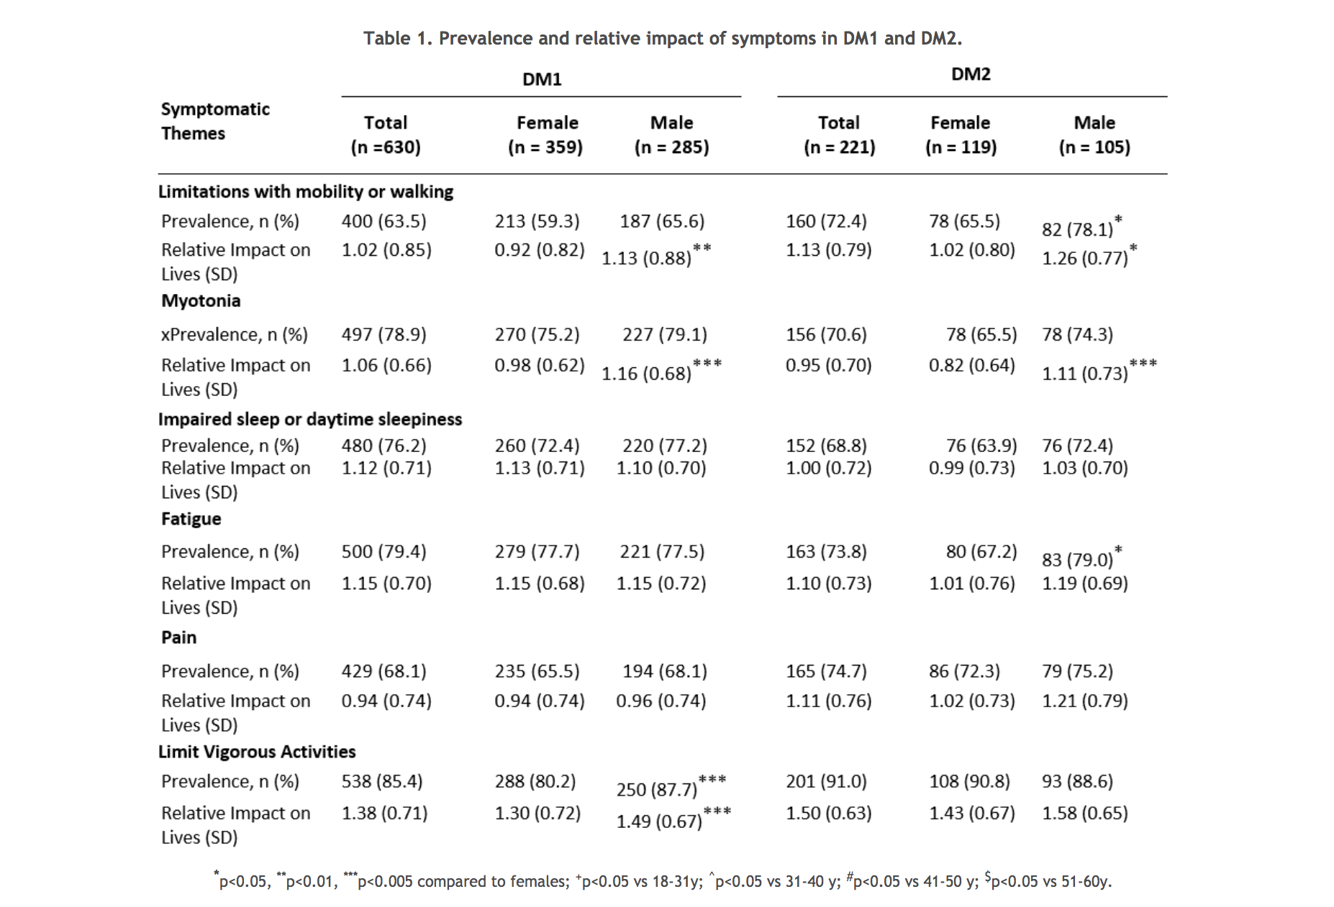
Myotonic Dystrophy Family Registry
Notes:
For the DM2 group, 89.8% of the diagnoses were confirmed via genetic testing. 53.1% of the 224 eligible DM2 patients were female. The average age of the DM2 group was 54 years (range 20-89+), with onset of symptoms occurring at an average of 36 years. The most prevalent symptom for both DM1 and DM2 included limitations in doing vigorous activities, such as exercise, (85.4% and 91%, respectively, Table 1). DM2 patient reports, which identified the next most prevalent symptoms as pain (74.7%), fatigue (73.8%) and limitations with mobility or walking (72.4%).

Slide 12
Ongoing Questions Researchers are Asking
What is the molecular basis for the disease?
What biomarkers can we identify that will indicate disease progression or disease alteration?
What biomarkers or splicing events are best to measure and target with therapeutic intervention?
How can we better understand the symptoms that indicate disease severity and or progression? i.e. CNS involvement?
Is there a grouping of symptomatology, i.e. CNS symptoms, muscle weakness, GI that if targeted by a therapy would impact a high percentage of patients with DM2?
Notes:
While the predominant disease process, a gain in function in the CNBP gene leading to build-up of toxic RNA is known to cause sequestration of MBNL proteins- the significant downstream alternative splicing events and the diffuse, highly variable symptomatology raise considerable questions about the molecular basis for the disease and the mutations critical to study for better disease understanding and targeted therapy. We will be discussing this with Dr Laura Ranum at length. While these questions are related to disease pathology, studying people with DM2 through studies that look at prevalence and continue to evaluate patients over time are critical to understanding the disease process and intervening to stop the diseases. We will be discussing prevalence studies and data with Ms. Chelsea Chambers, a genetic counselor working with Dr. Nicholas Johnson at VCU. How do we better access and amass prevalence data and longitudinal data for people with DM2?

Slide 13
Your enrollment and participation in registries and longitudinal studies is more critical than ever to understanding DM2 and for seeking ways to effectively treat and cure this disease.
Thank You!
https://www.myotonic.org/study-trial-resource-center

