Slide 1

2019 Myotonic Annual Conference
September 13-14, 2019
Philadelphia, PA

Slide 2
Myotonic Dystrophy & Exploring the World of Work
Michele Boardman, MA, CPWIC, CESP, LPC
Employment Coordinator, AHEDD
www.ahedd.org

Slide 3
Presentation Overview
Job Search
Resume Building
Interviewing
ADA Disclosure
Employment Services
Benefits Counseling
Strategies and Tips

Slide 4
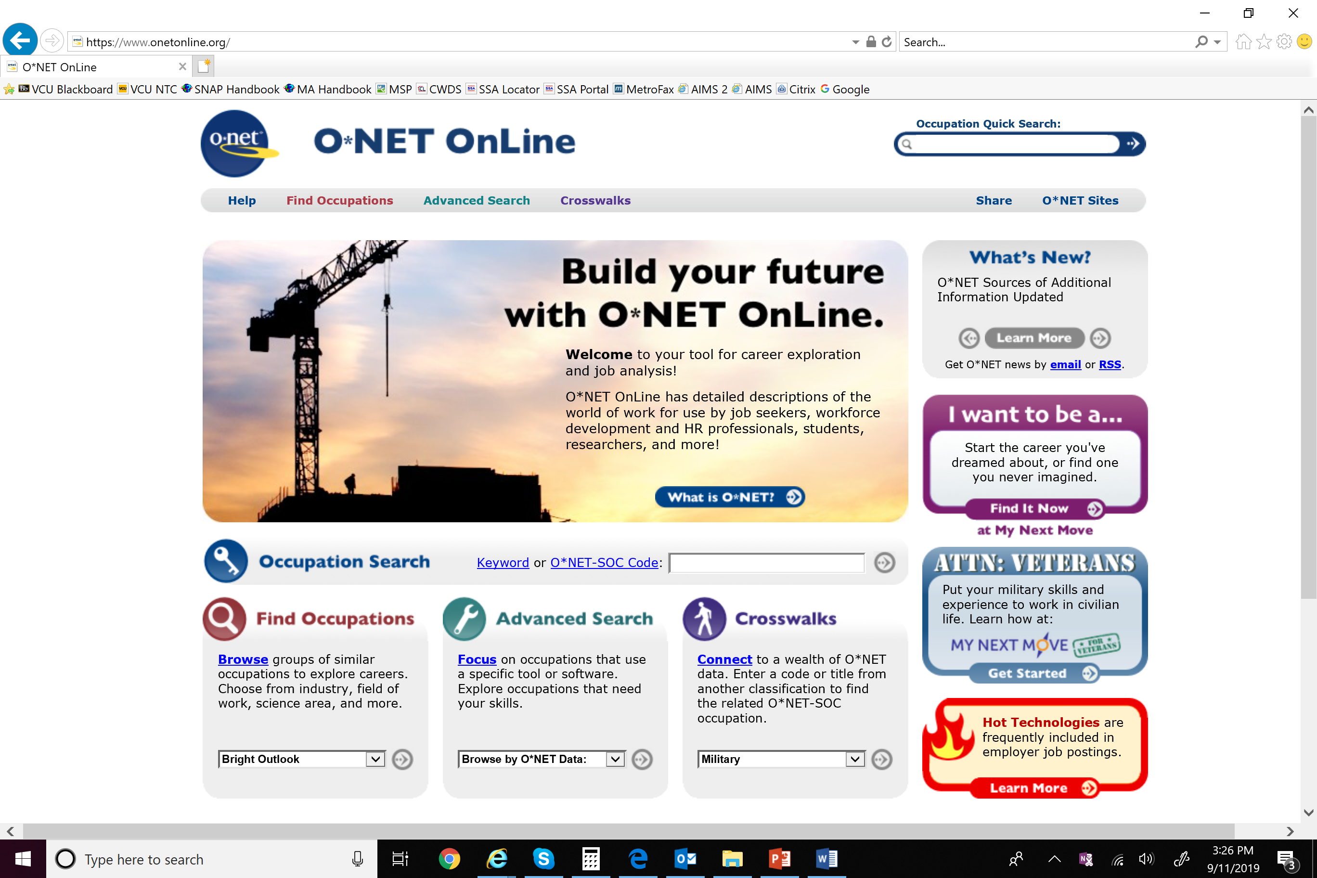
Job Search – Finding the Right Match
Assess your skills, abilities, interests, and qualifications
Consider location, transportation, and accessibility needs
Prepare for the application process and set aside time
  Gather work history and references
Career exploration and job analysis tools
https://www.onetonline.org/
https://askjan.org/

Slide 5
Resume Building
A resume is a living document
Consider consistency in formatting
Spell check and grammar usage
Bullet duties and responsibilities, 3-5 per job
Second pair of eyes
Types of resumes
  Chronological
  Functional
  Combination
  Targeted
Resume Formatting
  Background Summary vs Objective
  Education
  Work and/or volunteer experience
  Skills and Interests
  Professional Development

Slide 6
Preparing for the Interview
Prepare for questions in advance!
Review typical interview questions (Google and YouTube)
Look at company website to learn about history, mission, values, product/services, staff, etc.
Be memorable and relevant
  2-3 anecdotal “stories” or experiences for each question
Careful of “yellow flag” answers and address any “elephants”
Common interview questions
  Tell me about yourself
  Tell me about your work experience
  Addressing conflict resolution
  “Tell me about a time when…”
  What do you know about the company?
  Why do you want to work here?
  Why should I hire you?
  Do you have any questions?

Slide 7
Interviewing
First impressions count!
  Dress professionally
  Arrive at least 10 minutes early
Be confident and come prepared
“30 second commercial”
Answers to interview questions should be relevant to the position you are applying for
“I didn’t mean to say that!”
  Find a way to recover and steer it back in the right direction
An employer cannot ask you if you are disabled or ask about the nature or severity of your disability
An employer can ask if you can perform the duties of the job with or without reasonable accommodation

Slide 8
Disability Disclosure https://askjan.org/ - Job Accommodation Network
Rights under the ADA
Disclosure is a personal decision
Disclosure is recommended when you need to request a reasonable accommodation
Requesting an accommodation can be done at any time during the application process or while you’re employed
Who to Disclose to?
Check employee handbook, HR, or supervisor
What to disclose?
Basic information about your condition, limitations, and what accommodations you may need
When to disclose?
Before job performance suffers or conduct problems occur
Accommodation Request
Purpose: To enable a qualified person with a disability to perform the essential functions of the job
Examples:
  Flexible start time, working from home part of the time, extra breaks, barrier free accommodations, need for written instruction, etc.

Slide 9
Employment Resources in Community
Social Security's Ticket to Work program
Supports career development for people ages 18 through 64 who receive Social Security disability benefits (SSDI/SSI) and want to work
The Ticket program is free and voluntary
Helps people with disabilities move toward financial independence and connects them with the services and support they need to succeed in the workforce
State Vocational Rehabilitation
VR can provide a counselor and help to get a vocational assessment, get training or education, prepare the resume, and/or assist with a job search
Transition from school to work
Individualized Employment Services
Assistive Technology and Accommodation Assessment
Agency Providers
Typically contract with state or local entities to provide employment services
Possible Services Provided:
  Pre-employment Services
  Job Acquisition/Job Placement
  Job Coaching
  Follow Along
  Work Incentive Counseling

Slide 10
Financial Considerations of Employment
How much does the job pay?
Developing a budget
Work may impact government benefits, such as:
  Supplemental Security Income (SSI)
  Social Security Disability Insurance (SSDI)
  Child Disability Benefits (CDB)
Seek benefits counseling

Slide 11

Work Incentive Planning and Assistance (WIPA)
What is it and where can I get it?
WIPA/benefits counseling is a service provided by SSA or its approved sponsors to help individuals understand the impact of work on their Social Security benefits (SSI/SSDI/CDB) and healthcare
Utilize work incentives
Reporting earnings assistance
Communication with SSA
https://choosework.ssa.gov/

Slide 12
Working and Saving Money
ABLE Account
  Tax free savings accounts for individuals who became severely disabled before the age of 26
  Administered by the PA Treasury Department
  Direct contributions to 7 combinations of investment options offered by the PA ABLE Savings Program
Save up to $15,000 per year – investment grows tax free
Total pool of $100,000 exempt from means test for SSI, Medicaid, other state means tested benefits
Quarterly, ongoing fee ($15)
Purchase of wide range of “qualified disability expenses”

Slide 13
Employment Message
Challenge the Assumption – Change the Goal
“I don’t want to work
(or only want to work part time)
because I don’t want to lose my benefits”
TO
“I want to work and be better off financially”

Slide 14
Strategies, Tips, and References
Keep a daily rhythm
  Set milestones and goals
Don’t give up
You’re not alone
  Use the resources available to you
https://www.onetonline.org/
https://askjan.org/
https://choosework.ssa.gov/
https://choosework.ssa.gov/wise/
https://choosework.ssa.gov/findhelp/

Slide 15
“We love their passion for the cause,
Strong community and amazing staff.”
– Community Member

Slide 16
Thank you!

