Slide 1
Cognitive changes associated with Myotonic Dystrophy
What are they and how do you manage them?
John B. Williamson PhD
Center for OCD and Anxiety Related Disorders
Brain Rehabilitation Research Center
Assistant professor, Departments of Psychiatry and Neuroscience
North Florida/South Georgia VAMC
University of Florida

Slide 2
Overview
Neuropsychology
Understanding the effects of myotonic dystrophy on the brain
“Executive functions”
  What are executive functions?
  What do problems with executive functions look like in every day life?
Things that can be done to make life easier.

Slide 3
Myotonic dystrophy affects the brain
MD is a multi system disorder
Heterogeneous
  GI dysfunction
  Cognitive and affective disorders
  Cardiac disease
  Endocrine abnormalities (e.g., diabetes)
These conditions can influence one another
Effects can accumulate with age

Slide 4
Cognitive and emotional dysfunction and quality of life
Brain effects can be amongst the most debilitating
Impacts how we understand and relate to one another
Independence
Major National Institute of Health focus
Cognition, depression, psychiatric problems, dealing with disease all negatively affect quality of life
  Accumulates with age in MD1, outcomes SF-36, neuropsych, and mood inventories (n = 40)
    Antonini et al. 2006
Positive for quality of life?
  Family interaction
  Exercise
  Self-efficacy
  Attention control

Slide 5
Executive functions definition
That’s a tough one.
Inconsistent, interchangeable use
  Psychological definitions
  Proxy for anatomy (frontal lobes)
    Damage to other brain regions can cause executive dysfunction, depending on the breadth of definition and interconnectivity
“A set of cognitive processes such as attentional control, planning, reasoning, and monitoring.”
  Burgess and Stuss, 2017
Metacognitive construct, the sense of “I”
Muriel Lezak – “those capacities that enable a person to engage successfully in independent, purposive, self-serving behavior.”
In Dm1, a recent study showed that more than half (n = 60) had impairments in attention/working memory, processing speed, and executive functions
  Fujino et al., 2018

Slide 6

Problem of standardized testing
Early psychometrics focused on intelligence
Damage to frontal lobes doesn’t necessarily impact intelligence testing
Can’t measure all cognitive abilities with the same methodological approach
“Executive function”
  Karl Pribram, 1973
Karl Pribram

Slide 7
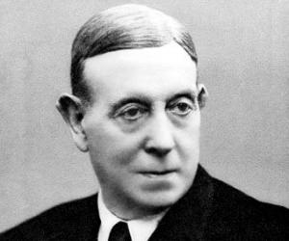
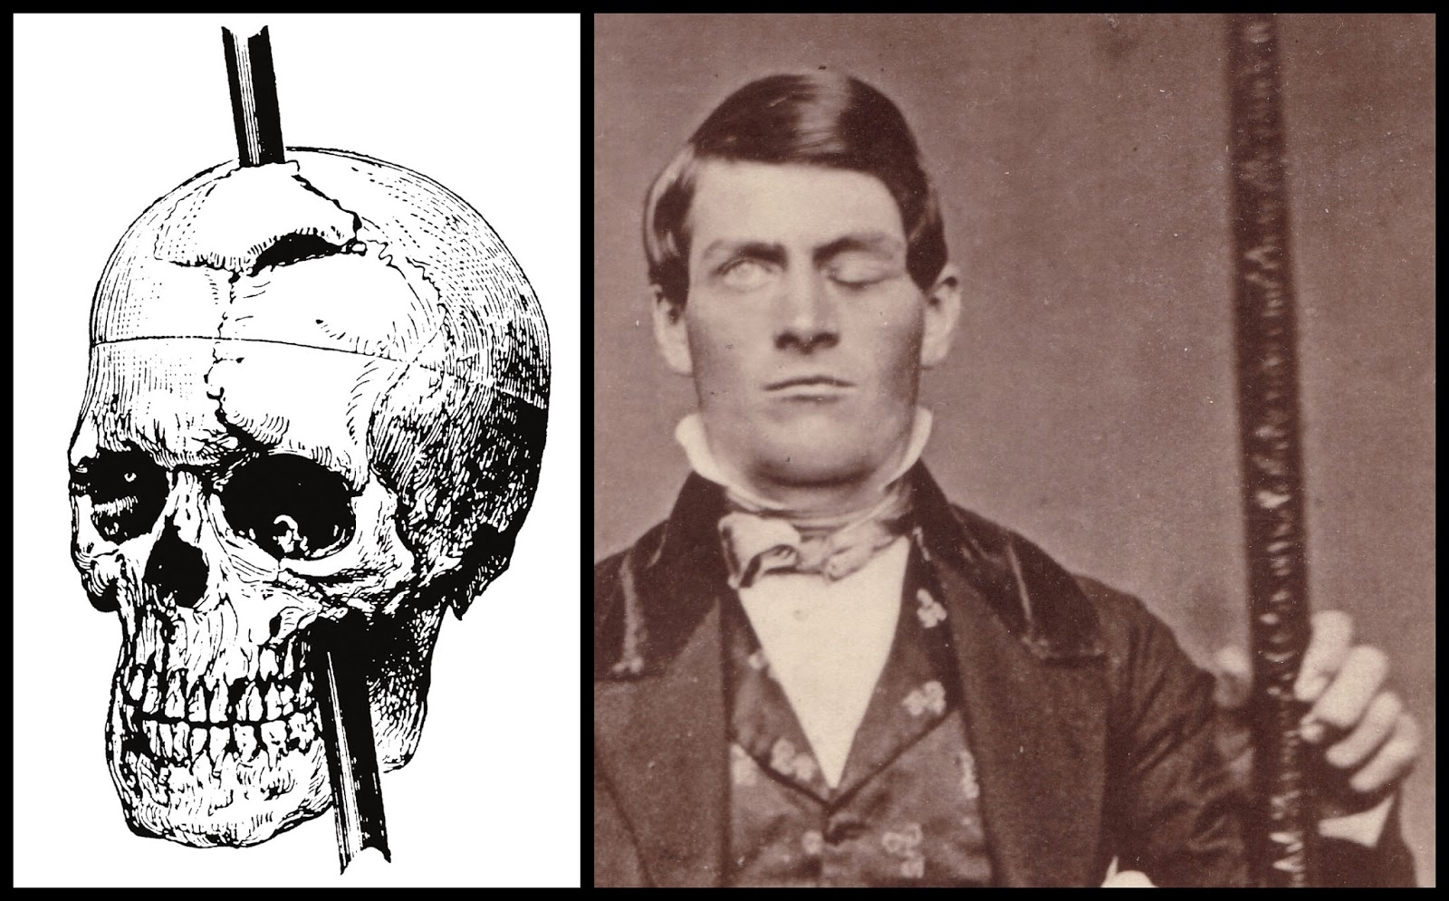
Evolution of a field
Phineous Gage
Egaz Moniz

Slide 8
Everyday effects
Problems driving
  More accidents
Lapses in attention
  Forgetting why you went into a room
Poor organization and planning
Problems with shifting from one task to another
  Confusion
Difficulty with emotional control

Slide 9
Treatment for executive dysfunction
Psychostimulants
  Also non-stimulant options, but still work on nor-adrenergic system
Meta-analysis demonstrates large effect size on symptoms of ADHD
  Including impulsiveness, attentional focus, organization
Also may work in DM1 (much smaller samples)
  Improves daytime sleepiness
Some limited data suggest that modafinil may help
What isn’t in the literature is measurement of
  Executive function w treatment.

Slide 10
Environmental tools
Goal setting
Reminders in visible places
Checklists
Morning task list use
  i.e., every morning create a list of what you want to accomplish and check it off as you go along
  Say your goals out loud
Establish good habits. Structure helps.

