Slide 1

KUMC Myotonic Dystrophy Day
Pulmonary Treatments
July 20, 2019
Damien Stevens MD
Associate Professor of Medicine
Division of Pulmonary Critical Care and Sleep
Medical Director KU Sleep Laboratory

Slide 2
Respiratory and Sleep Issues in Myotonic Dystrophy
Pulmonary complications leading cause of death in DM1
  Ineffective cough
  Pneumonia
  Chronic respiratory failure
  Acute respiratory failure
  Sleep disordered breathing
  Excessive daytime sleepiness

Slide 3
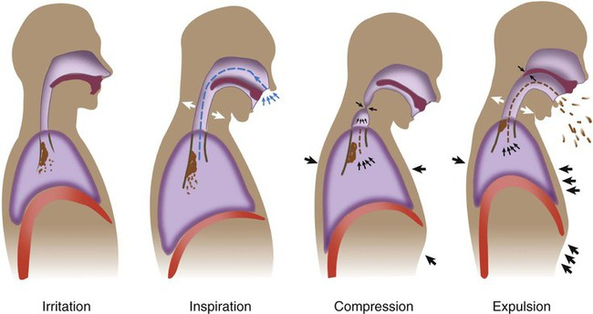

Slide 4
Respiratory Issues in Myotonic Dystrophy
Ineﬀective cough
  Normal peak expiratory ﬂowrate is >270 liters/minute
  Maximal inspiratory pressure is <60 cm H2O
  FVC values of 50% less than predicted
  Vaccinate for pneumonia and influenza
  Treat respiratory infections quickly
  Use cough assistance as needed
  Noninvasive ventilatory assistance as needed

Slide 5
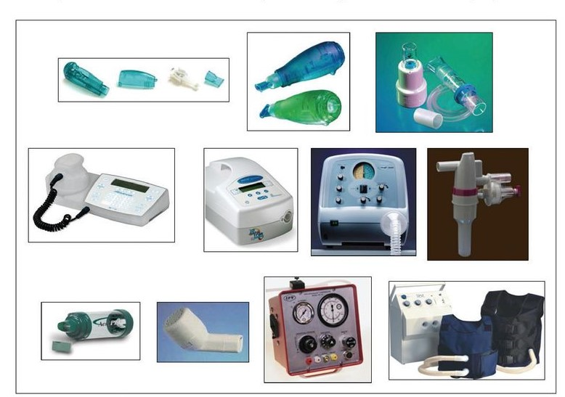

Slide 6
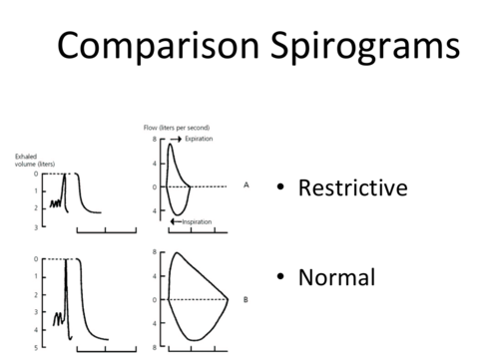

Slide 7
Respiratory Issues in Myotonic Dystrophy
Some patients will eventually require nighttime ventilator support or continuous ventilation.
Most patients with chronic respiratory insuﬃciency respond to noninvasive ventilatory support (NIV).
Use supplemental oxygen with caution and in conjunction with NIV
Patients experiencing acute respiratory failure require endotracheal intubation
Preoperative evaluation and clearance if need for anesthesia.

Slide 8
Sleep Issues in Myotonic Dystrophy
Assess with Epworth Sleepiness Scale or a similar instrument
Sleep study if sleep disturbance is suspected
Nocturnal oximetry possible useful
Possible obstructive sleep apnea or central sleep apnea
Sleep study often indicated depending upon symptoms
Excessive daytime sleepiness not explained by other process

Slide 9
Sleep Issues in Myotonic Dystrophy
Nocturnal or daytime hypoventilation also can be seen Noninvasive positive pressure ventilation may be beneficial
Pressure cycled versus volume cycled assistance
Consider referral to a pulmonologist

Slide 10
Sleep Issues in Myotonic Dystrophy
Excessive daytime sleepiness can be difficult to treat
Typically corelates with severity of other organ disease
Wake promoting agents typically first line option
Stimulants can be effective

