Slide 1
Genetics of Myotonic Dystrophy
MDF Myotonic Dystrophy DAY
University of Florida, Gainesville
Deborah Barbouth, MD, FACMGG
June 29th, 2019

Slide 2
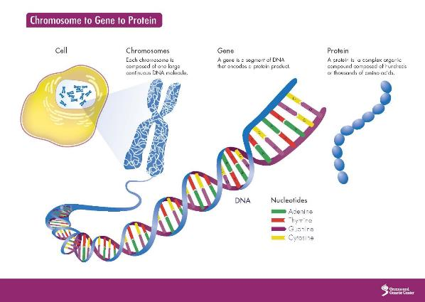
Genetics 101

Slide 3
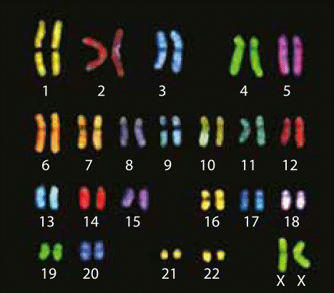
Chromosomes

Slide 4
What causes Myotonic Dystrophy?
Expansion of CTG in the DMPK gene (protein kinase) for DM1
Expansion of CCTG tetranucleotide CNBP (ZNF9) gene for DM2
Notes:
(zinc finger protein 9)

Slide 5
Repeat expansion
One nucleotide is one letter in the gene
  A, T, C, or G

Slide 6
Trinucleotide repeat expansion
One nucleotide is one letter in the gene
  A, T, C, or G
Trinucleotide is 3 nucleotides
  CAG, CGG, CTG, CTA, etc.

Slide 7
Trinucleotide repeat expansion
One nucleotide is one letter in the gene
  A, T, C, or G
Trinucleotide is 3 nucleotides
  CAG, CGG, CTG, CTA, etc.
Trinucleotide repeat is a region of the same 3 nucleotides over and over again
  CTGCTGCTG…

Slide 8
Trinucleotide repeat expansion
One nucleotide is one letter in the gene
  A, T, C, or G
Trinucleotide is 3 nucleotides
  CAG, CGG, CTG, CTA, etc.
Trinucleotide repeat is a region of the same 3 nucleotides over and over again
  CTGCTGCTG…
We expect everyone to have different numbers of repeats (but within the normal range)

Slide 9
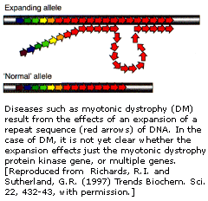
Trinucleotide repeat expansion
When the repetition of three nucleotides in a gene gets too big and causes the gene to no longer function properly
Notes:
The Slipped mispairing mechanism
Happen when the cells in the parent’s egg/sperm incorrectly copy the number of CTG repeats the parent has

Slide 10
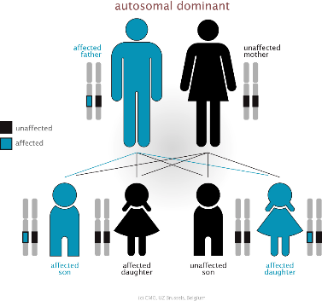
Autosomal Dominant Inheritance
Notes:
Repetitions of three nucleotides (e.g., CAGCAGCAG…CAG or CCGC-CGCCG) of 5 to 30 repeats.
Neurological disorders
Meiotic and mitotic instability
Pre-mutation level; threshold of disease
Correlation of DNA repeat # and disease severity;
Polymorphic in the population.
Anticipation
Most are inherited in an autosomal dominant manner.

Slide 11
Some interesting facts
Anticipation is the phenomenon that the symptoms become more severe or start at an earlier age as a disease is passed on to the next generation
Father vs Mother. The likelihood of repeat expansion differs between spermatogenesis and oogenesis.

Slide 12
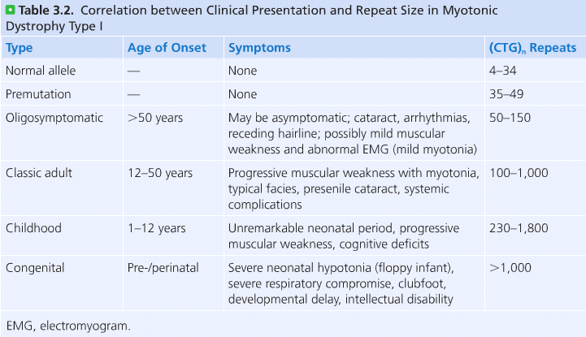
Myotonic Dystrophy 1
Schaaf, Zschocke and Potocki; Human Genetics: From Molecules to Medicine

Slide 13
Family planning options
Conceive naturally
  CVS or Amnio
In vitro fertilization with preimplantation genetic testing
  Costly
Adoption, sperm/egg donation, etc.

Slide 14
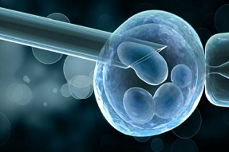
IVF with Preimplantation Genetic Testing
Go through the IVF procedure
Once embryos are obtained they are tested for DM
  Lab may ask for samples from additional family members
Those embryos that test negative for DM are implanted
Cons
  Cost
  No guarantee
https://www.iasoivf.com

Slide 15
Thank you

