Slide 1
MYOTONIC DYSTROPHY: OVERVIEW
S H Subramony M.D.
Professor of Neurology and Pediatrics,
University of Florida and McKnight Brain Institute
Center for Neurogenetics

Slide 2


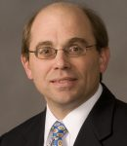




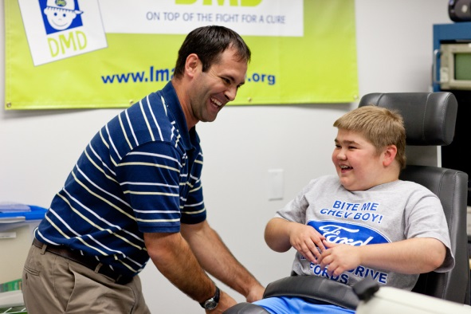
SOME OF THE UF MYOTONIC DYSTROPHY TEAM
Andy Berglund, John Williamson, William Miles, George McKillopp, Lisa Warren, numerous scientists, clinical coordinators, grad students and post-docs!

Slide 3
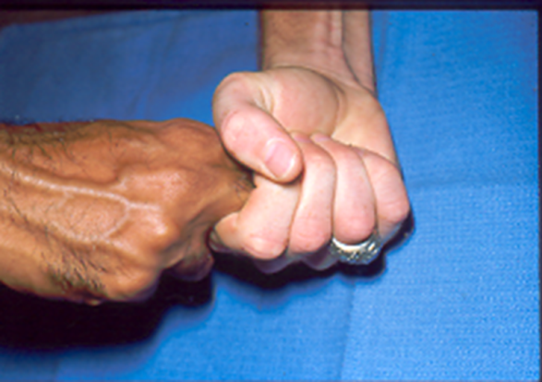

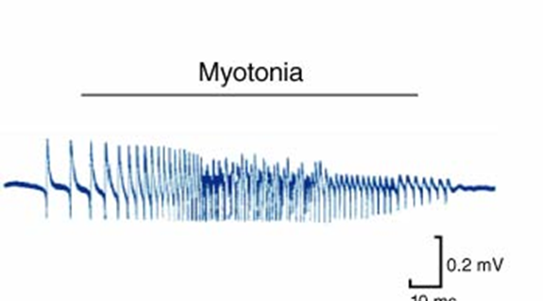
WHAT IS MYOTONIC DYSTROPHY?
Muscular dystrophy
  Genetic cause
  Progressive muscle atrophy and weakness
Myotonic dystrophy [DM]
  Dominantly inherited
  Dystrophy with associated myotonia
  Multi-system disease, no longer called “muscular dystrophy”
Most common dystrophy
  Duchenne MD 3/100,000
  Myotonic dystrophy 12.5/100,000
  Lou Gehrig disease 6/100,000

Slide 4
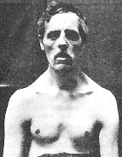

Steinert H (1909) Über das klinische und anatomische Bild des Muskelschwunds der Myotoniker. Dtsch Z Nervenheilkd 37:58–104
Batten, Gibb 1910
J Neurol Sci. 1989 Apr;90(2):231-7.
Myotonic dystrophy: hypotheses and facts about the illness of the Ypsilante brothers.
Leaders of the Greek revolution
Notes:
nn

Slide 5
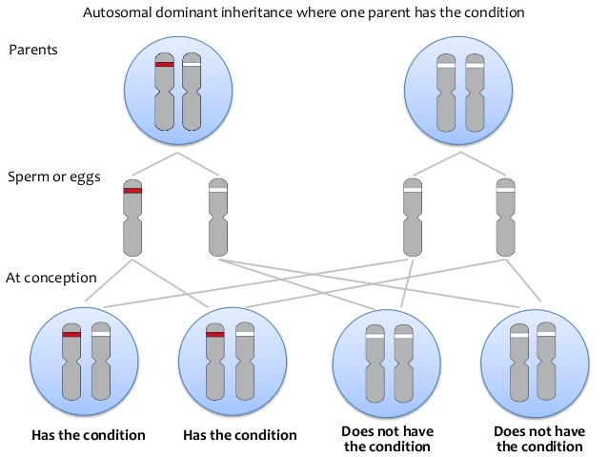
GENETICS OF MYOTONIC DYSTROPHY
Dominant mode of inheritance
  Occurs in successive generations
  Each gene comes in 2 copies (maternal and paternal)
  Having one copy (allele) mutated is enough to cause disease
  Each offspring of an affected individual has a 50% risk
Two genetic types DM 1 and DM 2
Genetic code created by permutation and combination of nucleotides. Cytosine, guanine, thymine, adenine (C,G,T,A).

Slide 6
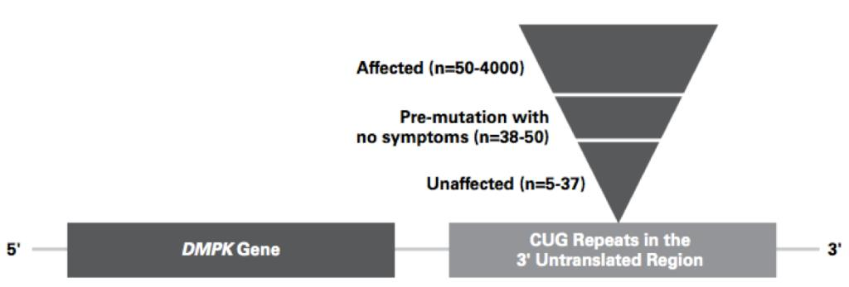
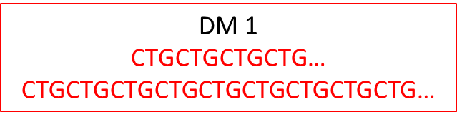
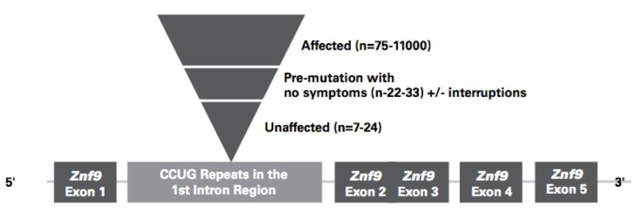
DMPK gene
CTG rpt: 3’ UTR region
CCTG repeat
DM 2
CCTGCCTGCCTGCCTG…
CCTGCCTGCCTGCCTGCCTGCCTG….
Notes:
.

Slide 7
INSTABILITY OF THE REPEAT SIZE
Unstable from generation to generation: the repeat number can contract, expand or stay the same when transmitted to the next generation.
Age at onset and severity: larger the size of the repeat earlier the onset and more severe the disease
Anticipation: expansions are more frequent
Repeat size alone cannot predict age at onset and severity
Unstable in different body parts

Slide 8
REPEAT SIZE AND CLINICAL FEATURES
Late onset/ asymptomatic | Cataracts, mild myotonia | 50-100 | Often missed
Classic, adult onset | Muscle, heart, and other typical problems | 100-1000 | Age at onset 10-30; Can present to many specialties
Juvenile onset | Similar to classic | 100-1000 | Age at onset 1-10; similar to classic, more brain issues
Congenital | Problems at birth or soon after | >1000 | Severe neuromuscular and brain issues beginning close to birth, misdiagnosed

Slide 9
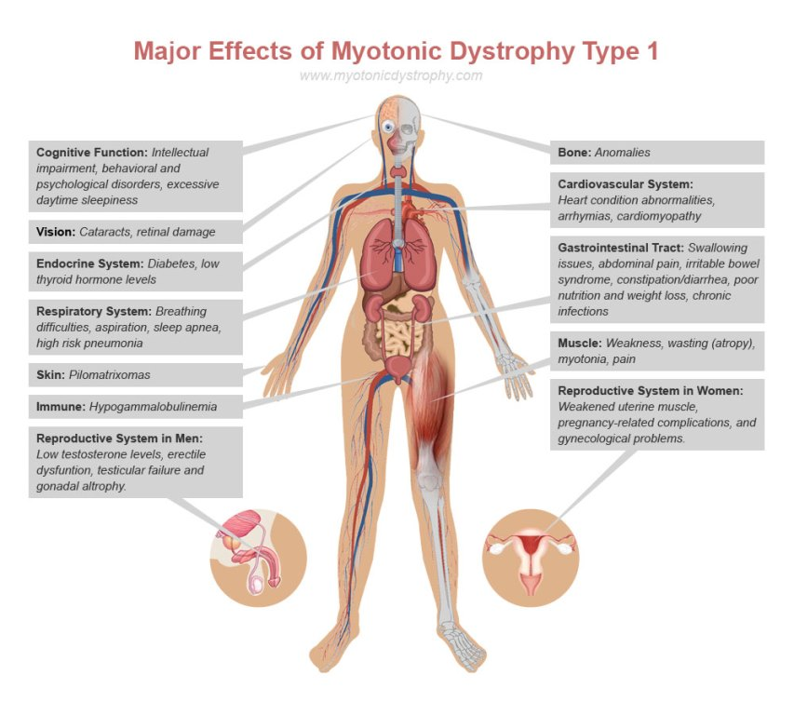

Slide 10
DM PATIENTS MAY SEEK DIFFERENT SPECIALTIES OFTEN NOT RECOGNIZING UNDERLYING DIAGNOSIS
Neurologists
  Typical childhood or adult onset weakness with myotonia
  Newborn difficulties
  Mental retardation, CP
Gastroenterologists
  Swallowing problems
  IBS like symptoms
  Abnormal liver function tests
Ophthalmologists
  Cataracts
Psychiatrists/psychologists
  Behavioral issues
  Attention deficit, autism like symptoms
Rheumatologist
  Fibromyalgia
Surgeons
  Gall bladder disease, thyroid disease
  Peri-operative difficulties
  Difficulty weaning after trauma
Endocrinologists/Gynecologists
  Diabetes, thyroid
  Hypogonadism
  Decreased fertility
  Maternal/fetal issues
Cardiologists
  Heart block
Pulmonary and sleep
  Fatigue, hypercarbia
  EDS
Geneticist
Oncologist?

Slide 11
SELECTED CLINICAL FEATURES
Myotonia
  Variable from time to time and in distribution
  Warm up
  May respond to mexilitine
Muscle weakness
  Face, jaw, neck, eye muscles, tongue and throat muscles
  Forearm, finger muscles
  Foot drop
Adaptive rehabilitation
Breathing and sleep
  Pumping capacity of chest/diaphragm can be reduced
  Cough may be ineffective
  Sleep becomes abnormal
    Oxygen levels go down during night
    Carbon dioxide may go up (headache)
    Obstructive apnea
    Daytime sleepiness and fatigue
Assistive devices: CPAP, biPAP, cough assists. Prevent respiratory infections
Sleep problems may have different mechanisms

Slide 12

SELECTED CLINICAL FEATURES: ANESTHESIA AND SURGERY ARE HIGH RISK
Complications out of proportion to severity of disease
Medications used may produce unexpected effects on muscles
Medications used may produce unexpected effects on brain
Unexpected challenges can arise due to heart disease and ineffective chest muscles
Also poor stomach emptying and inability to cough

Slide 13
SELECTED CLINICAL FEATURES
Gastrointestinal
  Chewing, swallowing
  Gastroparesis
  Gallbladder disease
  Bloating, constipation, diarrhea
  Pseudo-obstruction
  Incontinence
GI consult; swallow therapy consult
  Aspiration prevention
  Nutrition
  Fiber, laxatives, pro-secretory agents
  Exercises, surgical options
Pregnancy
  Does not worsen the disease
  Complications may be more frequent (ectopic, late abortion, placenta previa, polyhydramnios, prolonged labor, pre-eclampsia, pre-term delivery)
  Labor can be prolonged
  Higher chance of c section, instrumental delivery
  Anesthesia issues if surgery is contemplated
  Congenital MD in DM 1

Slide 14
DM 1 VS. DM 2
Age at onset later >40
Shoulder and hip muscles more affected, face/neck less
Tremor
Fibromyalgia like pain
Myotonia often very mild
Heart, lung, and other features milder and less frequent
No congenital disease

Slide 15
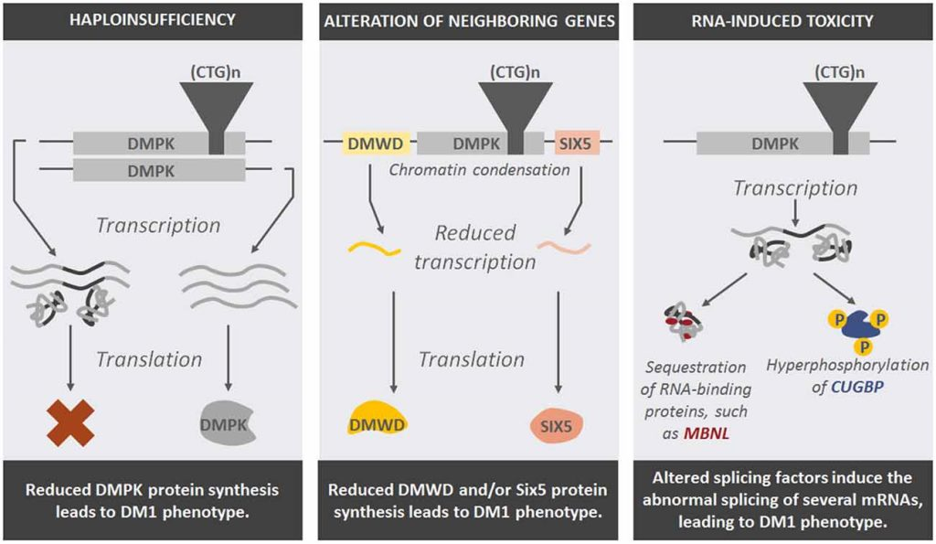
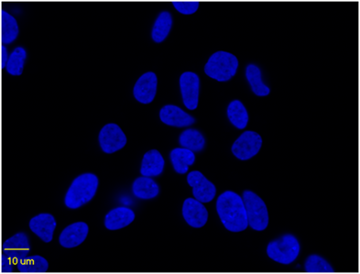
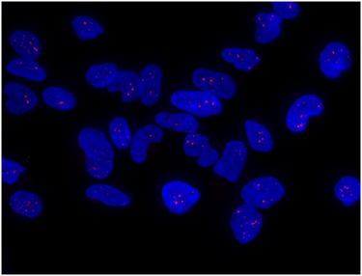

Slide 16
RESEARCH IN DM AT UF
Basic labs: Berglund, Swanson, Ranum, Wang
Clinical studies
  Phase 1/2a blinded placebo-controlled study to assess the safety, tolerability and dose range findings of multiple ascending doses of ISIS 598769 Administered subcutaneously to adult patients with myotonic dystrophy type 1 (IONIS PHARMACEUTICALS). Closed.
  END DM 1
  Muscle imaging in DM 1
  Gastrointestinal dysfunction in DM
  Skeletal muscle physiology in DM 1
  Cognition and related imaging and spinal fluid features
  Collaborative projects: tissue and sample banking
Contact: Aika Konn. aika.konn@neurology.ufl.edu. 352 273 6003

