Slide 1
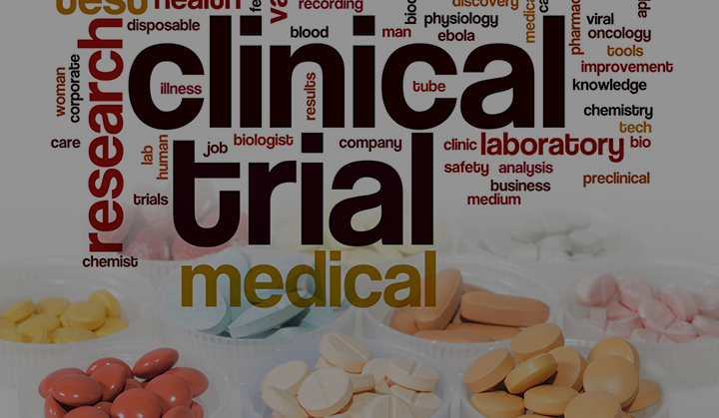
clinical trial readiness
Jeffrey Statland, MD
University of Kansas Medical Center
Notes:
Intro / who I am. I think it’s a hopeful time for muscular dystrophy research: I think most of you have probably read some of the newspaper articles about new drugs hitting th emarket, many have been negative, about the soaring drug prices. In that setting it’s sometimes easy to miss the fundamental change that’s occurred in the drug development landscape, where we are talking about molecularly targeted therapies, therapies that target the fundamental changes which cause inherited diseases of nerve or muscle. Many of the techniques fo rthese drugs would have sounded like science fiction even 10 years ago, things like exon splice regulators, exon skipping therapies, or gene therapy. But they are not science fiction any more, in just the last year the FDA approved 2 new molecularly targeted therapies, one for DMD and one for SMA. The same chemistries used to treat these diseases, ASO, can potentially work for MD. And the first human safety study of a molecularly targeted therapy for MD was completed about 1 year ago, and we will see the next generation drug entering human trial in the next 1-2 years. Hand in hand with the advances in drug design has gone advances in our understanding of the genetic and molecular pathology of MD, the development of cell lines and animal models to test new drugs, and in a landmark proof of concept study using a drug to clinical improve one of those animal models. This has brought a great deal of interest to the field, interest in basic scientists, academic researchers, and drug companies. But there is still a lot of work which needs to be done: we need to come together as a MD research community to lay the foundation, to build the tools necessary for high quality and efficient clinical trials. And this is what I want to talk to you about today.

Slide 2
Clinical Trial Readiness?
We as a community are stakeholders in the process of drug development
We need to provide input into the direction of therapeutic development for Myotonic Dystrophy (MD)
We need the tools in place, so we can be confident
We do not throw out drugs which might work
We do not approve drugs that will not help
Drug development is a conversation with many participants
Industry
Academia
MD advocacy groups
People with MD, and their family members

Slide 3
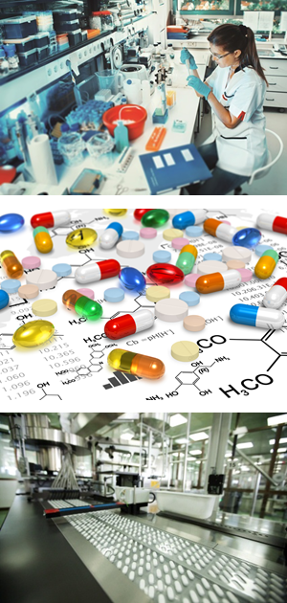
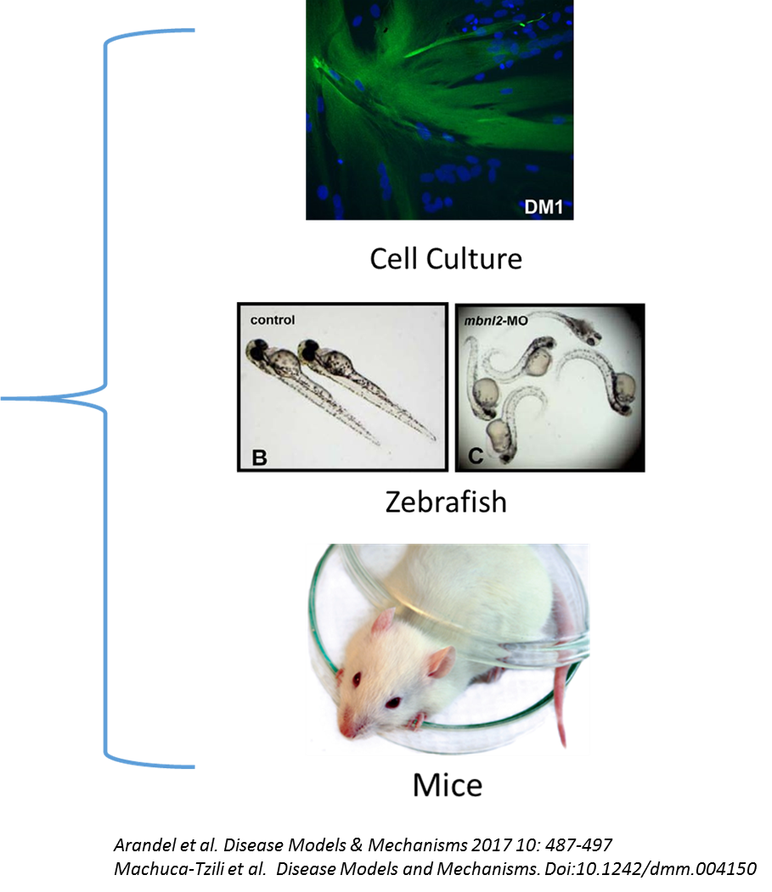
Clinical Trial Readiness is a Process: Everybody has a role
Basic Scientists
Understand the disease
Identify new targets for therapies
Develop model systems to test new drugs
Develop new therapeutic strategies
Pharmaceutical Industry
Develop drugs
Work with FDA
Early studies determine dosing, safety
Later studies ask does the drug work

Slide 4
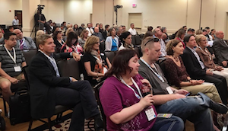
Everybody has a role
Patient Focused Drug Development Meeting 2016
International Dystrophia Myotonica Consortia - 7
People with MD and Your Family Members
Developing treatments is a Collaboration
Without people volunteering for studies we cannot make progress
Your participation means a lot!!!!
You help us figure out what aspects of MD you need treatments for
What things are important to measure
How big a change would be important to you: this may change from person to person, and may depend on the treatment
Help us understand what risk is acceptable for any potential benefit
Help us design our trials: how long is too long for a study visit, how many visits are reasonable, what kind of procedures would you be willing to do to test a new treatment???
Academic Clinical Researchers and Advocacy Groups
Hasten development of new therapies to help people with MD
From a practical POV there’s a lot of work that needs to be done
Ensure standard techniques for how we measure things
Address gaps in understanding of what happens clinically over time
Develop tools for clinical trials, and make sure results are consistent when implemented across multiple locations
Figure out what features predict how fast the disease changes: e.g. mutation, age, gender
Advocate nationally (internationally) for resources to pursue research and cures

Slide 5
Innovation and Collaboration
We need separate people from all over the world trying new things
Thinking of new ways to measure the disease
Thinking of new avenues for treatments
Thinking outside the box
But ultimately we need people to then come together to test these new ideas in large groups of people (we need to prepare)
We want things that work for all patients
To ensure our assumptions about what our tools measure and how they measure it are true
If we can agree on common approaches we can accelerate drug development
Examples: Duchenne Muscular Dystrophy, Spinal Muscular Atrophy

Slide 6
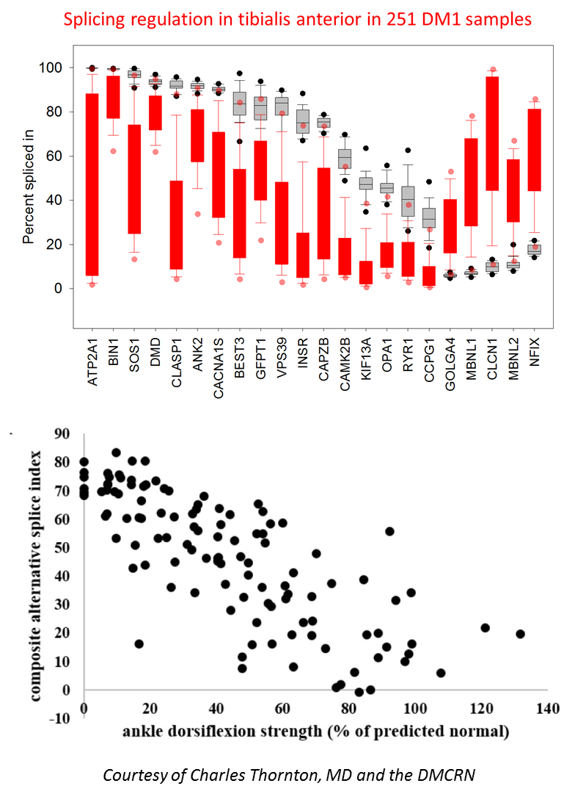
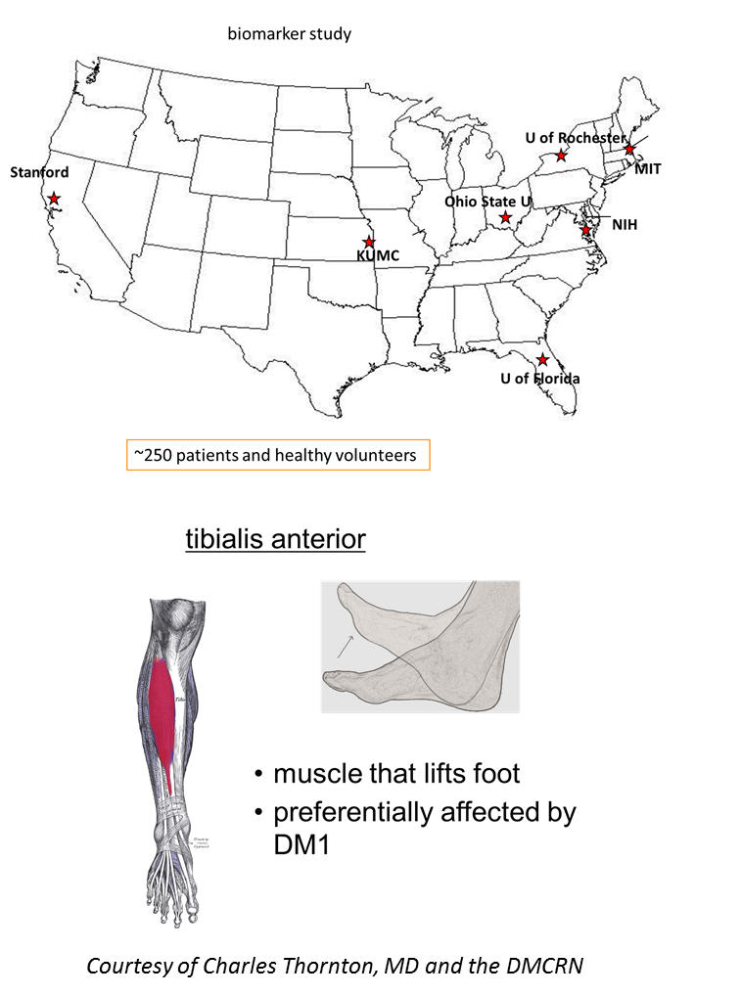
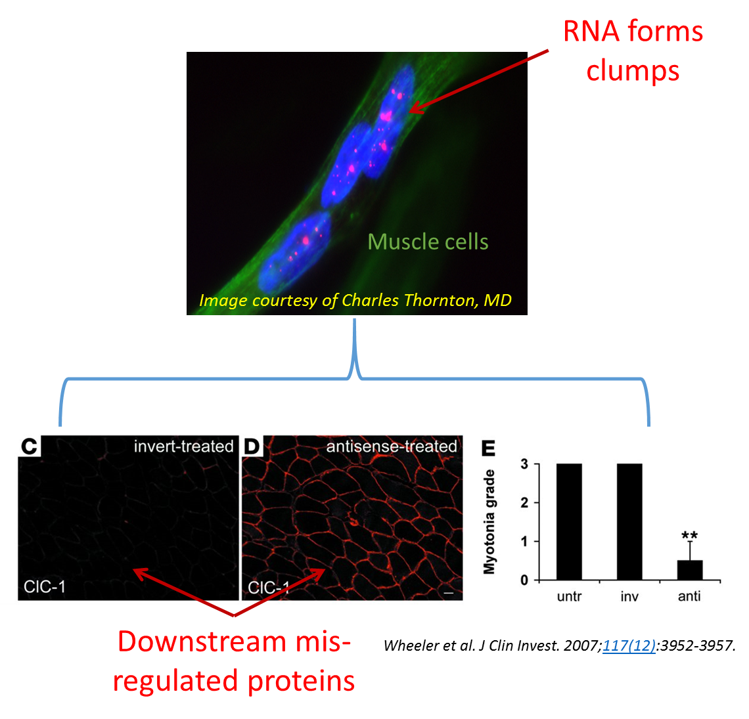
Getting Ready for Clinical Trials: Tools
Biomarkers: blood, tissue, other
Proof a drug is reaching its target
Monitoring disease activity
Monitoring physiological changes
Biomarkers important for early studies
But before we can use them:
Need to standardize the technique
Show we can get consistent results from multiple centers, on repeated occasions
Understand how they naturally change in people with MD over time

Slide 7
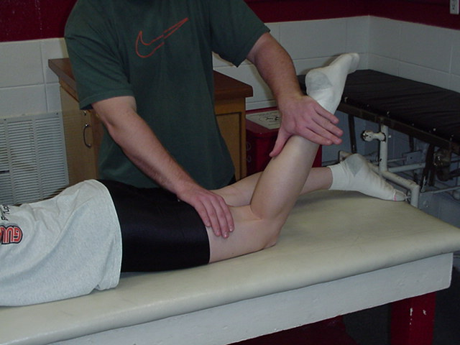
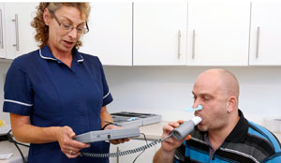
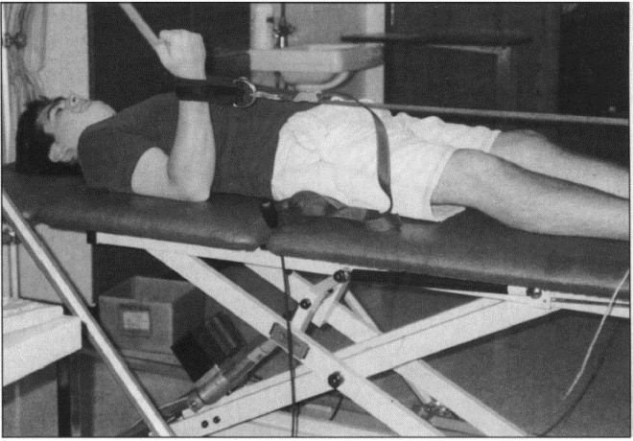
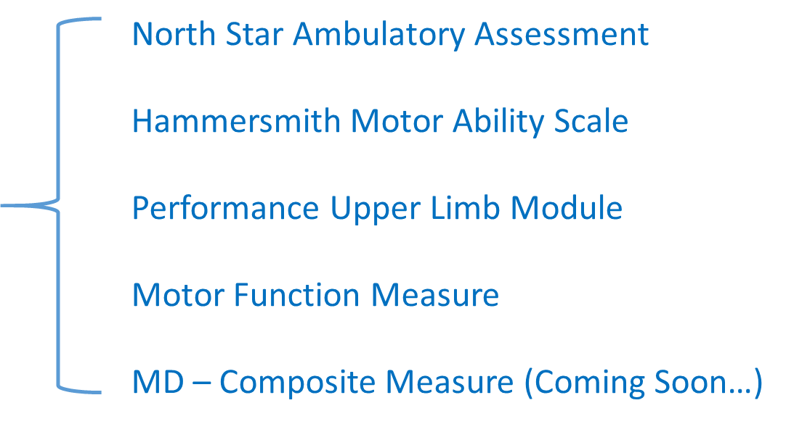
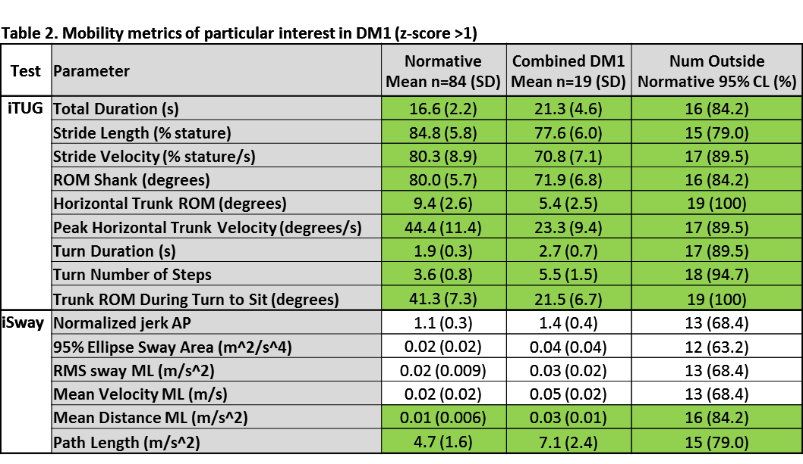
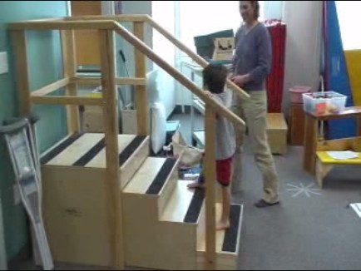
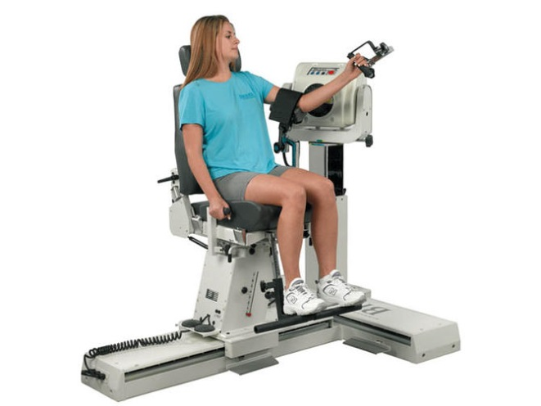
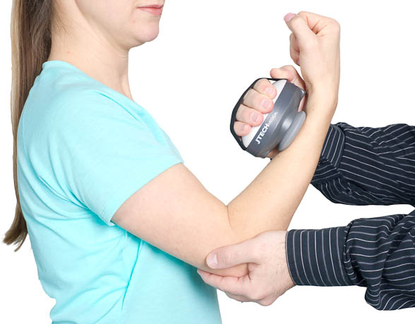
Getting Ready for Clinical Trials: Tools
Strength and Function
There are many techniques for measuring individual muscle strength
Standard functional tasks include things like how fast you can go 30 feet, get out of a chair, climbing 4 stairs, or how deep a breath you can take
Can combine tasks into a composite
Can instrument a functional task
There is still work that needs to be done:
We need to standardize our equiptment and procedures
Train our evaluators
Ensure we understand the relationship to genetics, age, gender, baseline functional status
Manual Muscle Testing
Quantitative Myometry
Force During Movement
Handheld Dynamometry

Slide 8
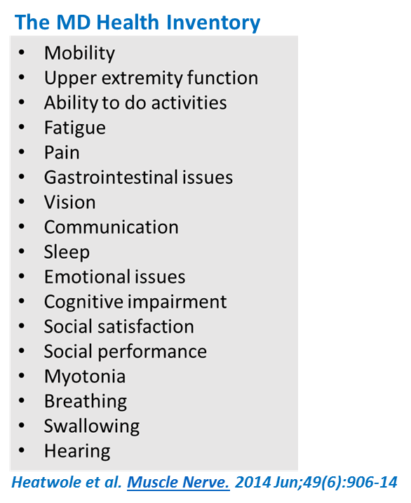
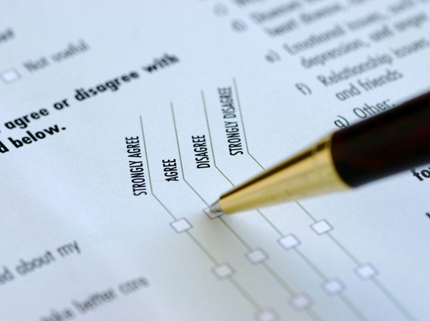
Getting Ready for Clinical Trials: Tools
Individual Interviews
with people with MD
The Person with MD’s Impression of the Disease
Ask the question whether a drug will be impactful on someone’s life
These can be standard instruments like: the Short-Form 36, the Individualized Neuromuscular Quality of Life Scale, the PROMISE scales
Or disease specific
Still need to:
Establish common instruments which cover full range of disability
Understand the normal variability from year to year
Determine if there are differences from region to region, culture to culture
Survey sent to > 250
people with MD
Ranked symptoms by
prevalence and impact
on their lives

Slide 9
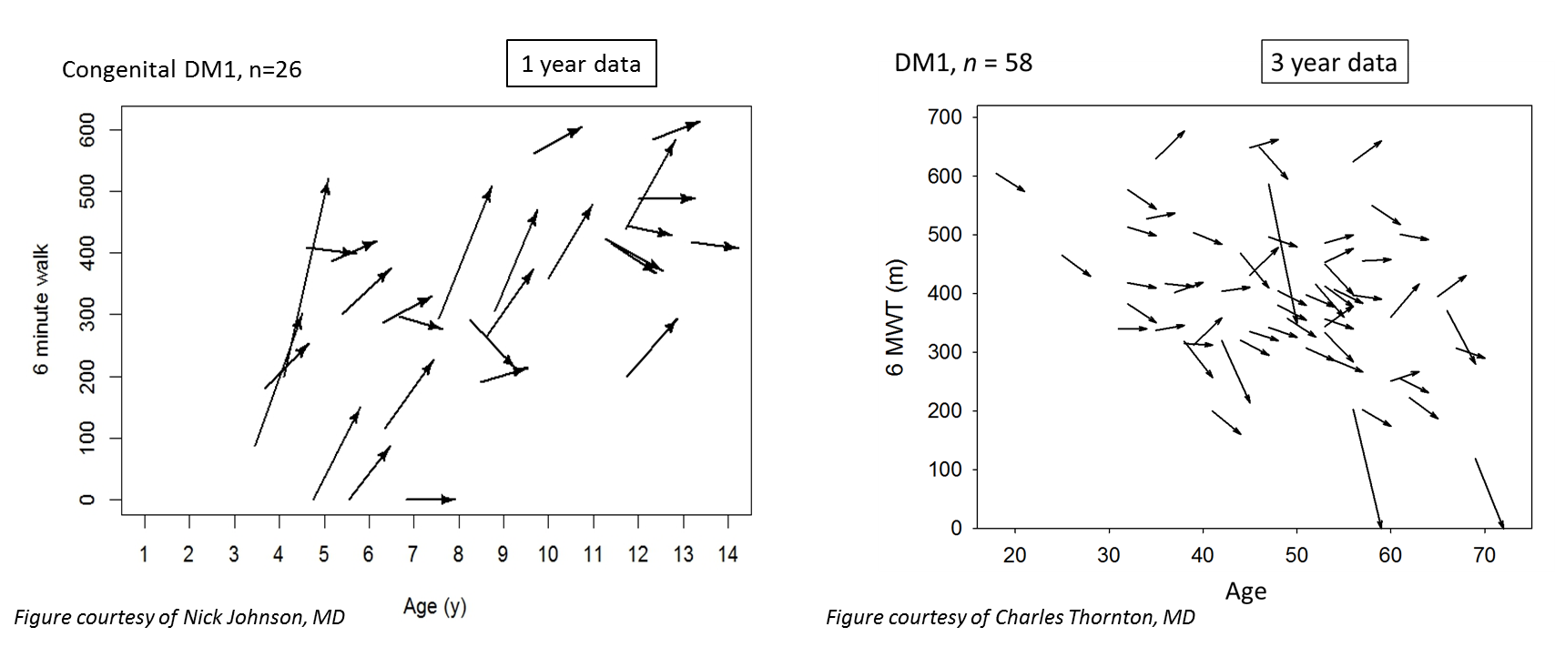
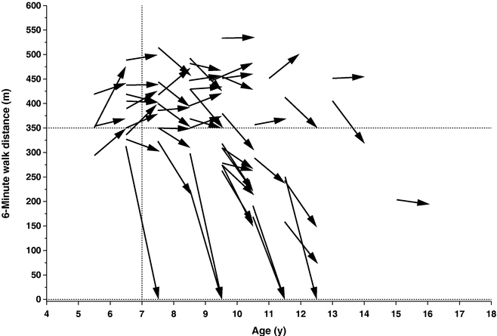
Getting Ready for Clinical Trials: Understanding disease progression
The ability to understand the normal progression of the disease and how it impacts the types of tools we choose for measurement can:
Help prevent the mistake of rejecting a drug or therapy when it may actually work (example: DMD)
Help us design more efficient clinical trials
Reduce the burden on individuals participating, by allowing us to reduce the number of people required for early phase studies
Help us design confirmatory trials
There are still several gaps in our understanding which need to be addressed:
How does genetics, baseline functional status, demographics influence rates of progression?
Are there simple tools we can use to ‘predict’ how someone might do over the next year?
McDonald CM, et al. Muscle Nerve. 2013 Sep;48(3):343-56.

Slide 10
Getting Ready for Clinical Trials: How big a change is meaningful
Ultimately understanding how big a change would be meaningful can help make the argument for approval of a drug
Short of hard outcomes like mortality, or time to requiring a wheelchair, or pacemaker or non-invasive ventilation we need other ways to determine how big a change would be meaningful
This will depend on what the treatment is for
For example a drug designed to help with pain does not need to improve how you walk
We can try and understand this using statistical techniques, by using questionnaires, or by relating a change in one measurement to a change in another
Your voice / your opinion is important!!!

Slide 11
Example: DMPK – 2.5 Rx Clinical Trial
Slide courtesy of Ionis Pharmaceuticals

Slide 12
Slide courtesy of Ionis Pharmaceuticals

Slide 13
Take home message: A better understanding of our biomarkers and our strength and functional measures will ensure
We know how many people we need to enroll to see a change in our proof of concept biomarkers to show the drug is reaching its target
How many more people we need to see changes in our strength or functional outcomes
Slide courtesy of Ionis Pharmaceuticals

Slide 14
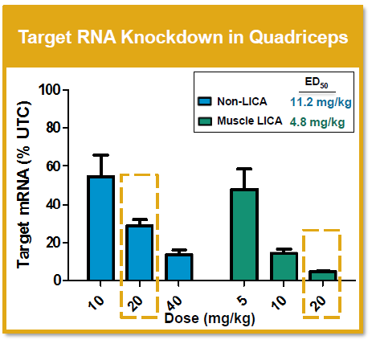
Slide courtesy of Ionis Pharmaceuticals

Slide 15
Future Directions
We are collaborating with many large centers across the US, the MDF, MDA, and NIH to form the Myotonic Dystrophy Clinical Research Network
Our goal: to hasten therapeutic development for MD
We are working with drug companies, researchers, and people with MD
To answer questions that can accelerate the development of existing drugs, or new drugs
Study 1 was recently completed, and we will be reporting results soon
Study 2 is going to start in the next few months: to help refine how we measure MD, look for other genetic modifiers, and really understand our biomarkers

Slide 16
Thank You!

