Slide 1
Myotonic Dystrophy and the Heart
Kevin M. Mulhern, M.D.
Cardiology Consultant
Muscular Dystrophy Association Clinic
The University of Kansas Health System

Slide 2
What Can Happen
May affect any heart tissue
Slow or fast heart rhythms more common
Weakening of heart muscle less common
Heart disease more common with increasing age
Heart involvement more likely with myotonic dystrophy type 1 (DM1) than with myotonic dystrophy type 2 (DM2)

Slide 3
Watch for These Symptoms
Palpitations
  Fast or irregular heart rhythm
Passing out or nearly passing out
  Slow heart rhythm
  Fast, potentially fatal heart rhythm
Shortness of breath
  Abnormal heart rhythm or congestive heart failure
Chest pain
  Very fast heart rhythm or heart failure with high pressures in heart

Slide 4
DM with No Signs or Symptoms of Heart Disease
DM1 or DM2
  Electrocardiogram (EKG or ECG) at diagnosis
DM1
  Repeat ECG every year or so
  Echocardiogram at diagnosis
  Echocardiogram every 3-5 years

Slide 5
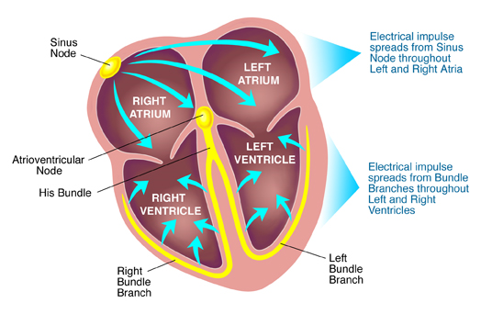
Electrical System of Heart
http://s0www.utdlab.com/contents/images/PI/71235/Heart_conduction_system_PI.jpg?title=Heart+conduction+system+PI

Slide 6
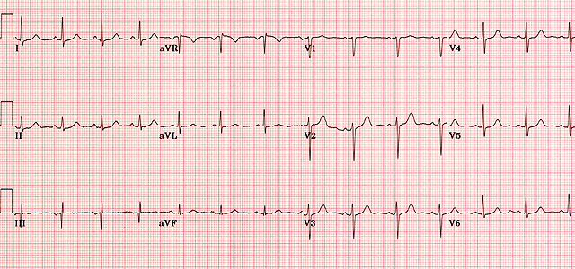
Normal Electrocardiogram
https://www.google.com/url?sa=i&rct=j&q=&esrc=s&source=images&cd=&cad=rja&uact=8&ved=0ahUKEwi99erQs5nVAhUJID4KHQ8KB8QQjB0IBg&url=https%3A%2F%2Fmeds.queensu.ca%2Fcentral%2Fassets%2Fmodules%2FECG%2Fnormal_ecg.html&psig=AFQjCNG0Nw77TnL5IYi_SZHwUdkSqjFVCg&ust=1500693090870049

Slide 7
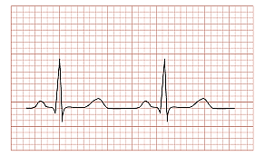
Normal Electrocardiogram
https://www.google.com/url?sa=i&rct=j&q=&esrc=s&source=images&cd=&cad=rja&uact=8&ved=0ahUKEwizypGLtZnVAhWC4yYKHZLuCsAQjB0IBg&url=https%3A%2F%2Fcommons.wikimedia.org%2Fwiki%2FFile%3ANormal_ECG_2.svg&psig=AFQjCNH5S1MtpeiSOnkh_ro0jFB3XW7CVw&ust=1500693489398180
http://s0www.utdlab.com/contents/images/PI/71235/Heart_conduction_system_PI.jpg?title=Heart+conduction+system+PI

Slide 8
Signs or Symptoms of Heart Disease
Echocardiogram
  Ultrasound examination of heart structure and function
Reduced heart function
  Repeat echocardiogram yearly
Preserved heart function
  Repeat echocardiogram in 1-3 years

Slide 9
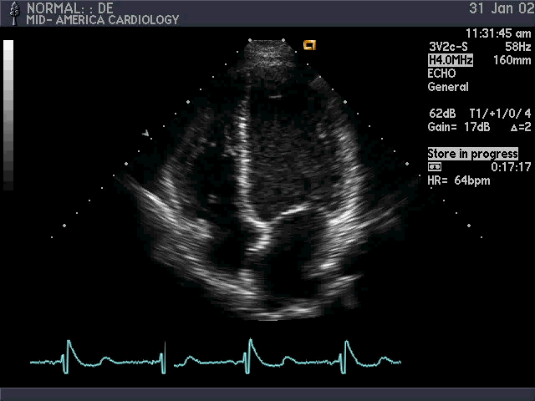
Echocardiogram
Notes:
nml1&232

Slide 10
Signs or Symptoms of Heart Disease
24- or 48-hour ambulatory ECG monitor (Holter monitor) or 30-day ECG event recorder
Repeat testing every 3-5 years if
  Symptoms support or
  ECG changes develop

Slide 11
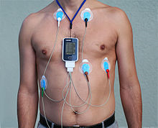
Holter Monitor
https://upload.wikimedia.org/wikipedia/commons/thumb/9/97/Alex_CM4000.jpg/220px-Alex_CM4000.jpg

Slide 12
Who Needs a Cardiologist?
Symptoms of a heart problem
Change in symptoms
Abnormal electrocardiogram
Abnormal heart imaging study
DM1 and age >40 years old

Slide 13
Treatment Options
Medications
Pacemaker
Biventricular pacemaker
Defibrillator
Biventricular pacemaker-defibrillator
Catheter ablation of abnormal rhythm
Left ventricular assist device
Heart transplantation

Slide 14
Medications
Control fast or irregular rhythm
Thin blood to prevent stroke
Treat heart failure
  Improve symptoms
  May improve survival

Slide 15
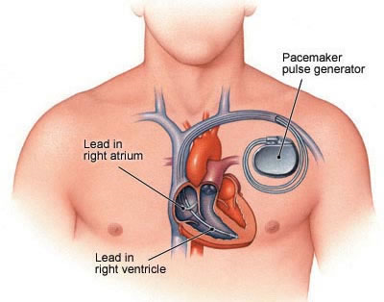
Pacemaker
http://www.newhealthguide.org/images/10438744/image002.jpg

Slide 16
Mexiletine
May reduce myotonia
Local anesthetic properties
Developed for treatment of life-threatening heart rhythm
Works by blocking sodium channels in cell membranes of muscles
Consider cardiology consultation
ECG before starting and within first 3 months of treatment

Slide 17
Mexiletine: More Common Side Effects
Nausea
Vomiting
Heartburn
Dizziness or lightheadedness
Tremor
Nervousness
Chest pain
Coordination difficulties
Headache
Blurred vision/visual disturbances

