Slide 1
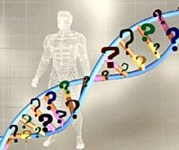
Genetics & Myotonic Dystrophy
Presented by : Janel Phetteplace, MS, CGC
Janel-Phetteplace@uiowa.edu

Slide 2
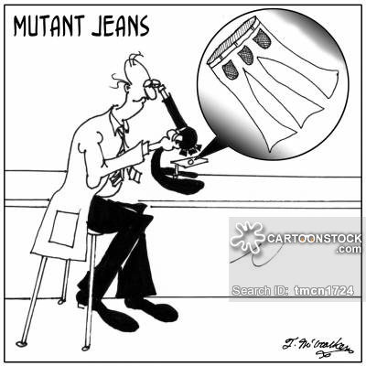
Overview of Genetics

Slide 3
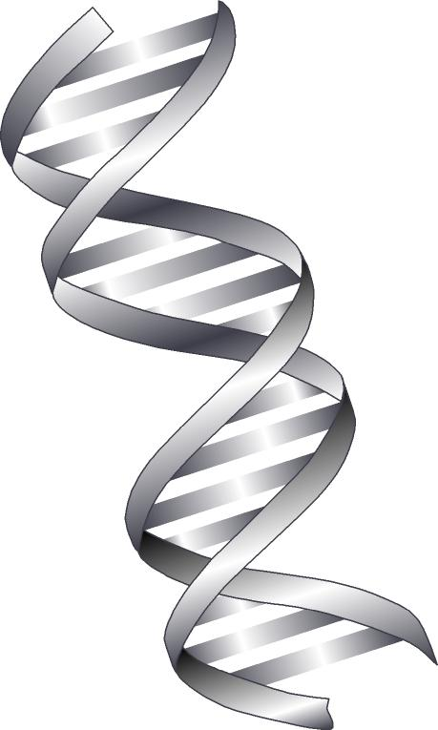
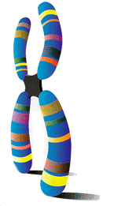
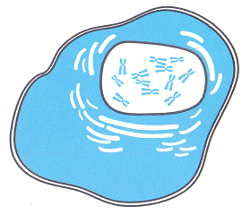
Genes (DNA) Comprise Each Chromosome
Cell
Chromosome
DNA

Slide 4
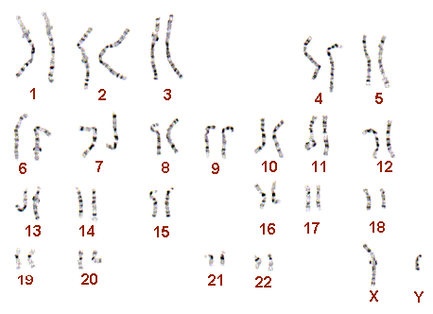
Myotonic Dystrophy (MD)
Myotonin-protein kinase
DMPK Gene
Inheritance
Autosomal dominant, maternal anticipation
Offspring of affected individual have 50% of inheriting the altered DMPK gene

Slide 5
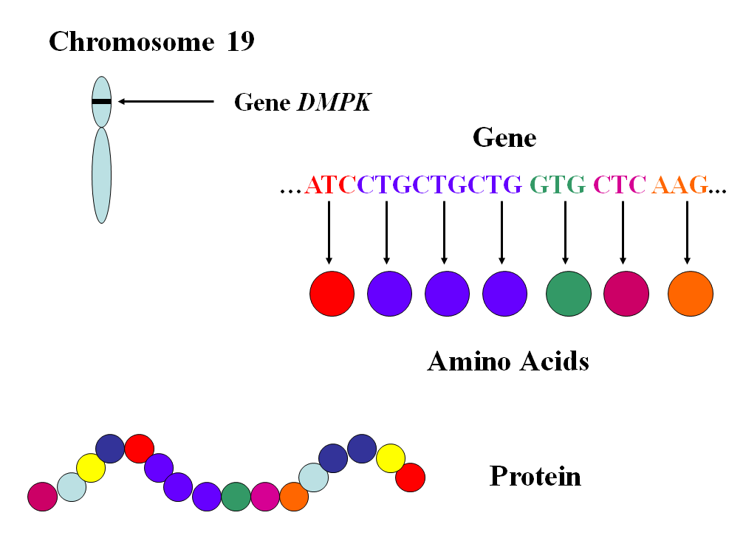

Slide 6
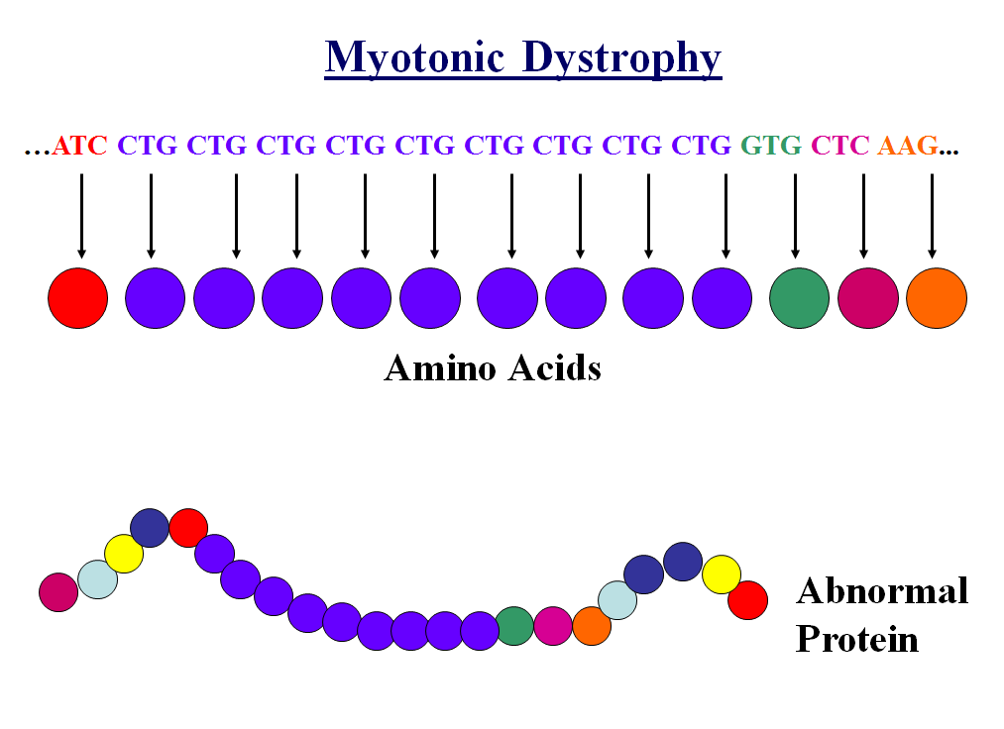

Slide 7
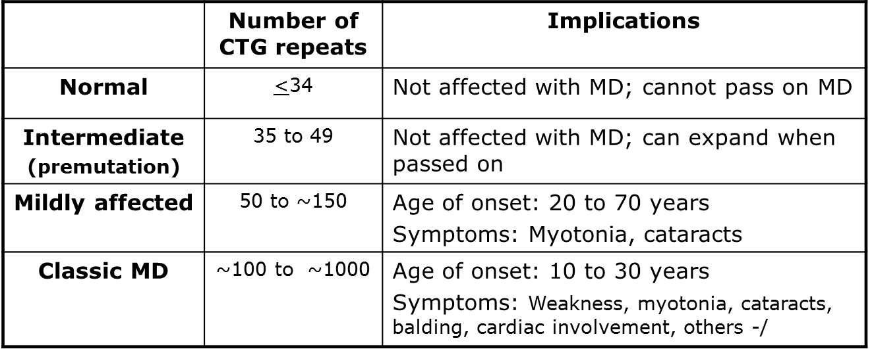
CTG Repeats

Slide 8
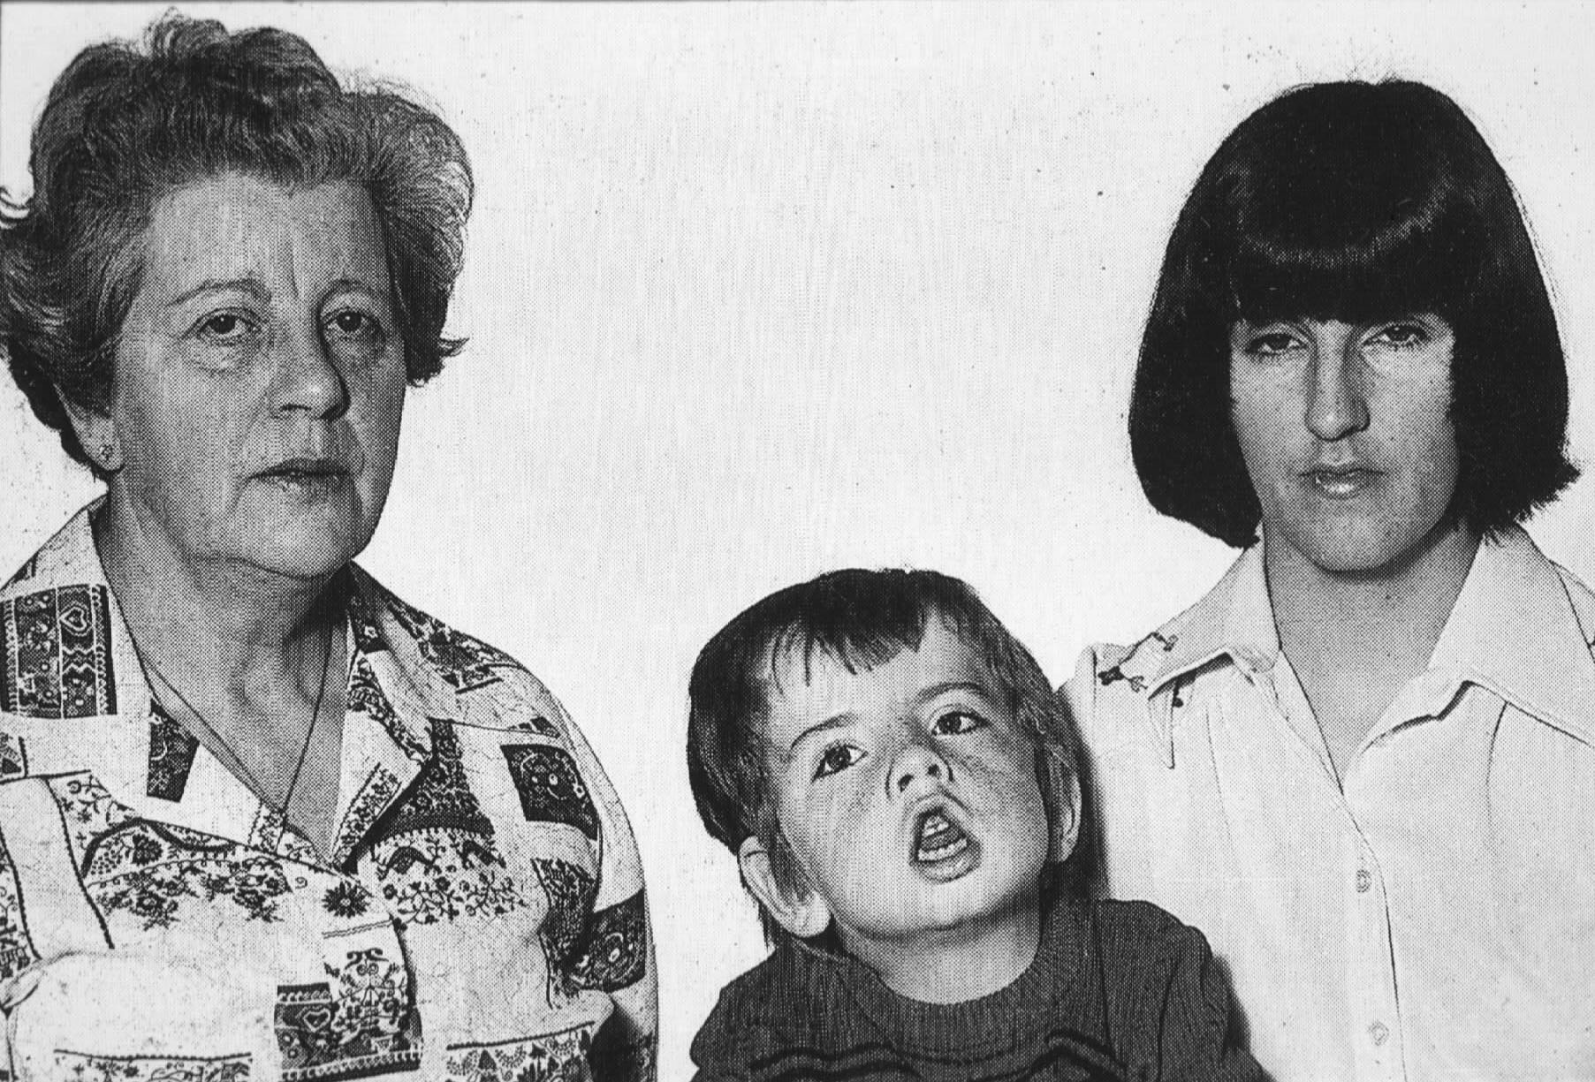
Anticipation in Myotonic Dystrophy

Slide 9
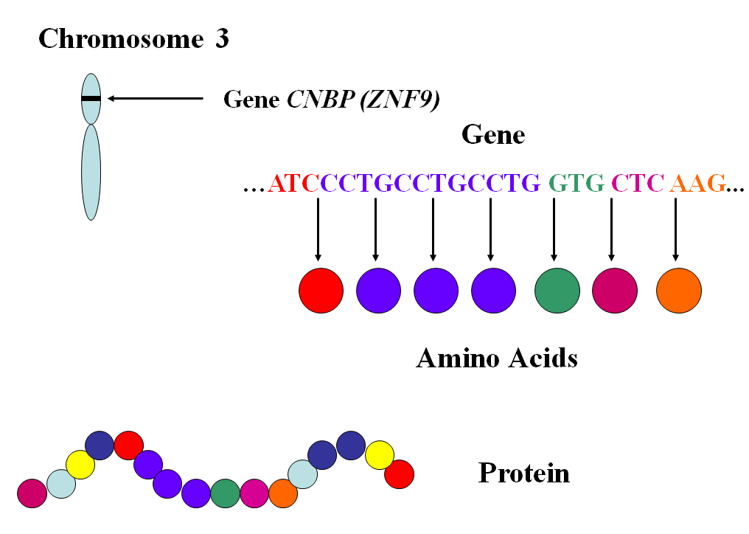
Myotonic dystrophy type 2

Slide 10
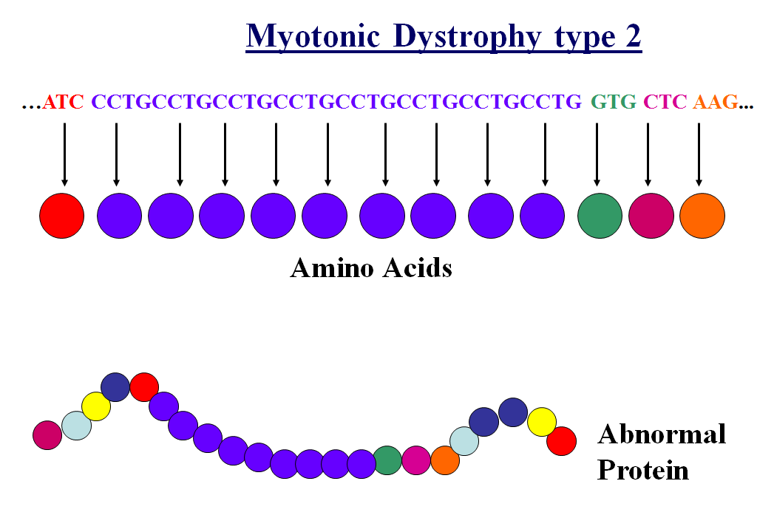

Slide 11
Autosomal Dominant Inheritance
Affected
Unaffected
Unaffected Affected Unaffected Affected

Slide 12
Family Planning Options
Biological children
Donation/adoption
During Pregnancy:
  Chorionic Villus Sampling (CVS)
    As early as 10 weeks
  Amniocentesis
    Typically past 15 weeks
  Maternal fetal cell analysis
    Not yet available
Before Pregnancy:
  Preimplantation Genetic Diagnosis (PGD)
  Costs ~$20,000 - $25,000
Donor options
  Sperm donation (banks)
    Costs ~$1,000
  Egg donation
    Costs ~$15,000 - $50,000
Embryo Adoption
  Costs ~$10,000 - $15,000
Traditional Adoption
  Costs ~$10,00 - $40,000

Slide 13
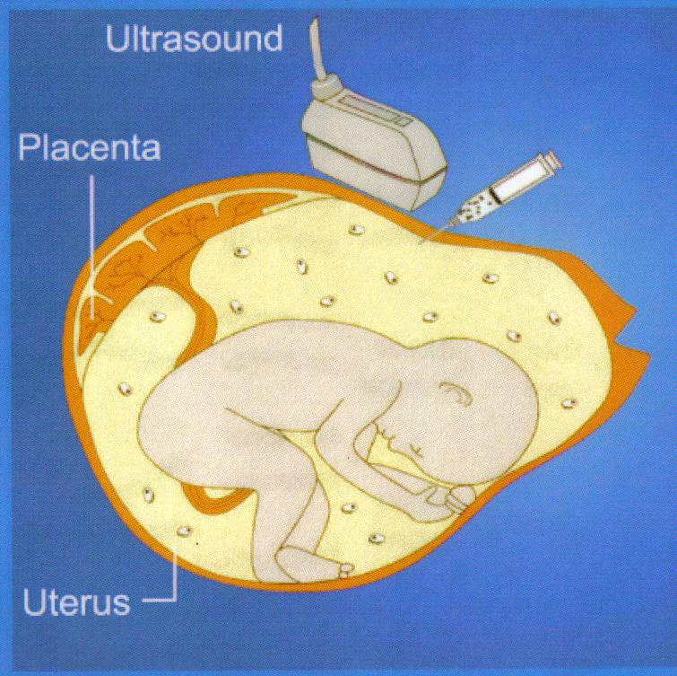
Prenatal Diagnosis

Slide 14
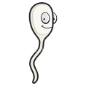
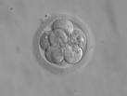

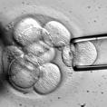
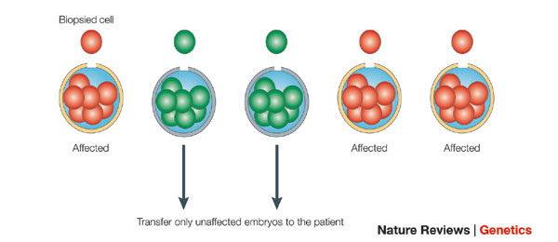
Preimplantation Genetic Diagnosis

