Slide 1
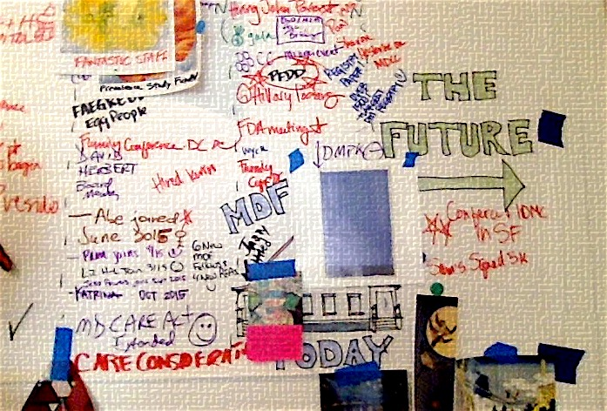
Myotonic Dystrophy Foundation
Programs Overview June 2017

Slide 2
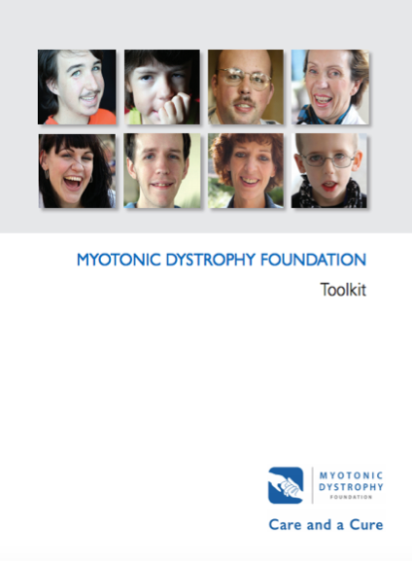
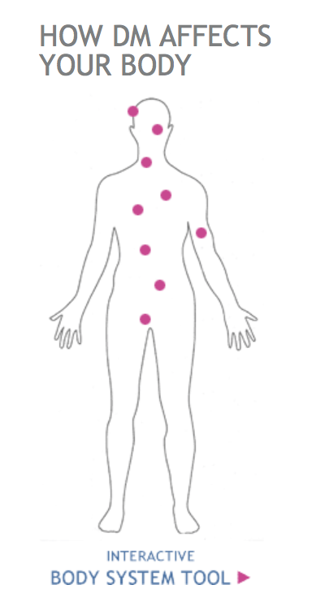

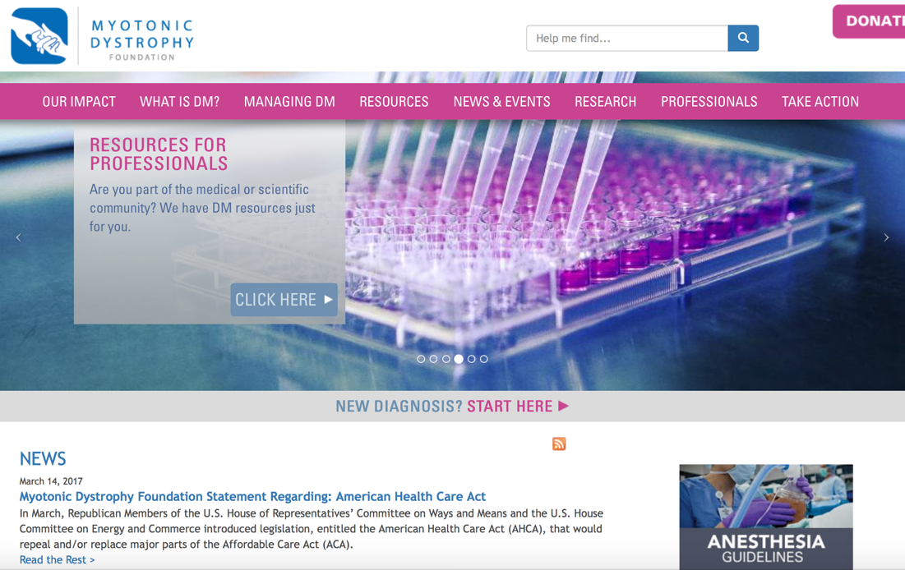
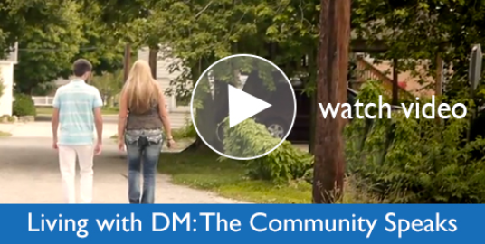
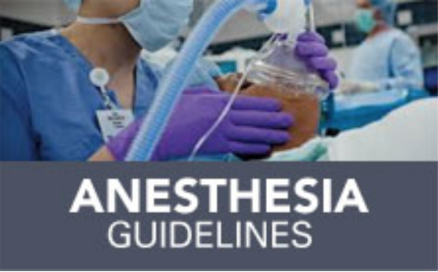

CARE
Toolkits & Guidelines | Website | Warmline
Annual Conference | Digital Academy | Newsletters
Care Guidelines | Find a Doctor Tool | Publications
Notes:
Toolkits: Anesthesia, SSA, developmentally disabled children 0-21 planning guideline
Annual conference: 300+ patients, family members, industry professionals and academic researchers; focus on symptom management, research updates & community building
Clinical care guidelines: first-ever for disease: for DM1 adults, DM2, congenital & childhood as well as specialty for cardiologists, pulmonologists, gastroenterologists, OTs, PTs
Warmline taking live calls daily
Monthly newsletters to the community (Dispatch), industry & academia (DM Research News – the only DM-only newsletter for professionals
Website: comprehensive information and resources for community members, and section for professionals
Much more

Slide 3





CURE
CLINICAL CARE
RESEARCH
DRUG DEV
ADVOCACY
PAYORS & ACCESS
International Clinical Care Recommendations
Clinical Research Coordinator Training and Recognition Program
CRC & PT Conference Travel Grants
Care Landscape Analysis and SWOT
NCATs, academic & industry fellowships Expansion
IP-Free BAC-Transgenic CRISPR Mouse Model
IP-Free iPSC Cell Line Library
Mouse SOPs
SAC Expansion and Development
Clinical Research Network Expansion
Biomarkers & FDA Qualification
Endpoint Development
Industry Drug Screening Grants
Regulatory Advocacy
International Endpoint SOPs
Registry Expansion to Longitudinal Data, PMS
Muscular Dystrophy Coordinating Committee
Federal agency advocacy for research funding
Population-Based Prevalence Study
Burden of Disease Study
FDA Workshop on Clinical Trials
1st Externally-Led PFDD meeting
Voice of the Patient Report
TIRS publication

Slide 4
IMPACT
CARE & A CURE
Clinical Care
Research & Development
Drug Development
Advocacy
Reimbursement & Access
Improved clinical care landscape
More dynamic and growing DM research field
Optimal drug review time
Improved trial processes
More industry engagement in DM drug development
More industry engagement in DM drug development
Improved clinical trial readiness
More pharma investment, exploration
Reduced trial risk
Enhanced case for reimbursement
Influence over pricing/access
More accurate clinical trial design
Improved capacity to evaluate drug efficacy
Better understanding of disease course
Increased efficiency of research output
More reliable research findings
More populated drug development pipeline
Approved therapies pricing more community-friendly
Public & private payers reimburse DM family members for approved therapies

