Slide 1
Myotonic Dystrophy Research: What’s Next
Peg Nopoulos, M.D. Professor of Psychiatry
Ian DeVolder, PhD, MDF Postdoctoral Fellow

Slide 2
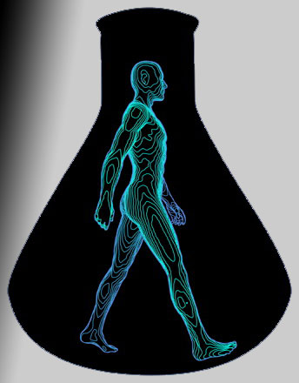
Research In Myotonic Dystrophy (DM)
Types of Human Research Studies
Should I volunteer for a research study?
Studies available for Myotonic Dystrophy

Slide 3
Types of Research Studies
Naturalistic or Observational
NO intervention – no drug or therapy is being tested
Study gathers data on signs and symptoms and biologic or body function measures
Thinking skills tasks
Motor skills; muscle strength
Measures of behavioral or psychiatric issues
Measures of physiology / measures of structure
Electromyography (EMG) – muscle function
Magnetic Brain Imaging (MRI) – muscle or brain structure (volume of certain regions)
Biologic samples
Blood for DNA, proteins
Cerebral Spinal Fluid (CSF) – called a spinal tap
Assessments are often done more than once – annual or every other year

Slide 4
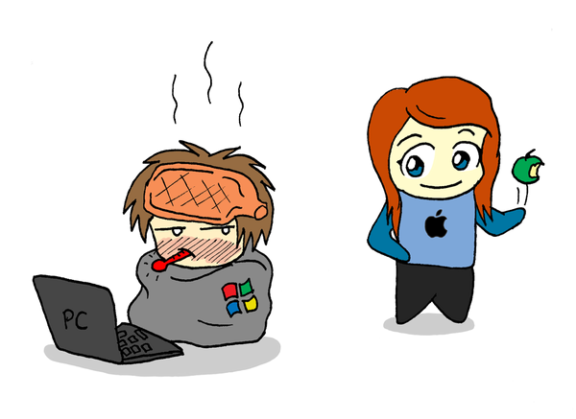
Types of Research Studies
Interventional
This is a treatment trial
Either a drug or some other type of intervention (for example exercise) to see if it has an effect on the disease
Experimental Drug

Slide 5
Informed Consent
This means that you have been given all of the information on the study and you
Understand all parts of the study
Giving your permission to be a study subject
You can always change your mind

Slide 6
Phases of a Drug Trial
FDA Approval
Pre-Clinical
Phase 1
Phase 2
Phase 3
Phase 4
Study the drug in ANIMALS
Test for SAFETY
20-100 subjects
What dose?
EFFICACY
Does it work?
100-500 patients
CONFIRM
>1,000 patients
Compare to other treatments
MONITOR
Drug now in use by the Public
About
4 years
2-3 years
2-3 years
2-3 years

Slide 7
Research In Myotonic Dystrophy
Types of Human Research Studies
Should I volunteer for a research study?
Studies available for Myotonic Dystrophy

Slide 8
Should I Volunteer for a Research Study?
Personal choice!
You volunteer your time
If you are under 18, both you and one of your parents have to agree to be in the study
Balance of risk and benefit
For an observational study, NO BENEFIT to the person participating. It may help people in the future.
Typically LOW RISK
Often there is money provided to help with travel to the study site, meals, and also some as ‘compensation’ for your time
For an interventional study
HIGH RISK, potential HIGH BENEFIT

Slide 9
Research In Myotonic Dystrophy
Types of Human Research Studies
Should I volunteer for a research study?
Studies available for Myotonic Dystrophy

Slide 10
Research In Myotonic Dystrophy
Myotonic Dystrophy Foundation (MDF) Website
Research / Study & Trial Resource Center

Slide 11
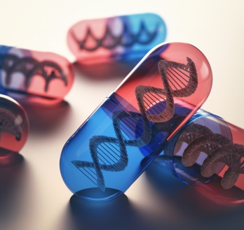
Gene Therapy
GENE THERAPY (also called Gene Silencing)
Myotonic Dystrophy caused by ONE GENE
mRNA = ‘messenger RNA’ is toxic
Get rid of this toxic mRNA

Slide 12
Gene Therapy
GENE THERAPY
IONIS-DMPK_{Rx}
Targets the toxic RNA of DM1
Given as a ‘sub-cutaneous’ or just under the skin shot
Phase I trials completed – no safety concerns
Phase II Trial
In January 2017 they announced that there was variability in how much of the drug got into the muscle
In some people, it worked really well, in others, not so well
So the trial has ended for now
However – IONIS is working on a new kind of drug (LICA)
This drug will get into muscle better

Slide 13
Biomarkers and Outcome Measures
What is a biomarker or outcome Measure and why are they important?
Myotonic Dystrophy is a progressive disease – ‘degenerative’
This means worse over time
The primary goal of gene therapy is to prevent progression
A drug that protects against progression

Slide 14
Biomarkers and Outcome Measures
Example of progression over time – muscle strength
Normal Aging
DM1 Untreated
0 1 2 3
Time (in years)

Slide 15
Biomarkers and Outcome Measures
Example of progression over time – muscle strength
We want the drug to stop progression of muscle strength
Normal Aging
DM1 Untreated
DM1 treated with a protective drug
0 1 2 3
Time (in years)

Slide 16
Biomarkers and Outcome Measures
Example of progression over time – muscle strength
We want the drug to stop progression of muscle strength
So we measure muscle strength over time – outcome measure
At 2 years out, the untreated patient has muscle strength of roughly 70 while the treated patient has almost 80
80
70
60
50
40
30
Normal Aging
DM1 Untreated
Begin Drug
DM1 treated with a protective drug
Outcome Measure
Evaluation Time Points:
Does drug alter disease course?
0 1 2 3
Time (in years)

Slide 17
Biomarkers
Biomarker – a biologic measure of disease progression
Often, biologic changes happen way before symptoms
They may be more sensitive to changes in disease progression
Example: measure of toxic RNA
80
70
60
50
40
30
Normal Aging
DM1 Untreated
Begin Drug
DM1 treated with a protective drug
Biomarker
Evaluation Time Points:
Does drug alter disease course?
0 1 2 3
Time (in years)

